Slide 1

Workshop on MD simulations
EHP-CZ-ICP-3-012
Brno University of Technology
2-4.8.2022

Slide 2
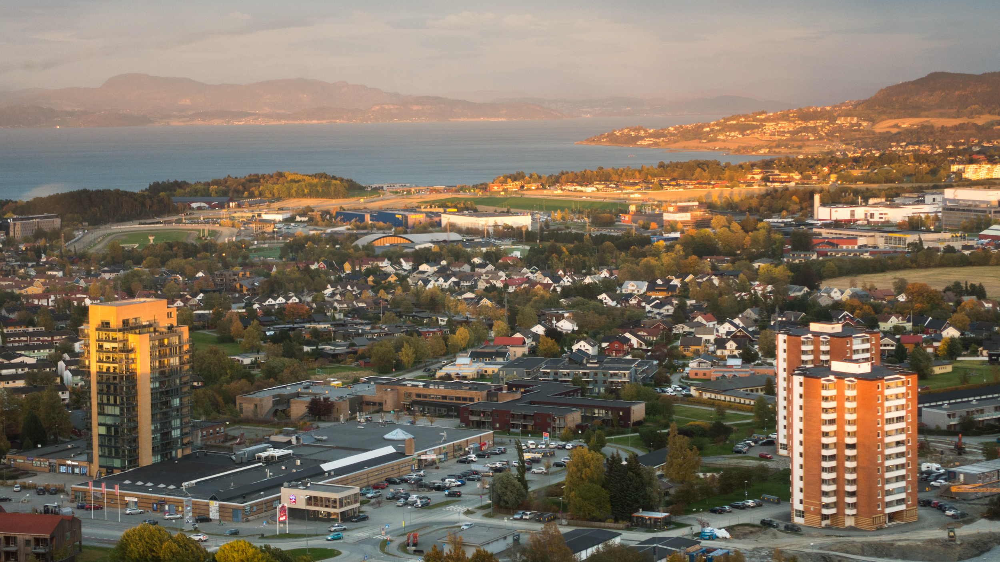


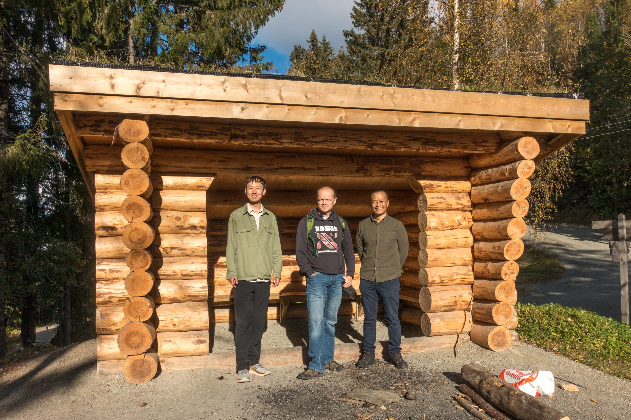

Trondheim

Slide 3
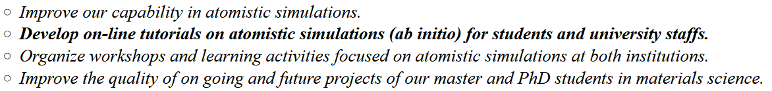
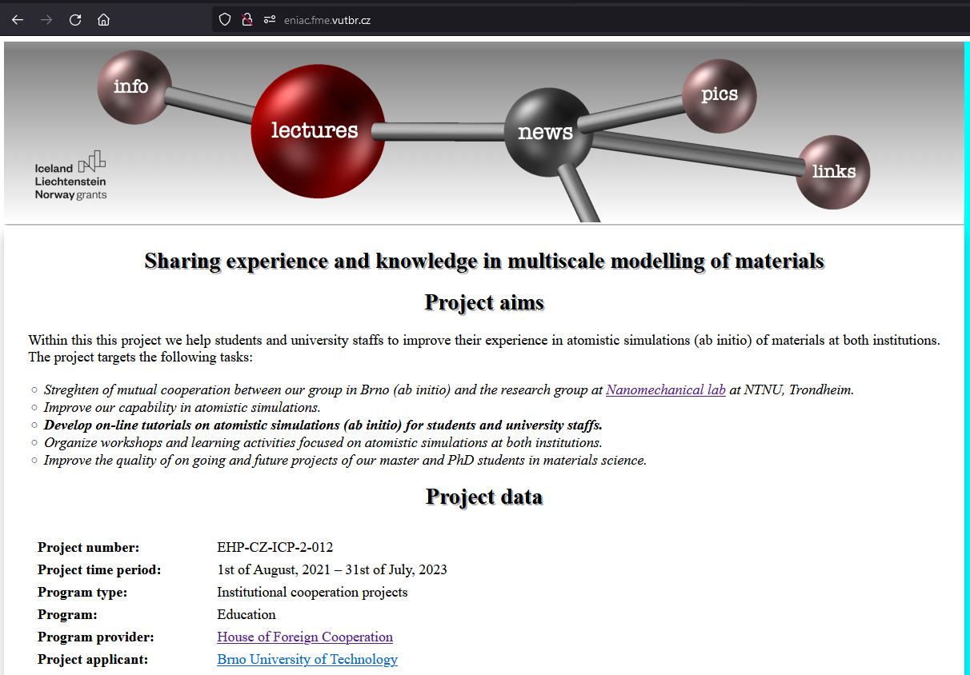
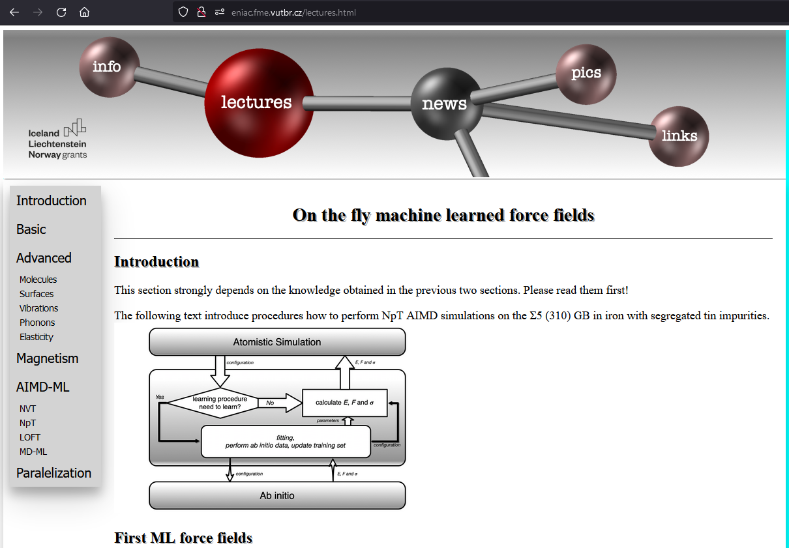
Sharing experience and knowledge in multiscale modelling of materials
+
-
-
-
-
eniac.fme.vutbr.cz
EHP-CZ-ICP-3-012

Slide 4
Organization info
Pictures for the funding agency and also for the project.
Do not forget to take some snacks.
WIFI – SSID: ATOMISTIC PASSWORD: lammpsatomic (EDUROM also available)

Slide 5
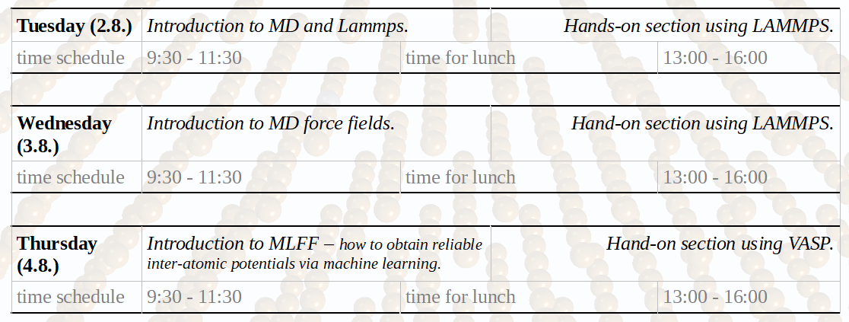
Workshop time schedule

Slide 6
MLFF – MD with
EHP-CZ-ICP-3-012
almost
DFT precission
Petr Šesták
Workshop MD
4.8.2022

Slide 7

HPC – High Performance Computing
Czech National Supercomputing Centre – IT4I (www.it4i.cz)
You always reach to some point
where your simulations
overwhelm capability you local PC.
MD or DFT large systems are preformed
at HPC facilities.

Slide 8
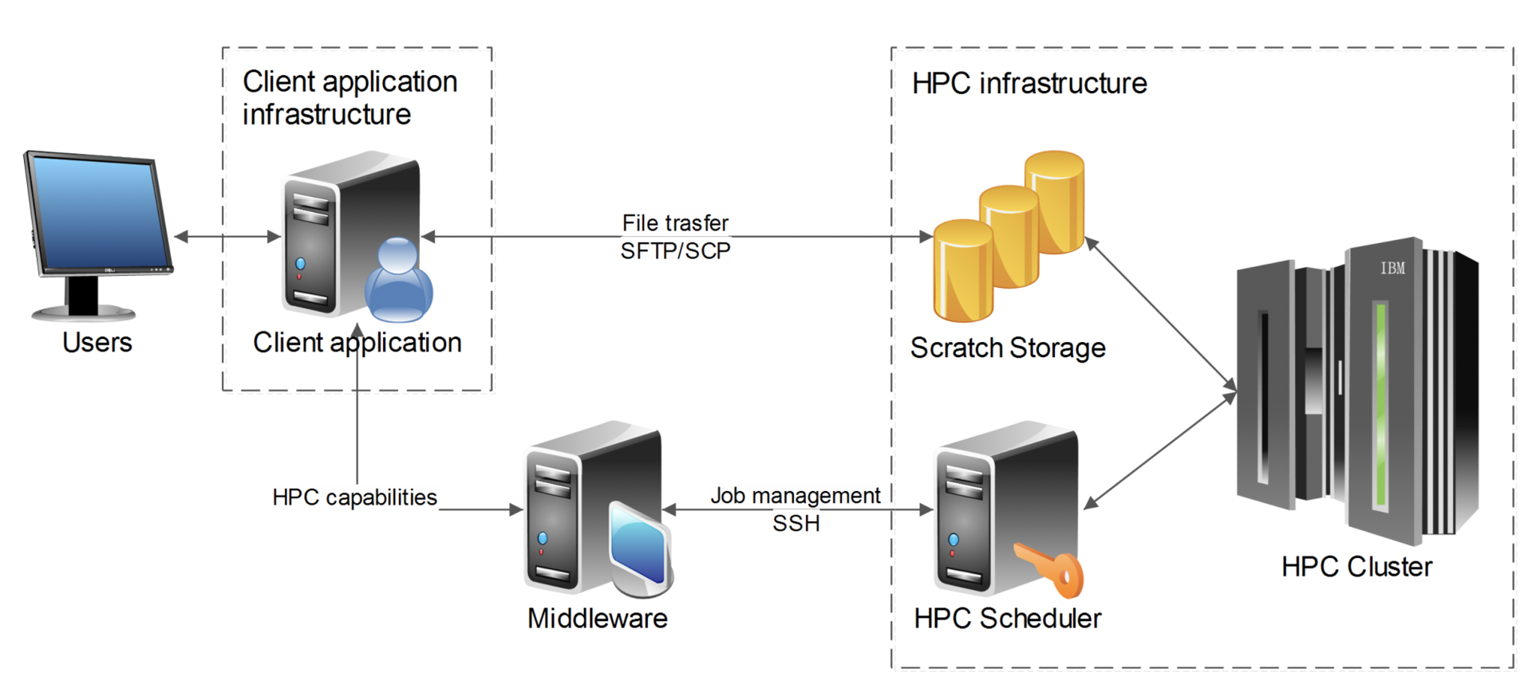
HPC – High Performance Computing
https://www.it4i.cz/en/research/research-flagships

Slide 9
HPC – High Performance Computing
#!/bin/bash
#PBS -N NAMEJOB
#PBS -l nodes=1:ppn=64:epyc7551
#PBS -l mem=120gb
#PBS -q default
##PBS -l walltime=2:00:00
cd $PBS_O_WORKDIR
module add vasp-6.3.0-openmpi-4.1.0
mpirun vasp_std >log.txt

Slide 10
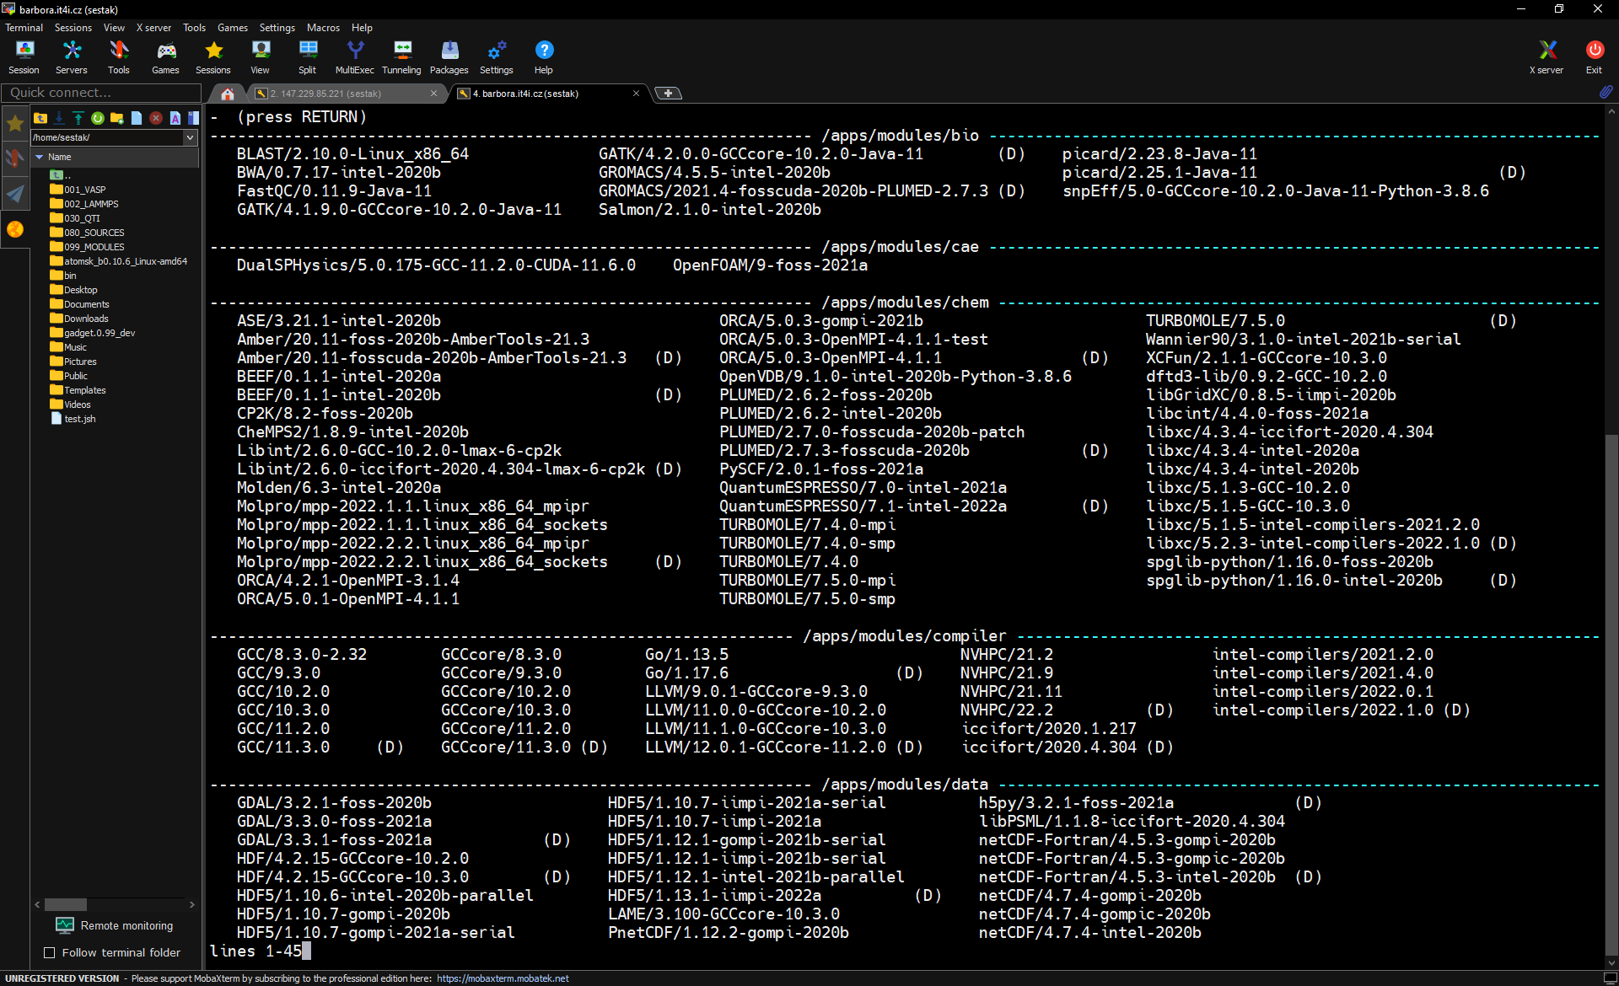
HPC – High Performance Computing

Slide 11
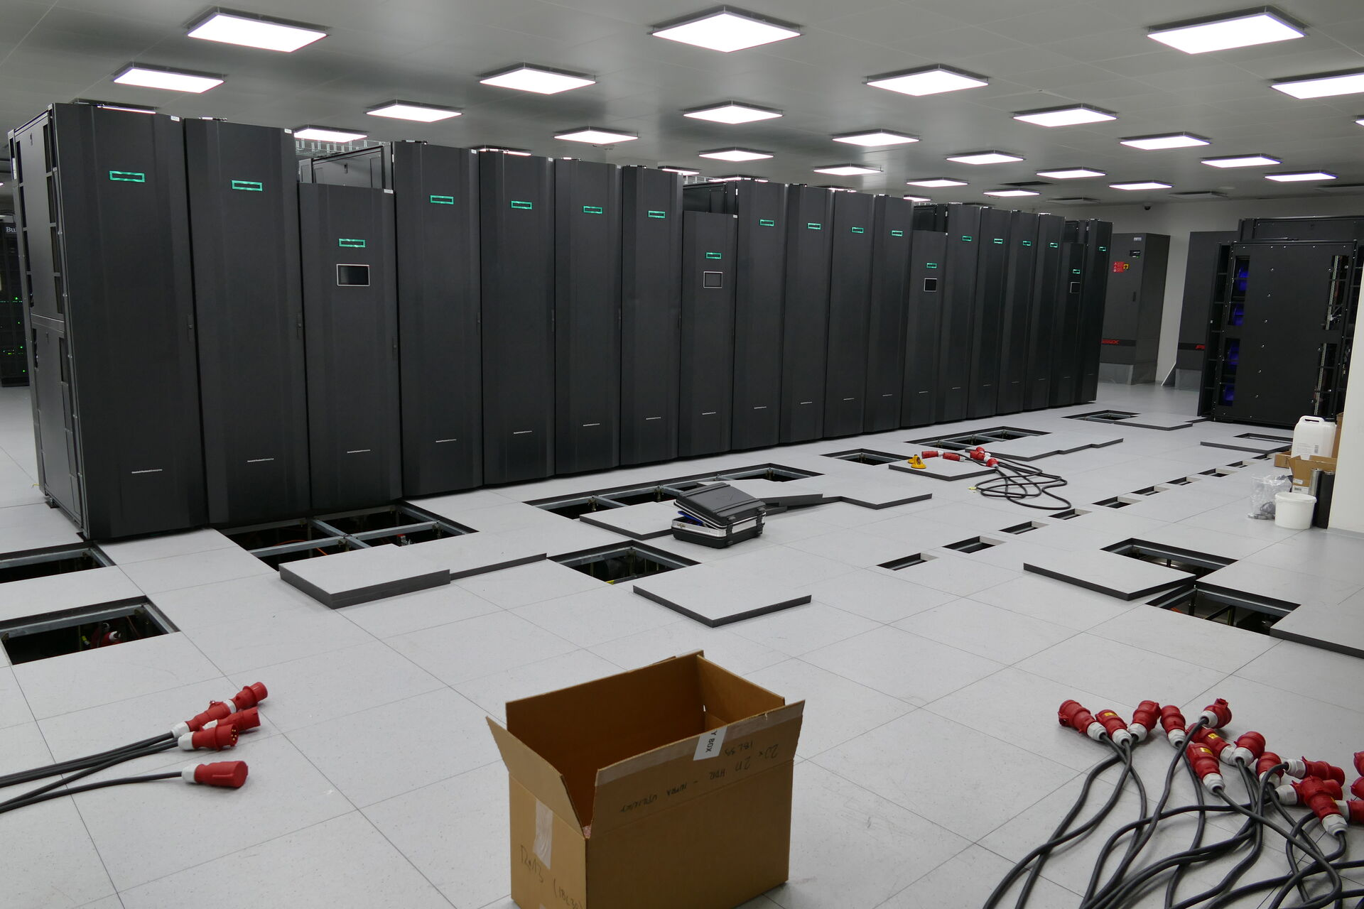
HPC – High Performance Computing
https://www.it4i.cz/en/infrastructure/karolina

Slide 12
Plan
Comparison MD and DFT – advantages and disadvantages.
Simple introduction into AIMD – Ab initio molecular dynamics.
How to speed up AIMD via on the fly machine learned force fields.
How to generate machine learned force fields database.
Classic MD with MLFF interactions.

Slide 13
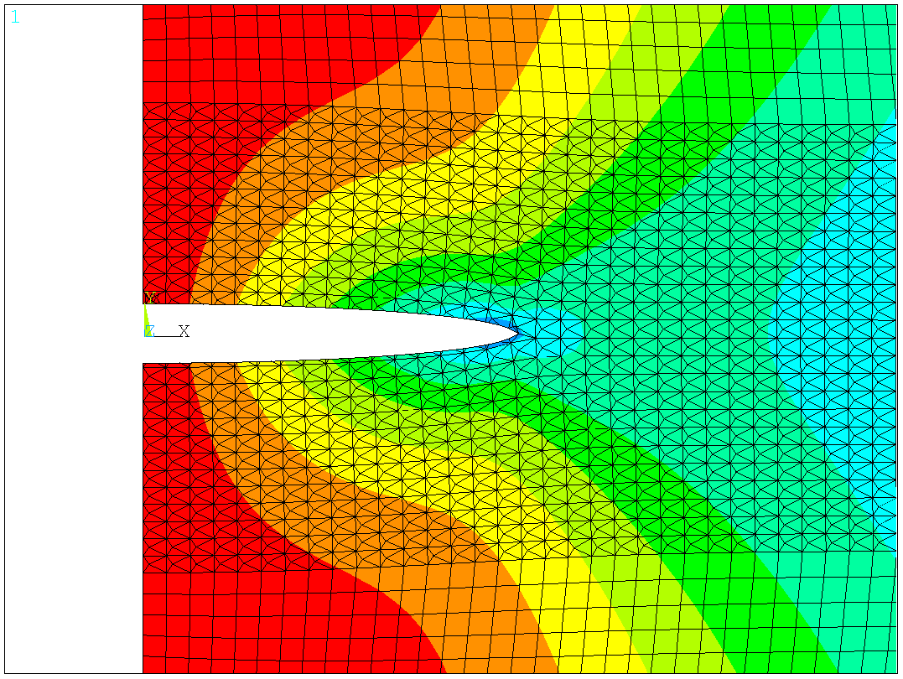
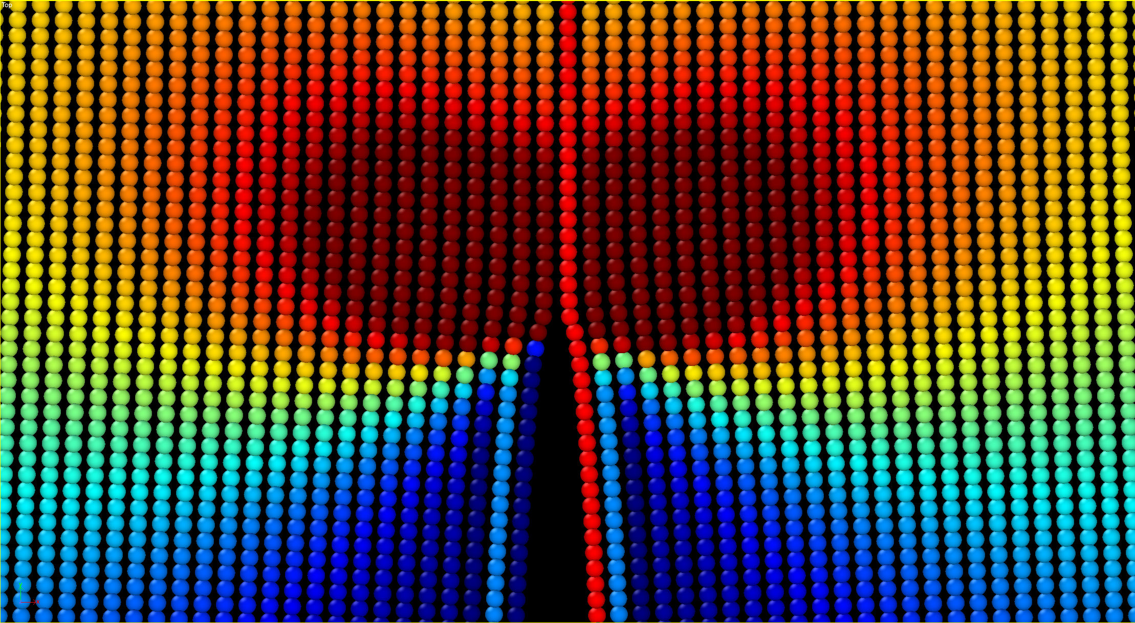
Multiscale modeling
continuum model
finite elements
microstructure
discipline
physics – chemistry – mat. science – engineering
atomistic model
molecular dynamics
quantum mechanics
ab initio
nm
μm
mm
m
length

Slide 14
Reactions from audience of experimentalists
I believe in DFT calculations but I do not believe in DFT models.
We need quantum computers!
MD potentials can reflects behavior they were tested for.
Precision must be improved!

Slide 15
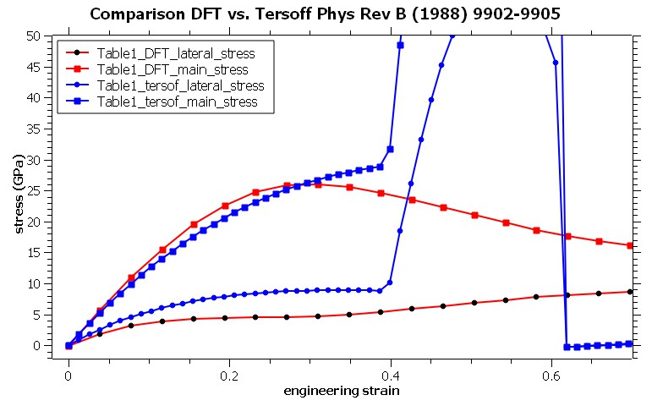
Comparison MD with DFT
The authors have to read paper describing the Tersoff potential again because is not able to reproduce interaction in their simulations.

Slide 16
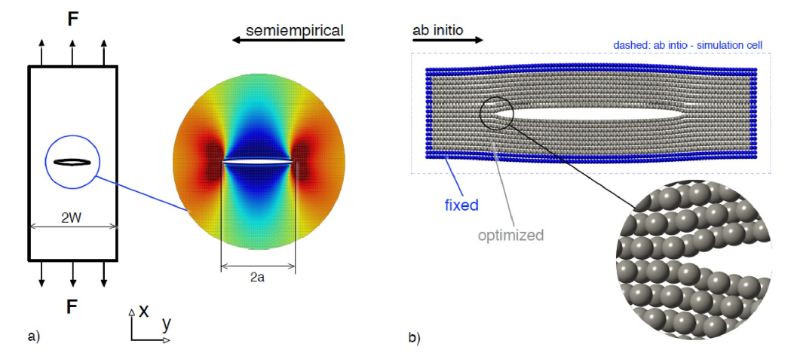
Comparison MD with DFT
-
-
-
-
Kotoul M. et al., 2019: Ab Initio Aided Strain Gradient Elasticity Theory in Prediction of Nanocomponent Fracture. MECHANICS OF MATERIALS 136, p. 103074-1 - 10

Slide 17
How to get DFT precision into MD??

Slide 18
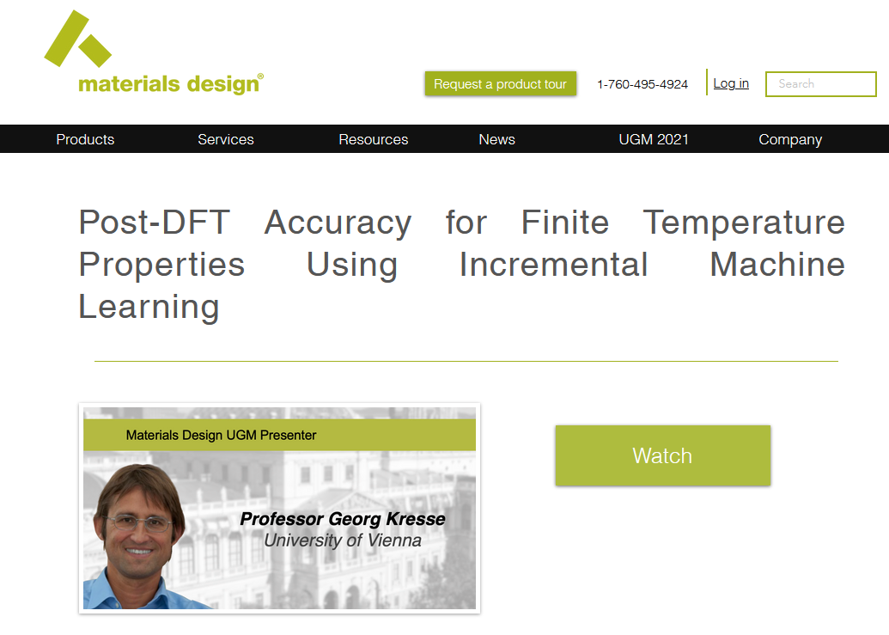
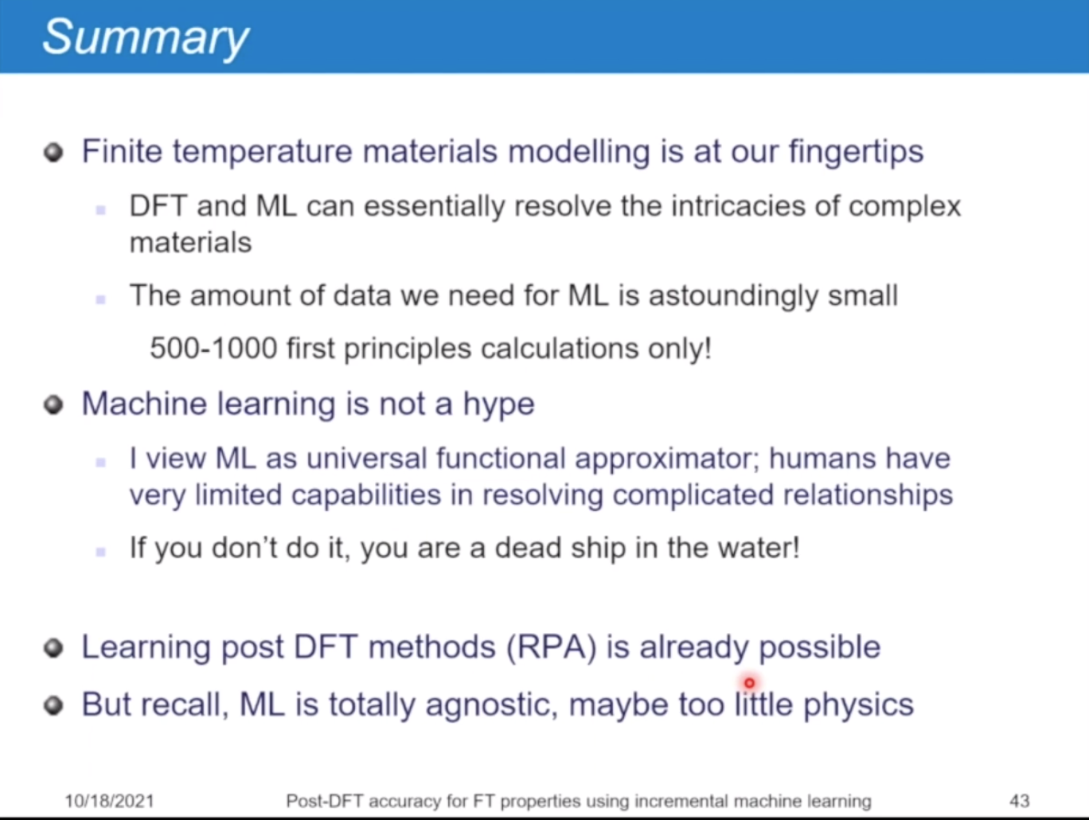
If you don’t do it, you are a dead ship in the water!
Webinar available at:
https://www.materialsdesign.com/
webinars/recorded/ugm-2021-kresse

Slide 19
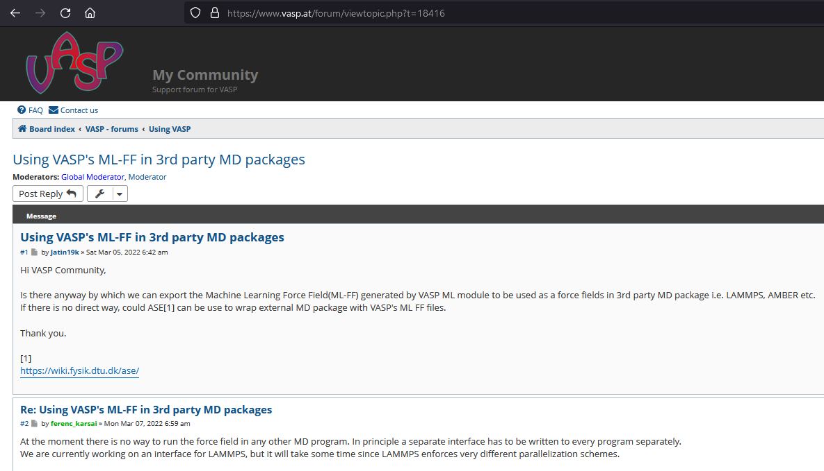
Why LAMMPS and MLFF?

Slide 20
Comparison MD and DFT
Kotoul M. et al., 2019: Ab Initio Aided Strain Gradient Elasticity Theory in Prediction of Nanocomponent Fracture. MECHANICS OF MATERIALS 136, p. 103074-1 - 10

Slide 21
Ab initio simulations and molecular dynamics
molecular dynamics | ab initio
easy – based on Newton mechanics | results from Quantum Mechanics
simulations of large scale system with planar defects, temperature | magnetic, optical, electrical, etc. characteristics
fast | accuracy, no input data needed
potentials require calibration | no temperature – simul. at absolute zero temp.
potentials for all interaction – Ni-Ni, Ni-Ti, etc. | limited to small systems (approx. 100-1000 atoms)
 | standard DFT no vdW but has been impl.
requires HPC (High Performance Computing) | requires HPC (High Performance Computing)
-
-
-
-
Ab initio is very often used for calibration of MD potentials.

Slide 22
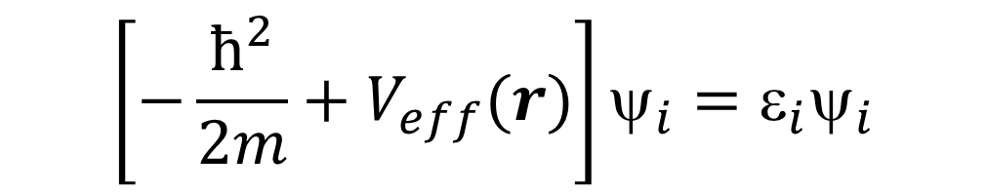
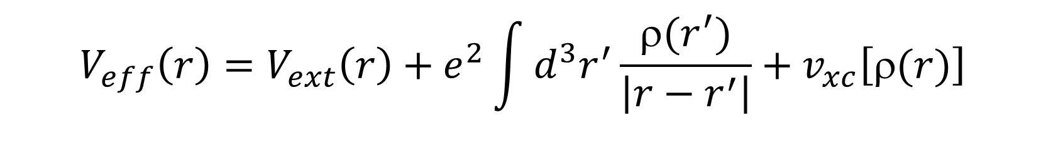
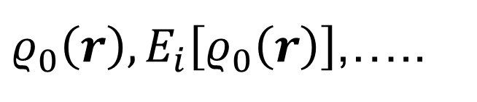

DFT self-consistent cycle
Initial Guess of ρ (r)
Calculate efective potential
NOT YET?
LETS DO
ANOTHER
STEP!
$$V_{eff}\left(r\right)=V_{ext}\left(r\right)+e^{2}\int{d^{3}r^{′}\frac{ρ(r^{′})}{\left|r−r^{′}\right|}+v_{xc}\left[ρ(r)\right]}$$
Solve Kohn-Sham Equations
$$\left[−\frac{ħ^{2}}{2m}+V_{eff}(r)\right]ψ_{i}=ε_{i}ψ_{i}$$
Evaluate the ellectron density & total energy
$$ρ\left(r\right)= \sum_{i}^{ }{{\left|ψ_{i}(r)\right|}^{2}\overset{→}{ } E_{tot}\left[ρ(r)\right]}=..$$
OUTPUT QUANTITIES
Converged ?
$ρ_{0}\left(r\right), E_{i}\left[ρ_{0}\left(r\right)\right]$,…..

Slide 23


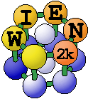
Ab initio methods (first principles)
computational codes
  VASP (Vienna Ab initio Simulation Package) – pseudopotentials (www.vasp.at)
    commercial license
    the most used ab initio code in the world
    available pseudopotentials are very well tested
    hybrid pseudopotentials
  Abinit – pseudopotentials (www.abinit.org)
    free under GNU license
    generation of pseudopotentials by users
    some extra features than other codes (Linear Response Functions - direct calculation of phonon spectra, elastic constants, etc.)
    very good parallelization (using multithread program run)
  Wien2k – all electron (no pseudopot.) (www.wien2k.at)
    commercial license
    computationally more demanding than VASP or Abinit
    good parallelization
    no pseudopotential – all electron code
pseudopotentials
  PAW (Projector Augmented Waves), ultra-soft, norm-conserving
  exchange – correlation energy:
    LDA – Local Density Approximation
    GGA BPE – Berdew Burke Ernzerhof
    GGA PW – Perdew Wang
MLFF capability!!!

Slide 24
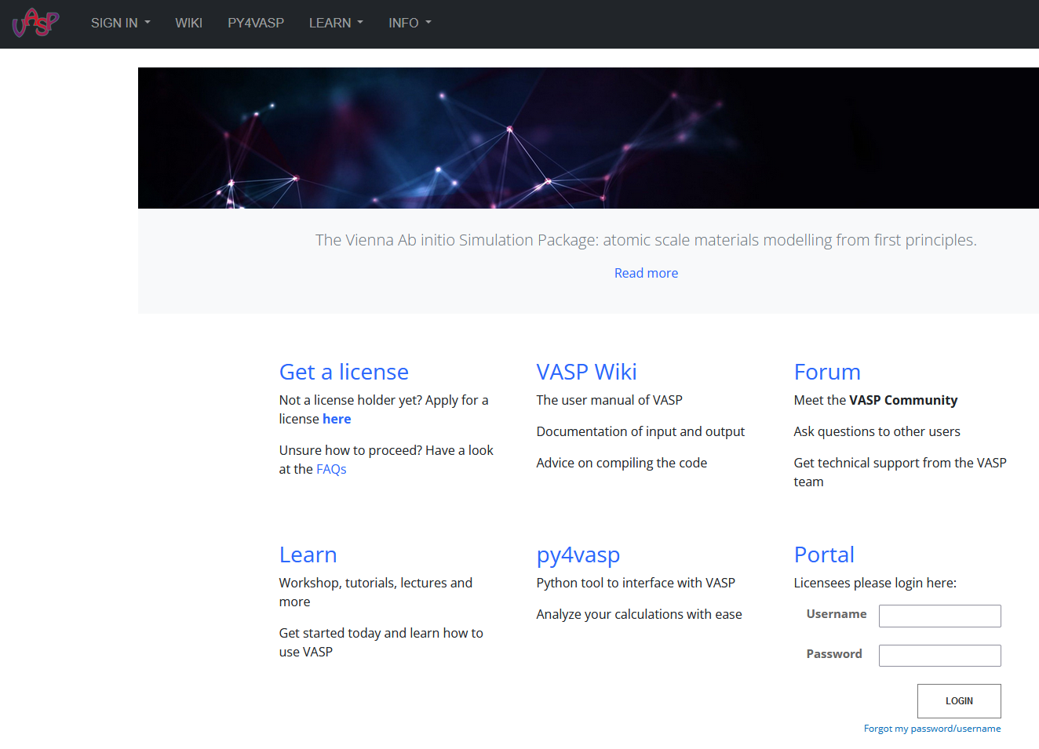
VASP – Vienna Ab initio Simulation Package
www.vasp.at

Slide 25
AIMD
+
-
-
-
-

Slide 26
ATOMS MOVES ALSO IN AB INITIO

Slide 27
MD fundamental scheme
structure – initial position and velocities
topology – molecular description
forces are determined from the DFT calculations
force fields – potential functions V of interactions
compute forces
update r and v in repeating in N steps
solve Newton equation
of motion
output – position, velocities energies

Slide 28
AIMD – ab initio molecular dynamics
AIMD
Taking disadvantages from both approaches (ab initio and MD), small cell, CPU time consuming, limited number of MD steps (small time period).
Advances: temperature included, no potential needed, magnetism, high precision.
VASP – Vienna Ab initio Simulation Package (license needed).
Simulation cell at least 100 atoms. My recommendation is 200 – 400 atoms.
+
-
-
-
-

Slide 29
Characteristics of AIMD
small simulation space
up to approx. 500 atoms.
large requirements of CPU power
HPC required
limited capabilities when compared to the classic MD

Slide 30
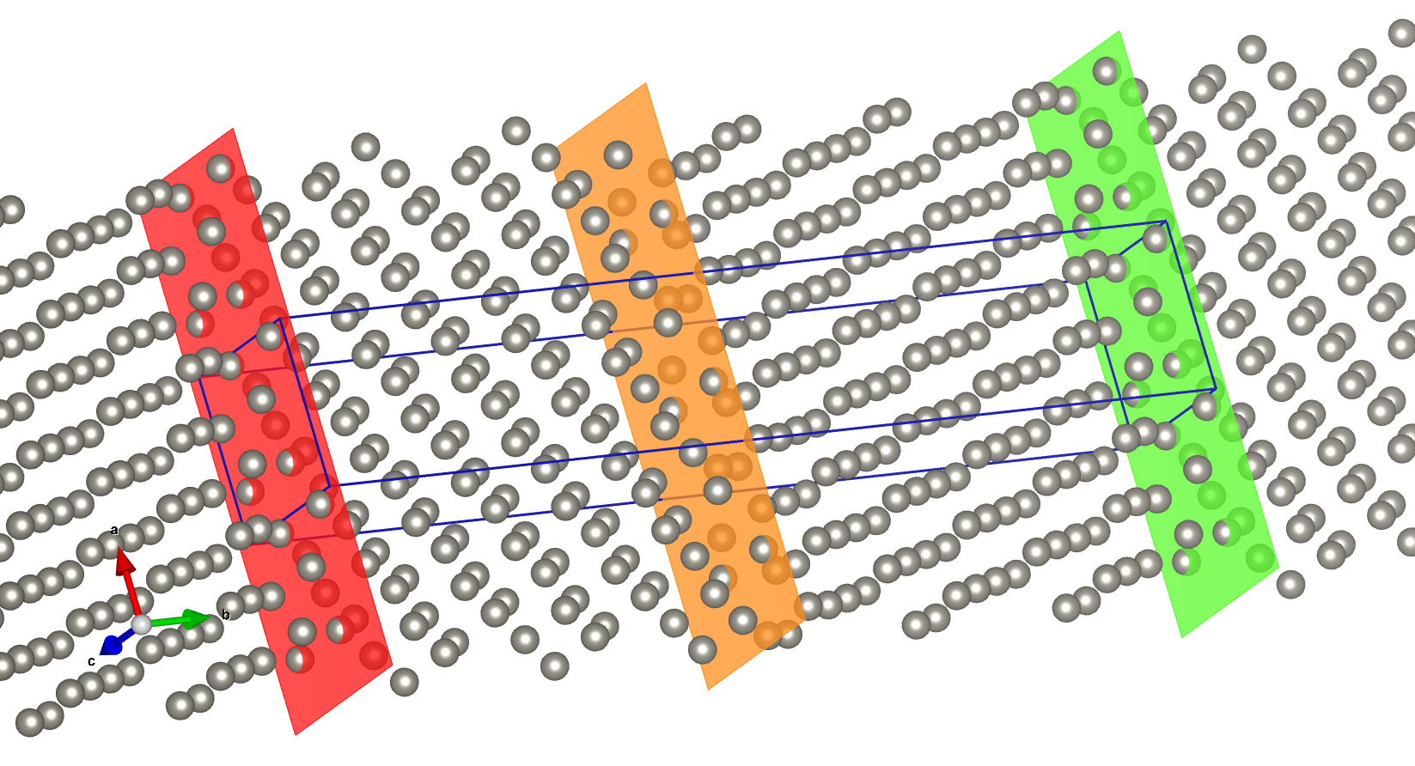
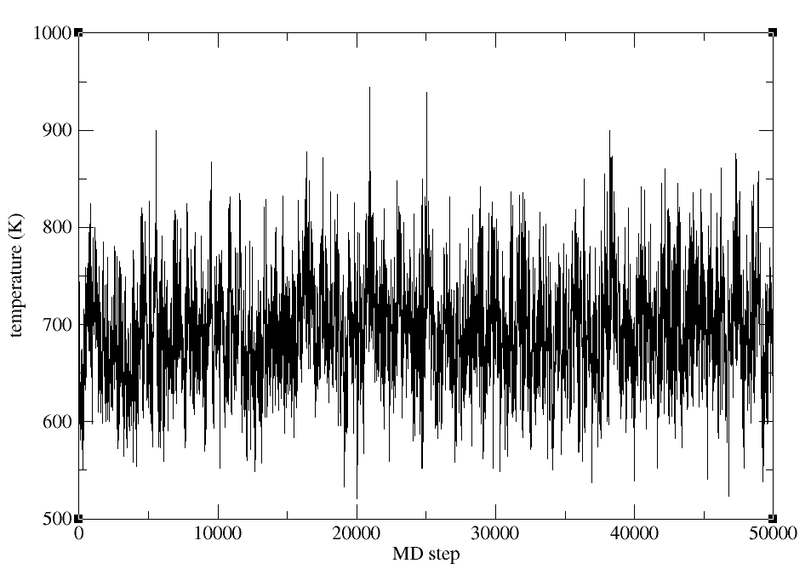
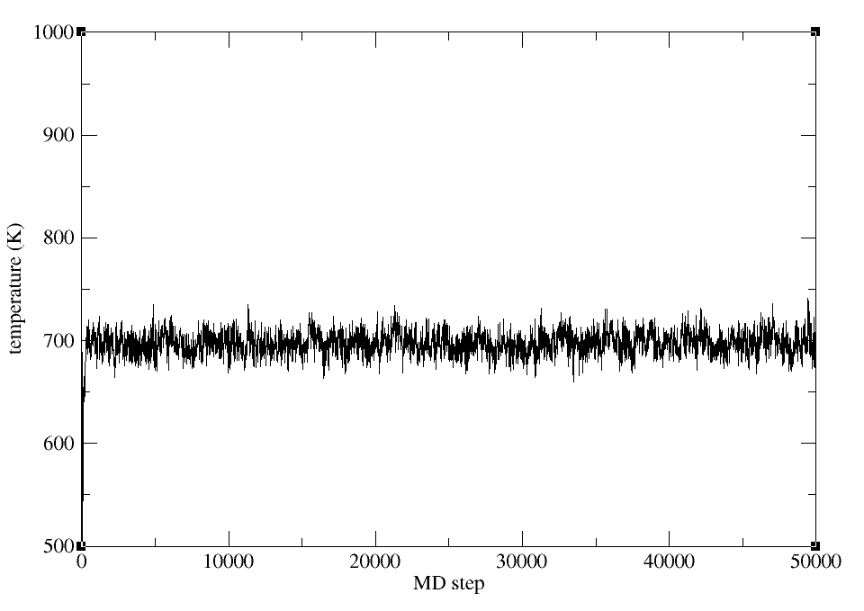
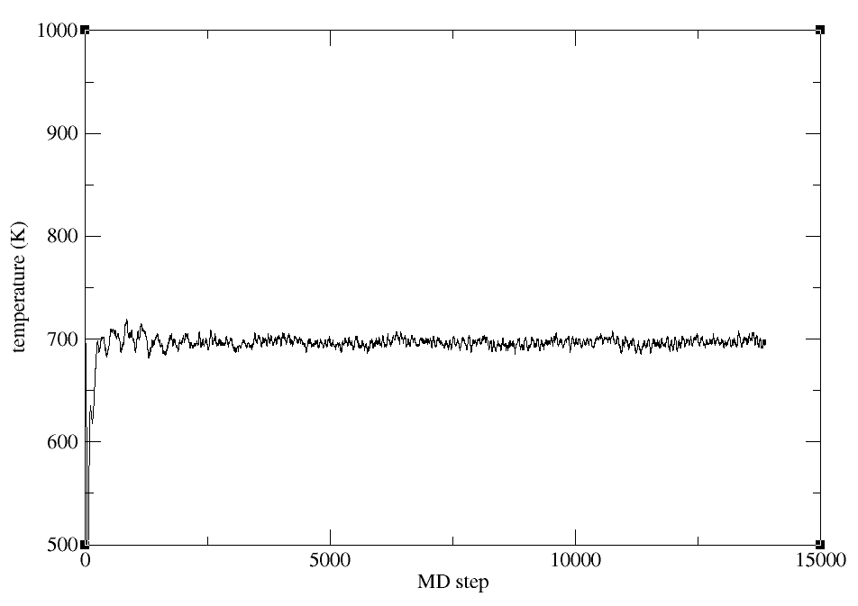
Affected by the simulation cell size
Simulation cell size strongly affect temperature fluctuation.
116 atoms
2900 atoms
23200 atoms

Slide 31
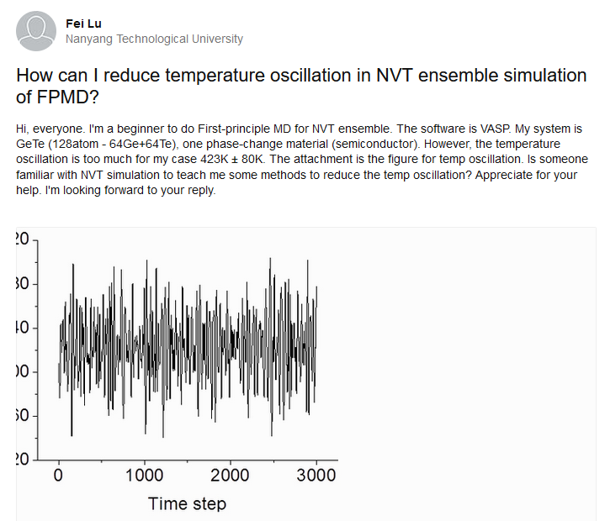
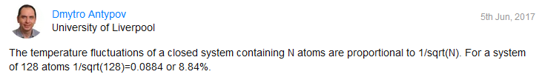
How I can decrease temperature oscillations?
Look to SMASS parameter and play with it.
https://www.researchgate.net/post/How-can-I-reduce-temperature-oscillation-in-NVT-ensemble-simulation-of-FPMD

Slide 32
Types of ab initio MD
Classical motion
atom velocity according to classical mechanics
Damped MD
mostly used as a geometry optimizer
Quantum motion
unknown to us

Slide 33
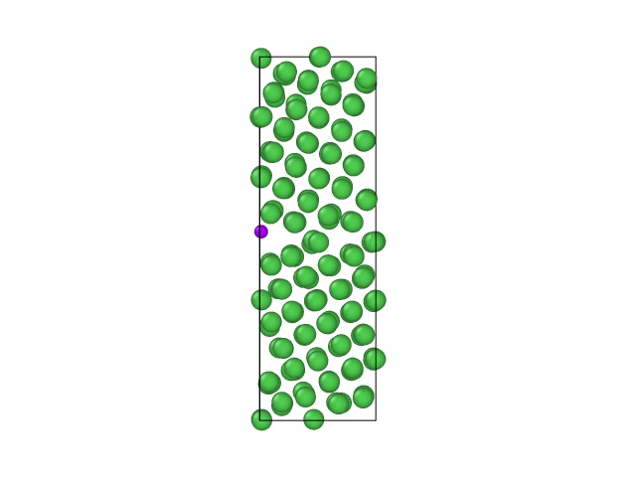
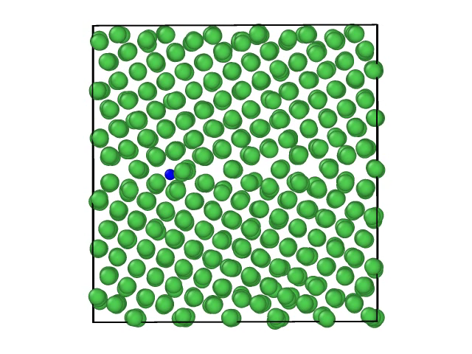
Training set – the most important choice
AIMD
MLFF

Slide 34
MLFF
+
-
-
-
-

Slide 35
As part of the VASP code released in February, 2022.

Slide 36
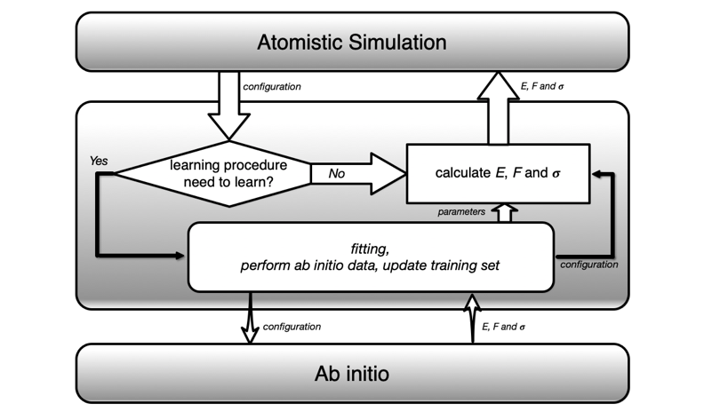
On the fly machine learned force fields

Slide 37
On the fly machine learned force fields
They are not new. They are developing
for almost 20 years.
In many cases the ML potentials requires
user interactions – some calibration.
Now ML was implemented as a tool for learning
without any user interaction.

Slide 38
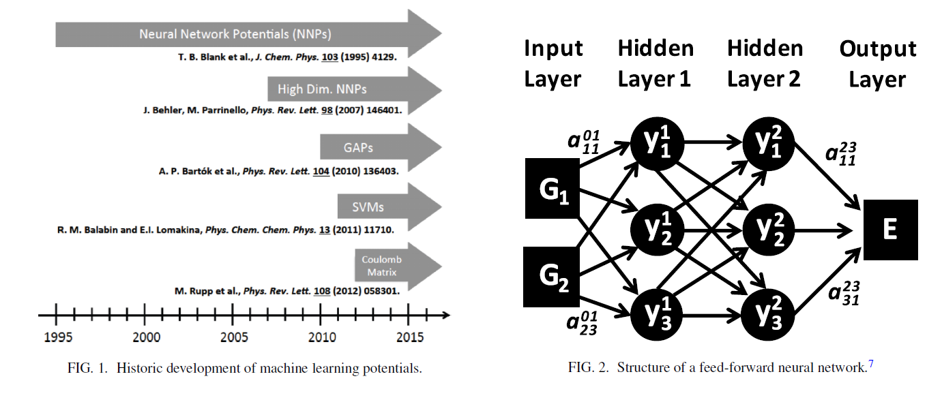
Perspective: Machine learning potentials for atomistic simulations
recommended reading
Behler, Jörg. “Perspective: Machine Learning Potentials for Atomistic Simulations.” The Journal of Chemical Physics, vol. 145, no. 17, 7 Nov. 2016, p. 170901,
10.1063/1.4966192.
‌
ML potentials have been available only for
low-dimensional systems.
Several different ML approaches suitable for high-dimensional systems containing thousands
of atoms have now become available.

Slide 39
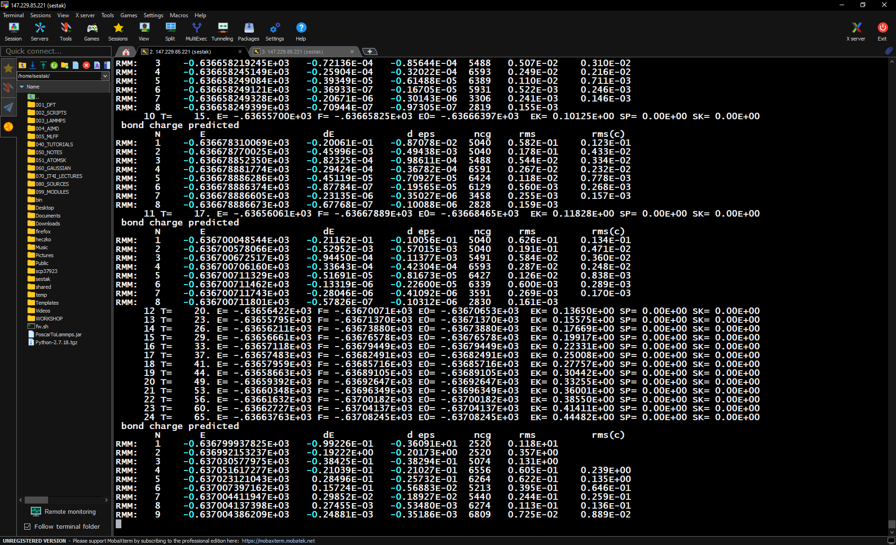
On the fly machine learning
✦ 10-1000x faster than the classic AIMD
✦ be careful about characteristic related to electronic structure as they are not included (magnetism, etc.)
✦ number of skipped steps cannot be predicted -> difficult guess of CPU time

Slide 40
What we achieved since releasing in February?

Slide 41
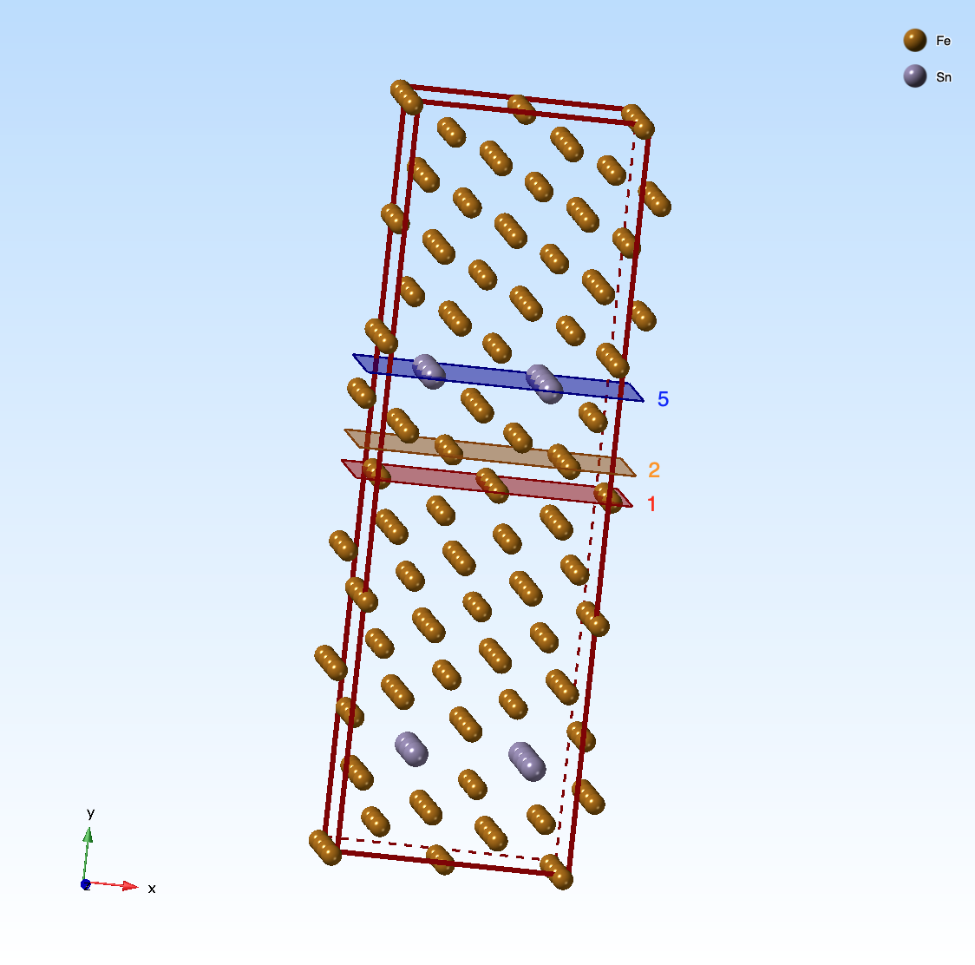
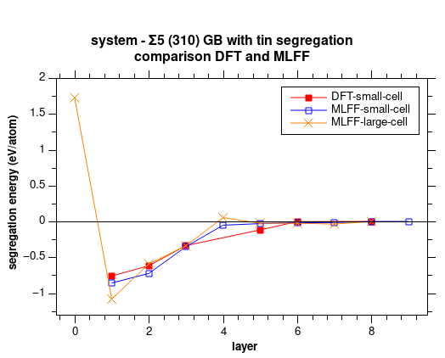
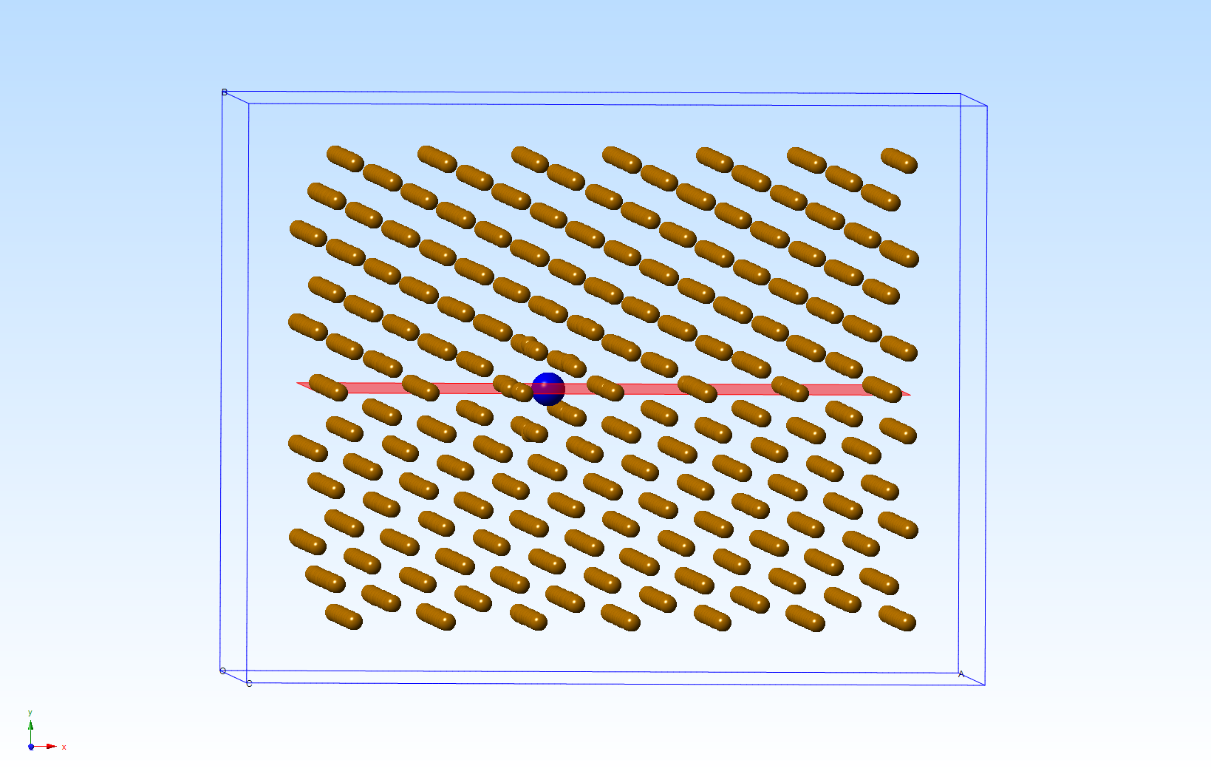
Tin GB segregation

Slide 42
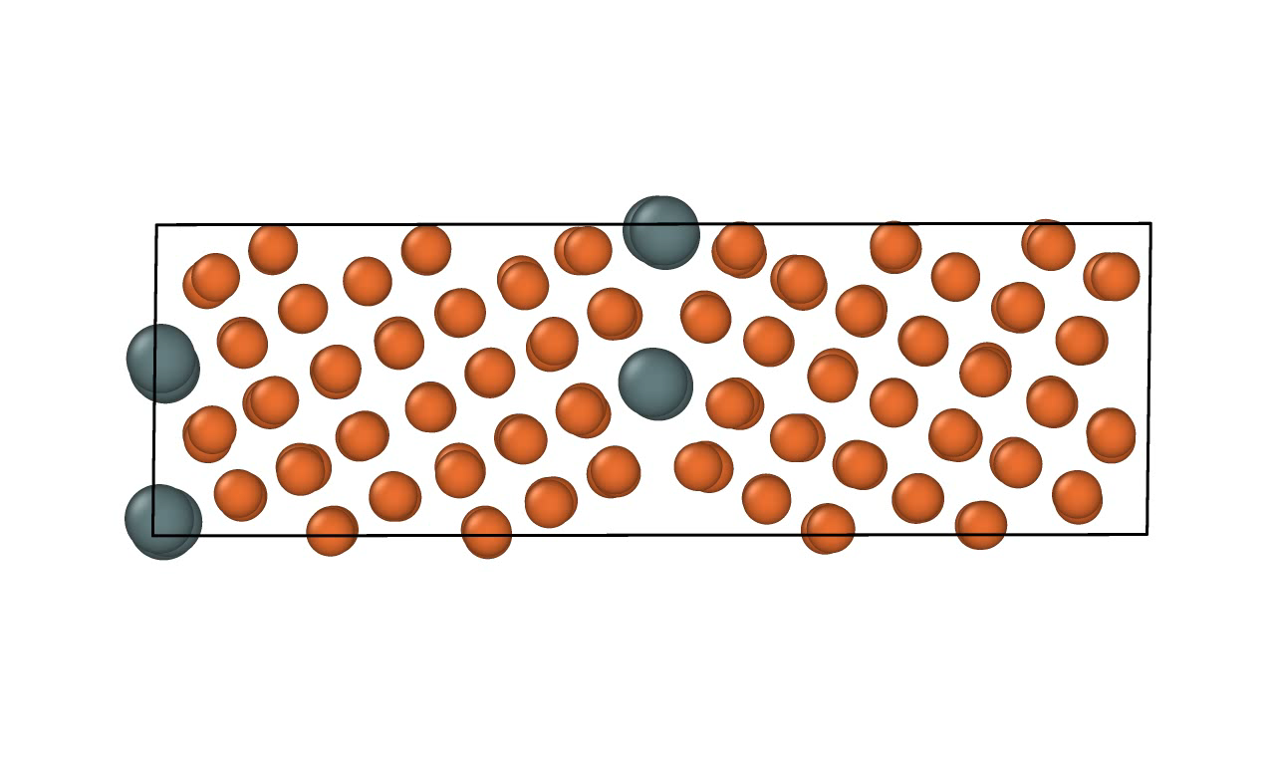
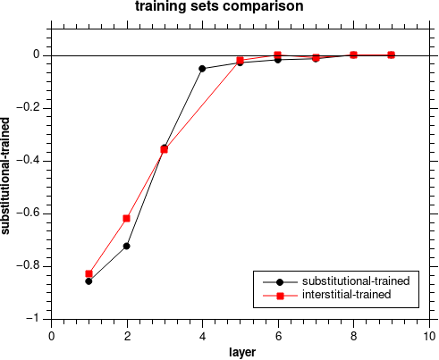
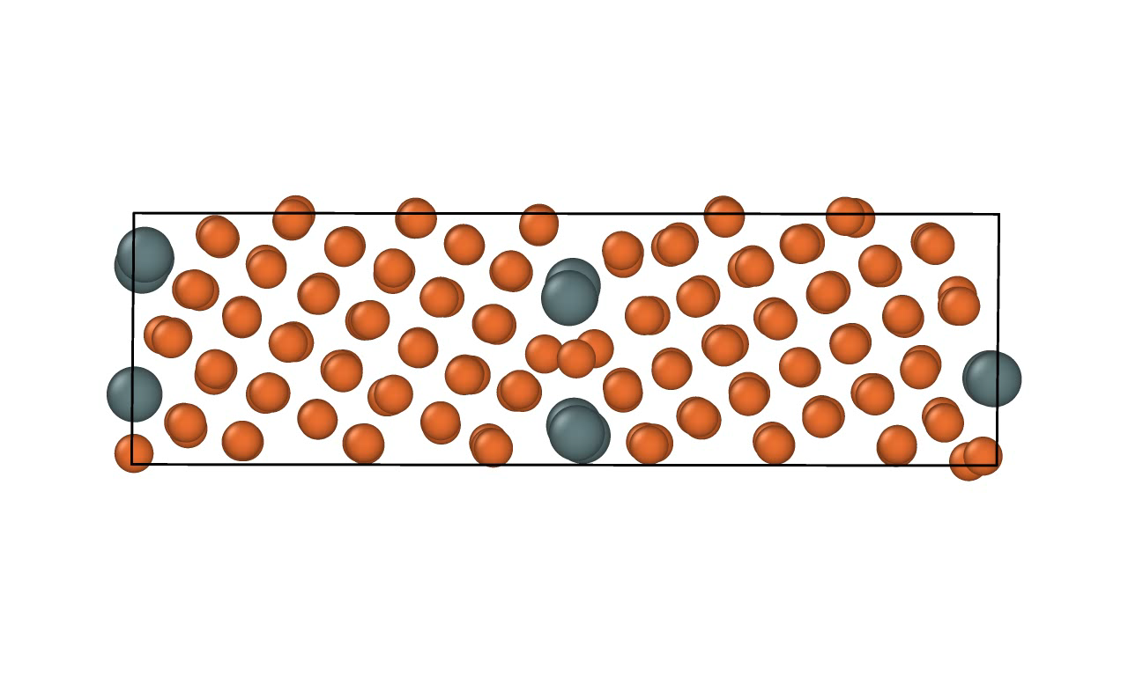
Tin GB segregation

Slide 43
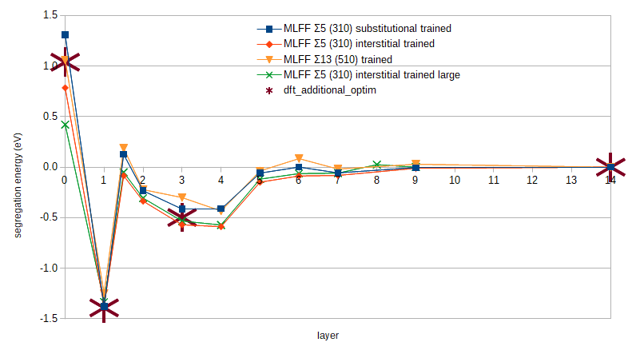
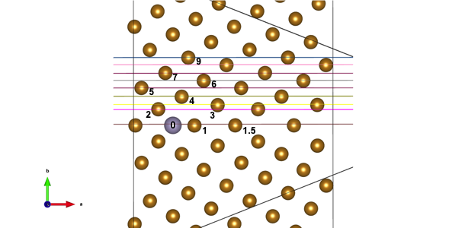
Tin GB segregation
Trained MLFFs are independent to GB type.

Slide 44
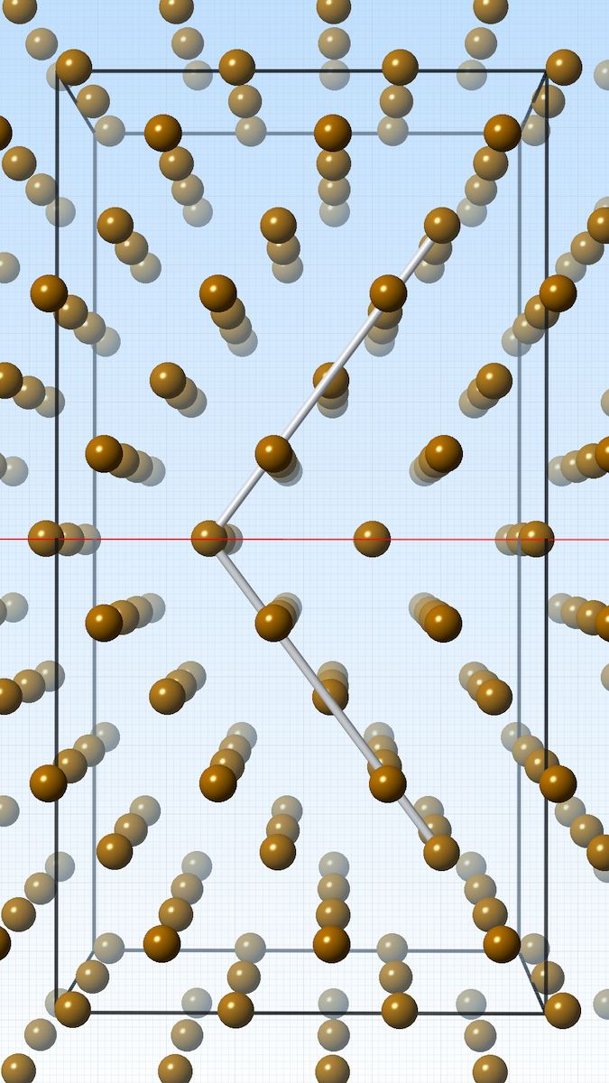
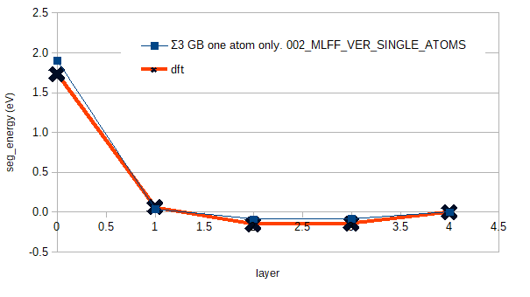
Tin GB segregation

Slide 45
On the fly machine learned force fields
MLFF – machine learned force fields
Five order magnitude faster than ab initio.
With MLFF almost ab initio accuracy.
Stored quantities: forces between atoms, total energy and stress tensor.
Be careful regarding magnetism and characteristics strongly related to electronic structure.
Advantages: temperature, large simulation cells, extraordinary speed.
+
-
-
-
-

Slide 46
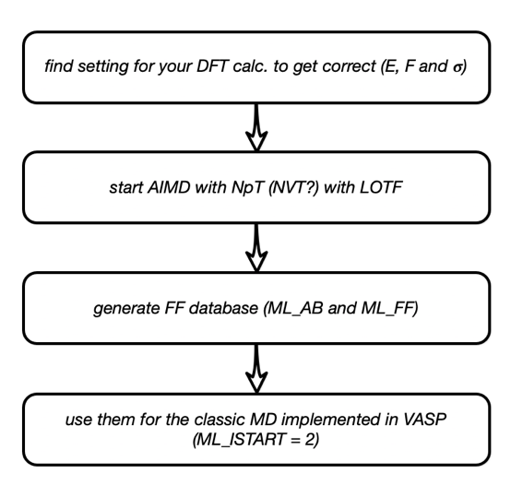
On the fly machine learned force fields

Slide 47
How to plan your AIMD
create training system
minimize it
heat up the structure (NpT or NVT)
equilibrate
continue with simulations

Slide 48
Training set – the most important choice
Do not use super cell containing bulk.
We achieved a very good MLFFs trained
on a super cells with grain boundary.
At least 100 atoms.
Type of GBs doesn’t play any role.
Simulation cell at least 5 Angstroms length.

Slide 49
Let’s go to make same examples
+
-
-
-
-

Slide 50
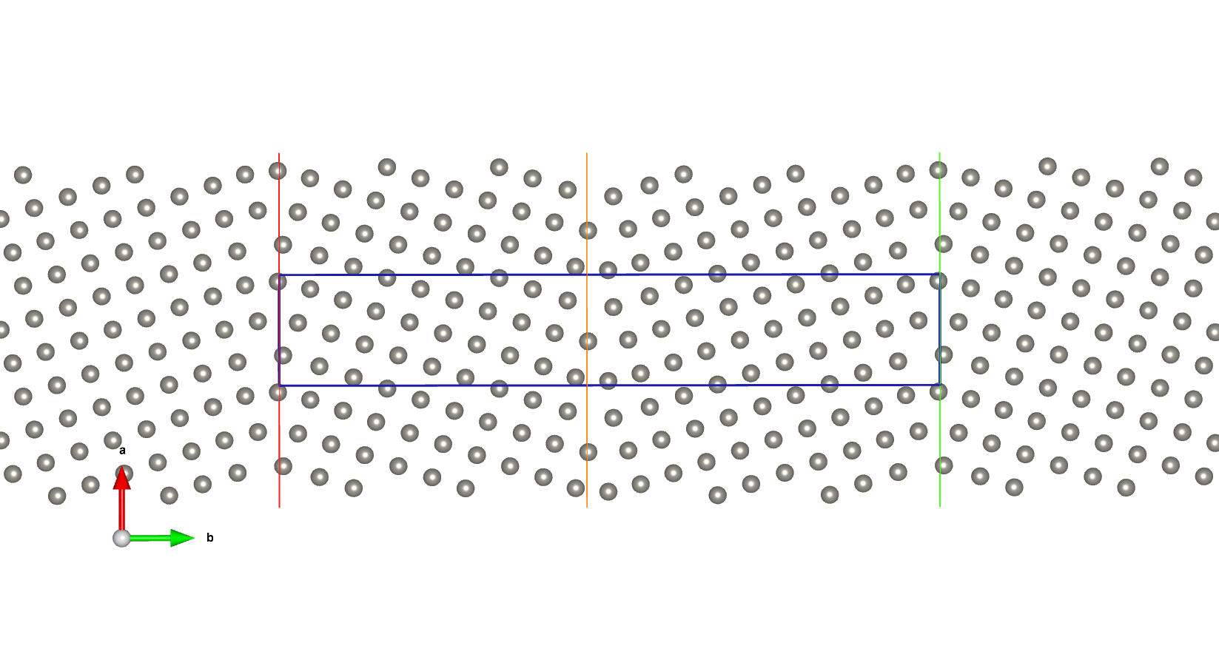
Training set – the most important choice – W Σ5 GB (310)

Slide 51
Starting the learning procedure for MLFF
Copy the data from /workshop to you home directory.
Download the structure file POSCAR.
Use VESTA or OVITO to visualize the straining structure for AIMD with on the fly machine learning.
Look into INCAR file. The are notes for the input variables.
Do not any change of POTCAR and leave it as it is. The file contains PAW pseudopotential of tungsten.
Start your simulation with on the fly learning forces and generate ML_ABN and ML_FFN files.
Enter command “qsub run.sh”.

Slide 52
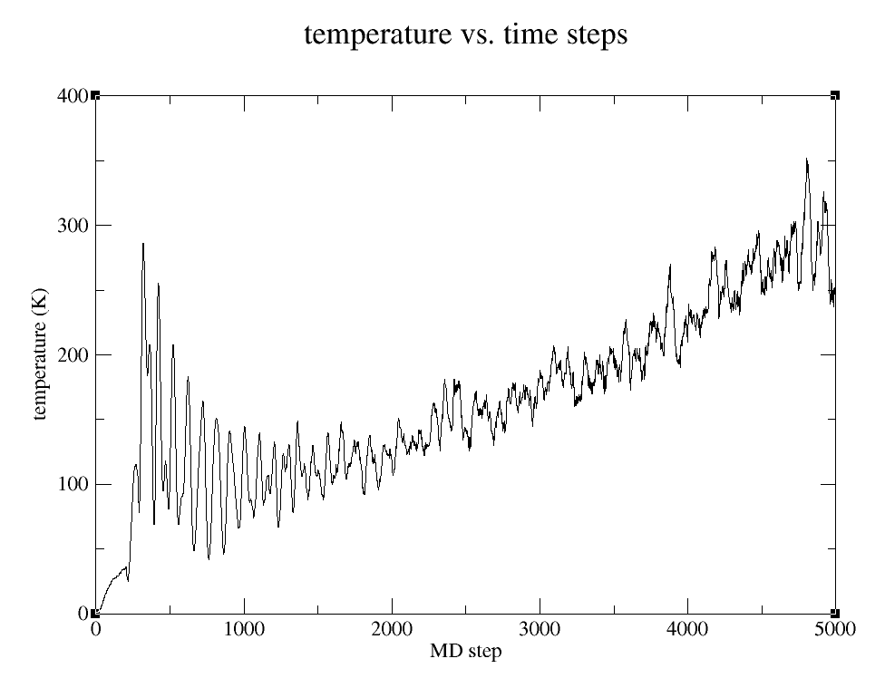
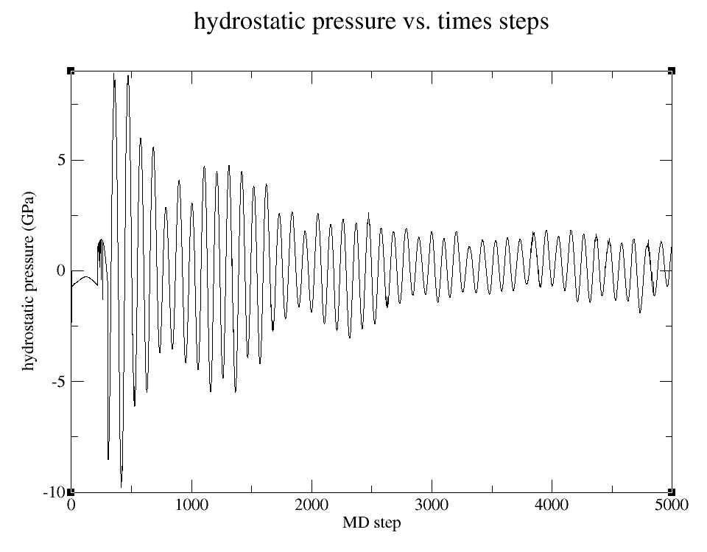
Examine obtained results
Look how many steps were performed by the DFT calculation and how many from the MLFF dataset.
  [grep rms OSZICAR |wc –l]
Print temperature vs. number of steps.
Print pressure vs number of steps.
Use VESTA or OVITO to visualize the straining structure for AIMD with on the fly machine learning.

Slide 53
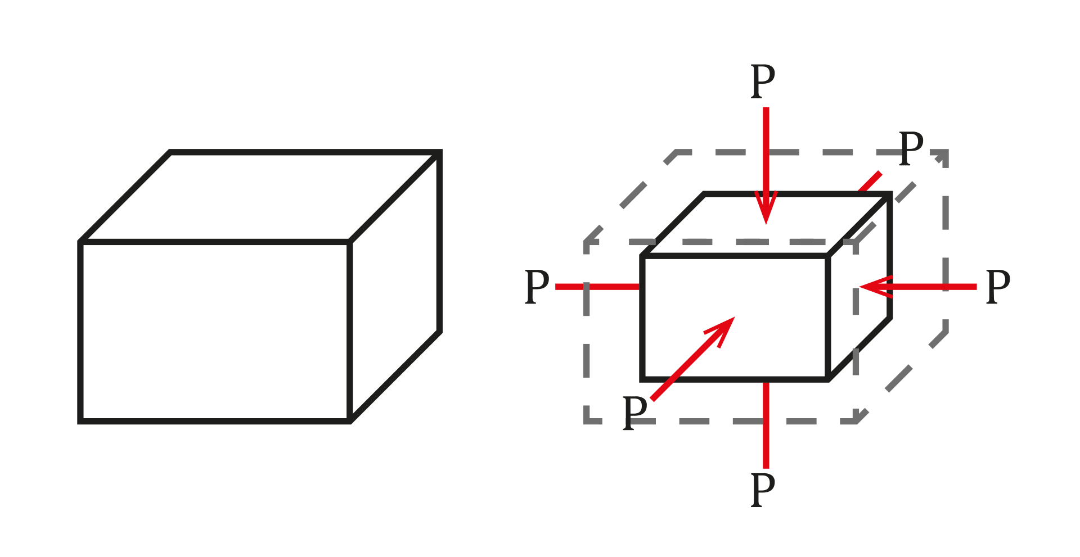
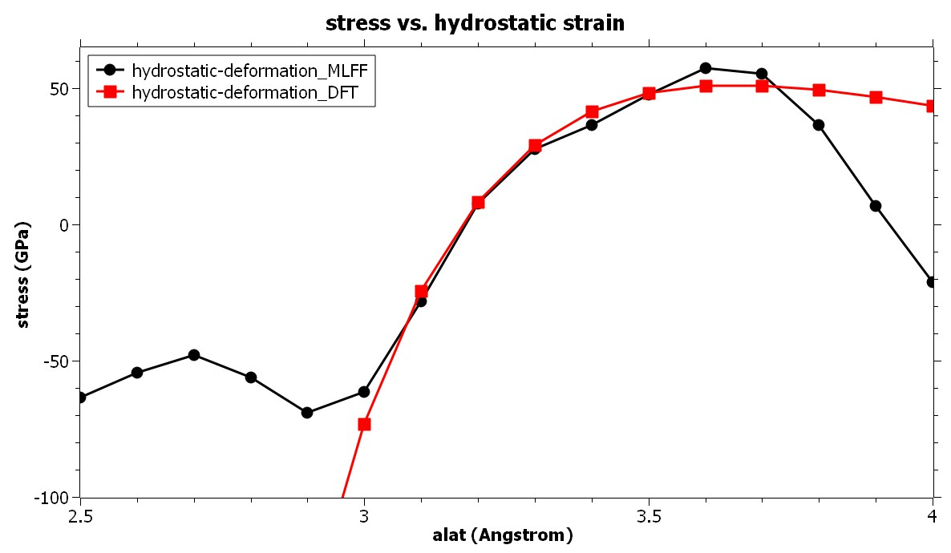
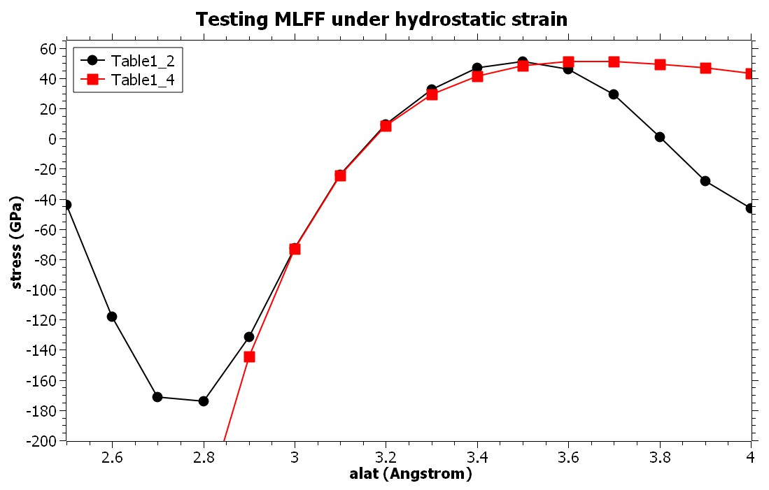
Can MLFF reflect hydrostatic strain?
Go to directory and start the MLFF as well as the DFT simulation for comparison.
Get data via the present script.
Print them and compare, e.g. SciDAVis.

Slide 54
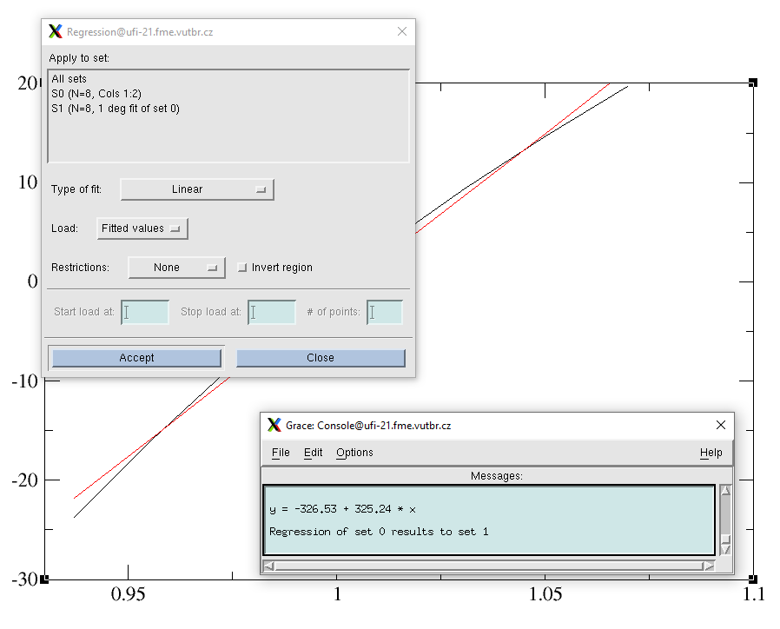

Bulk moduli?
Go to directory and start the MLFF as well as the DFT simulation for comparison.
Get data via the present script.
Print them and compare with the DFT results (also available under DFT directory) and experiments.
https://en.wikipedia.org/wiki/Bulk_modulus

Slide 55

Thank you!
www.eeagrants.org
Facebook, Twitter, LinkedIn, Instagram
YouTube: EEANorwayGrants
Mail: info-fmo@efta.int

