Slide 1
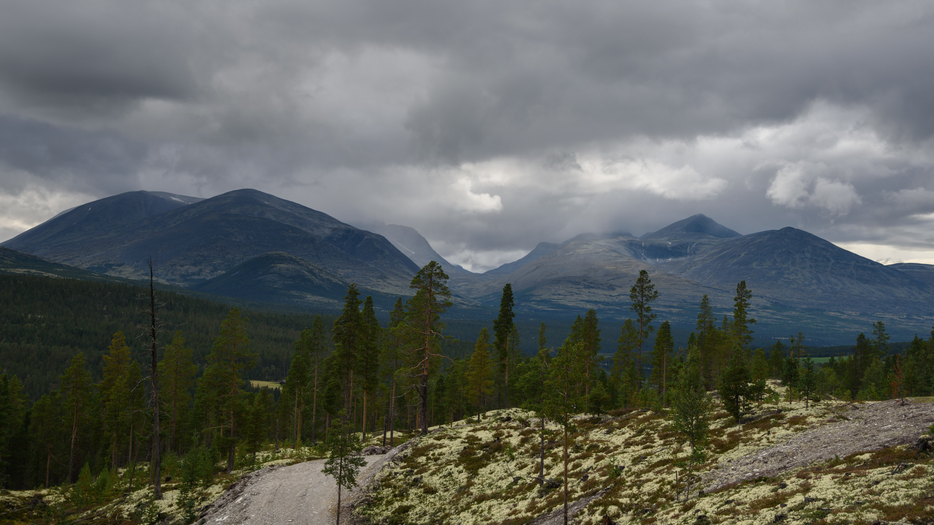
Current possibilities in machine learning – how to glue MD and DFT together
EHP-CZ-ICP-3-012
Petr Šesták
6.9.2023

Slide 2
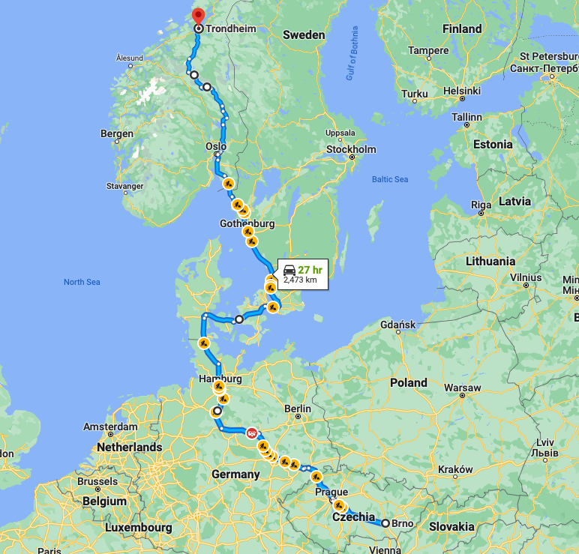
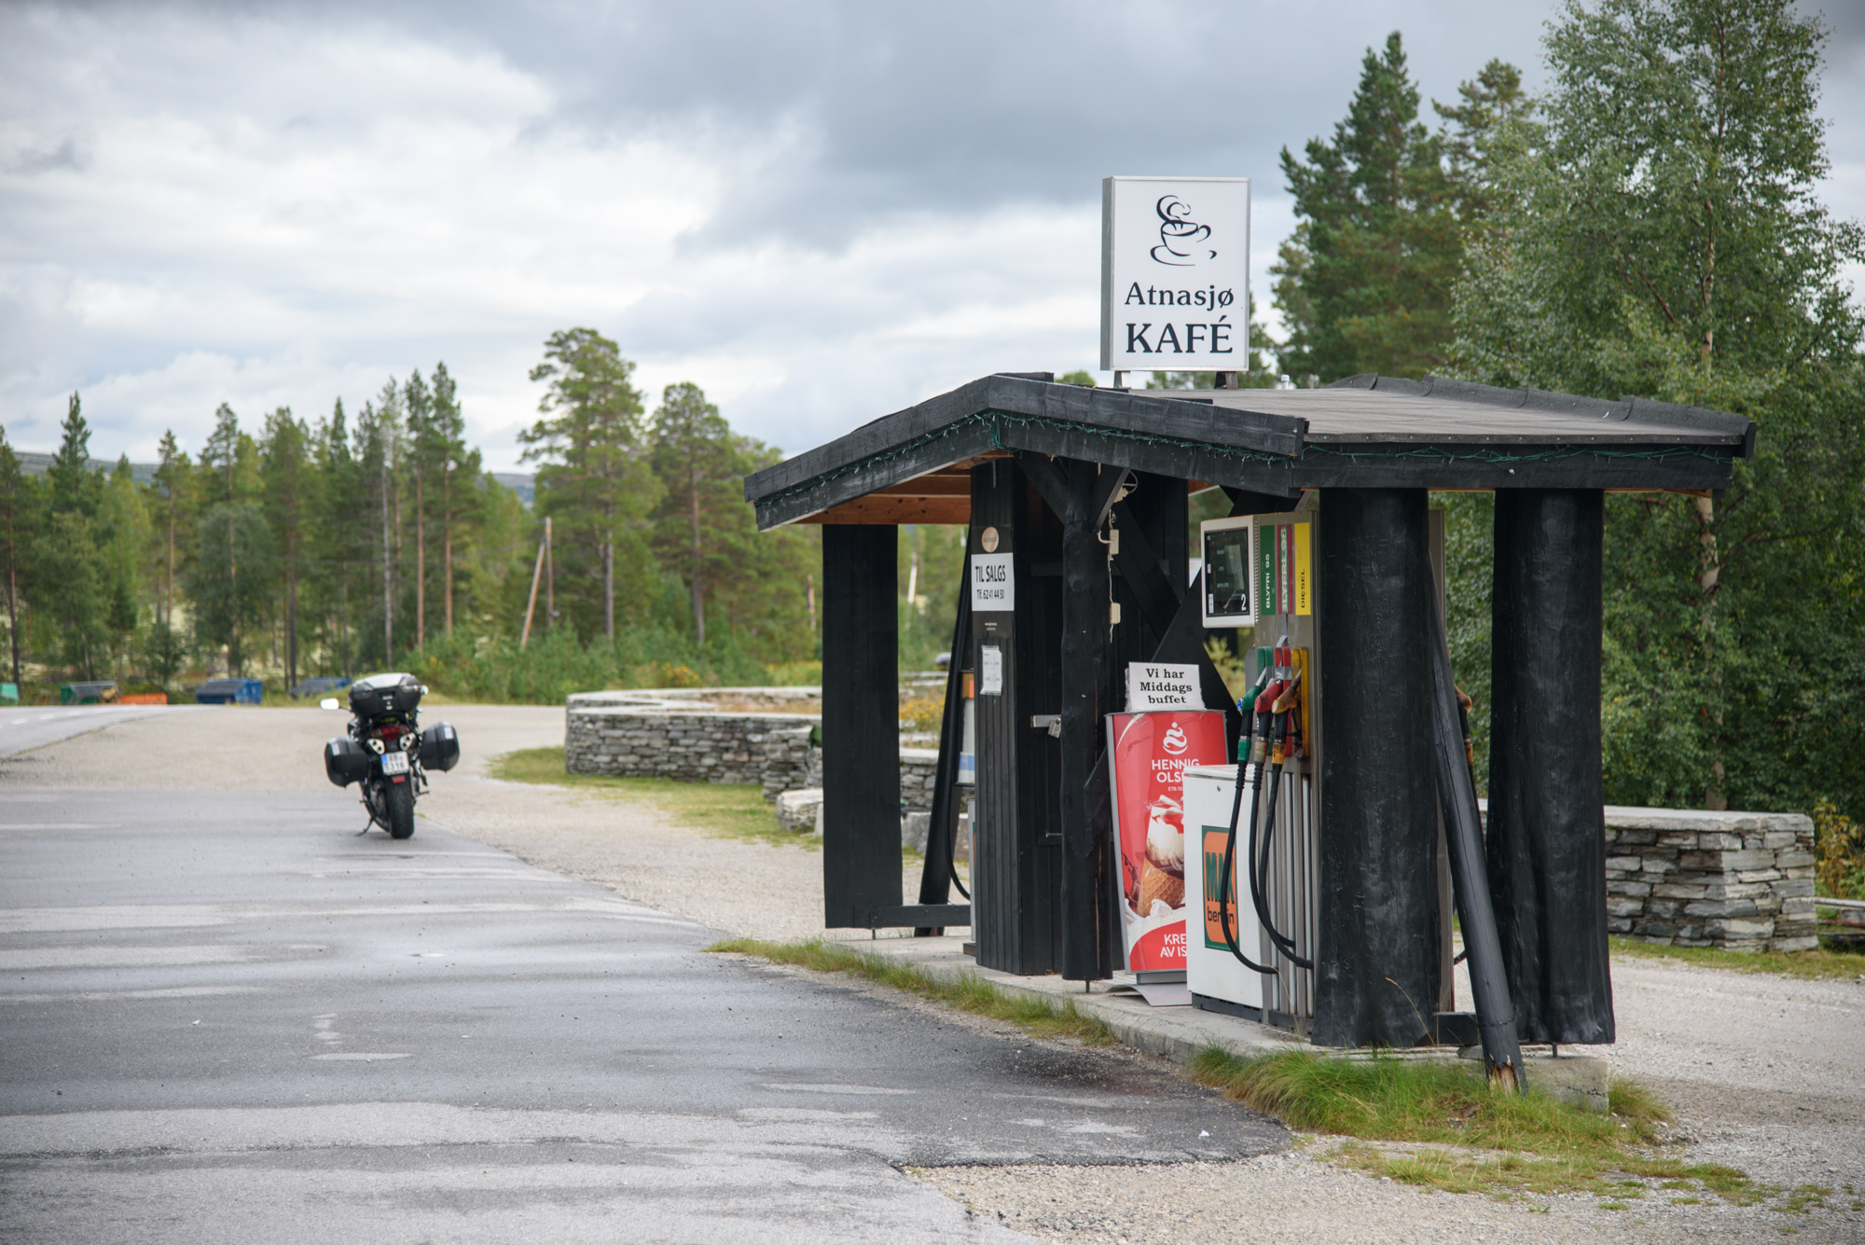
Brno - Trondheim

Slide 3

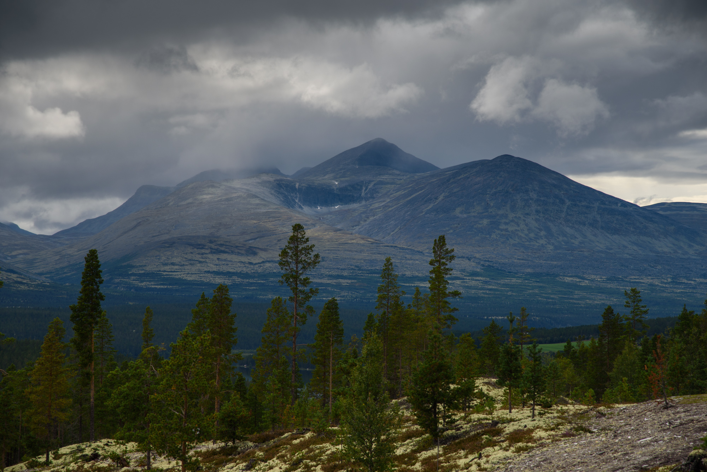

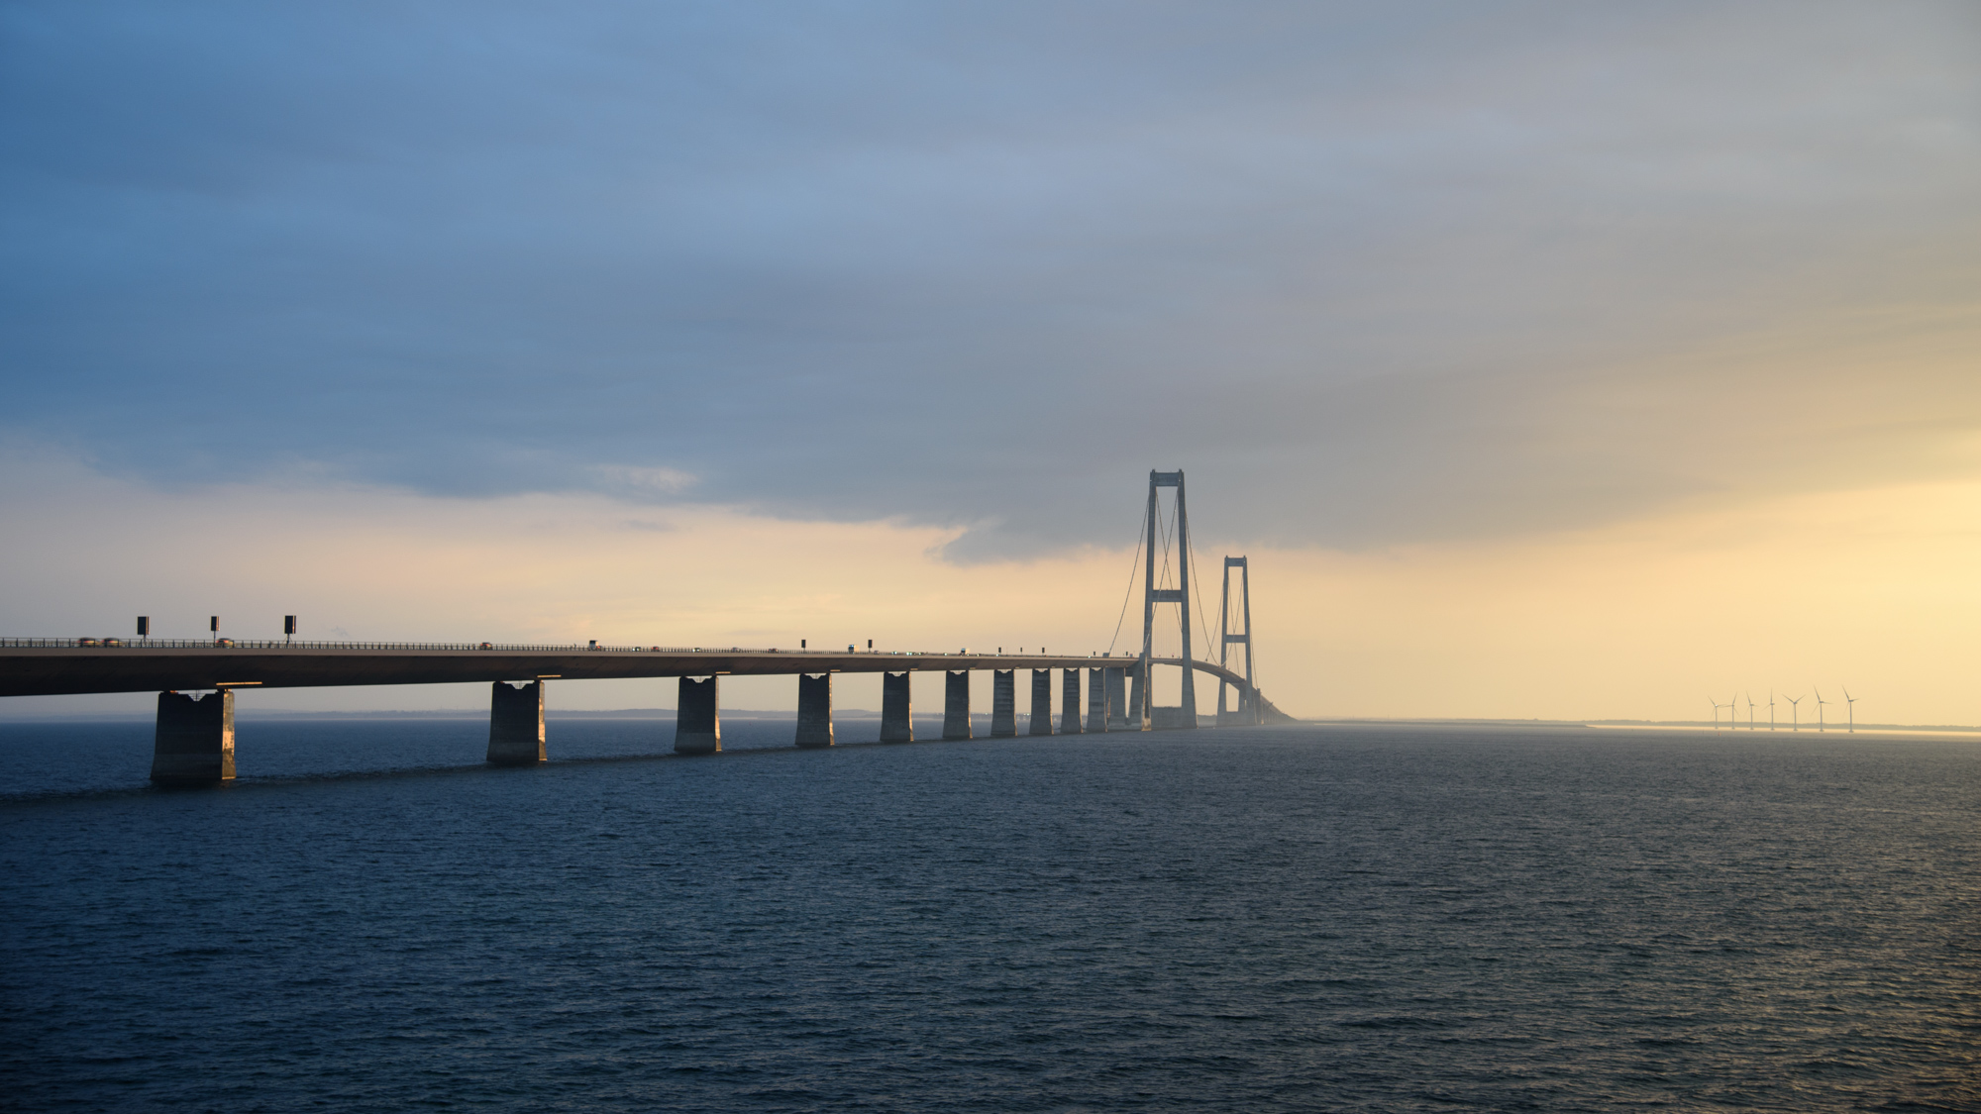
Brno - Trondheim

Slide 4
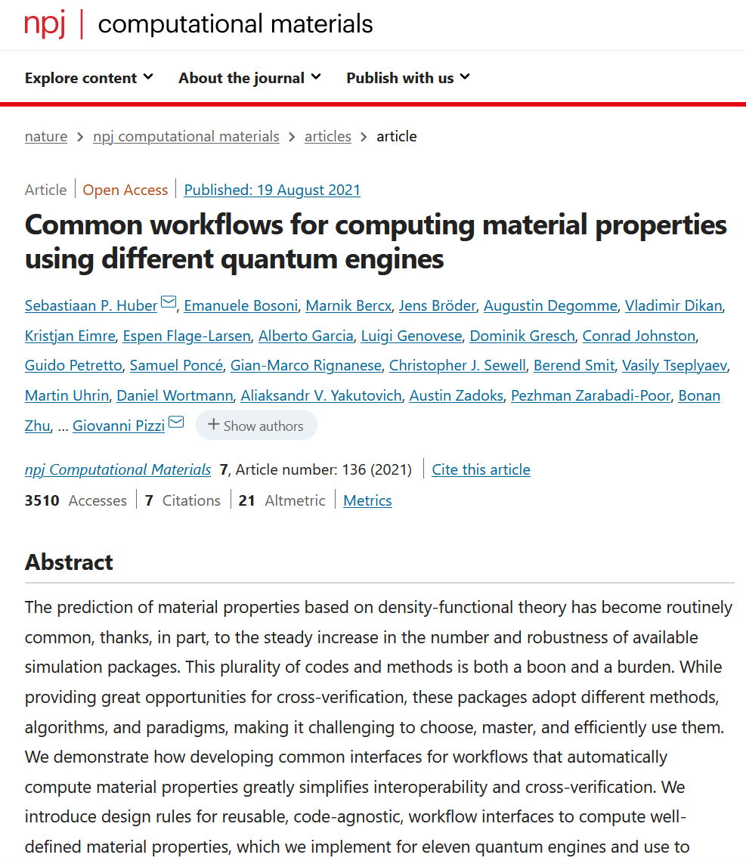
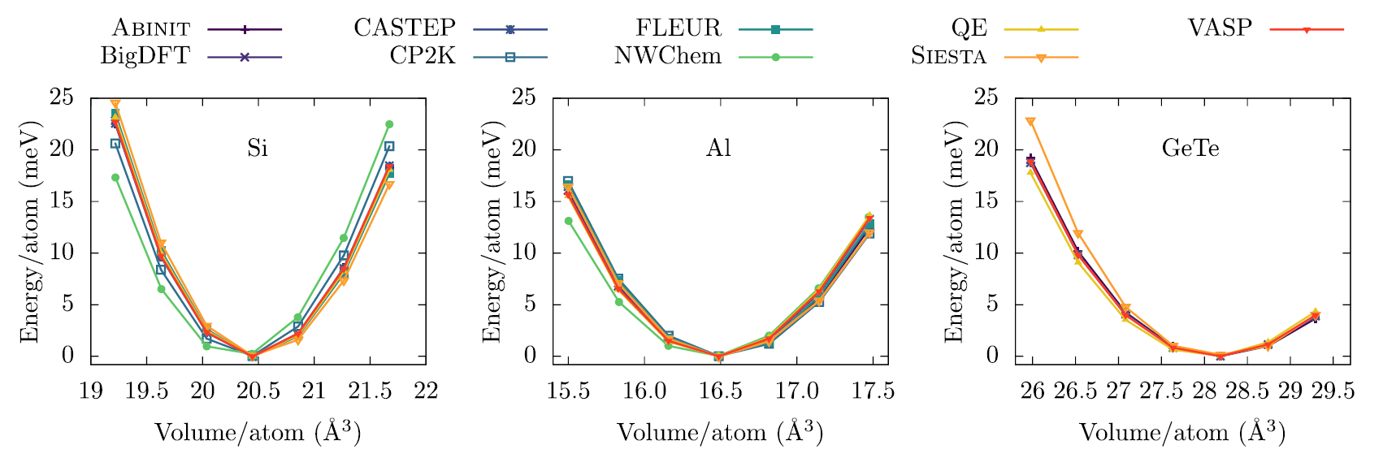
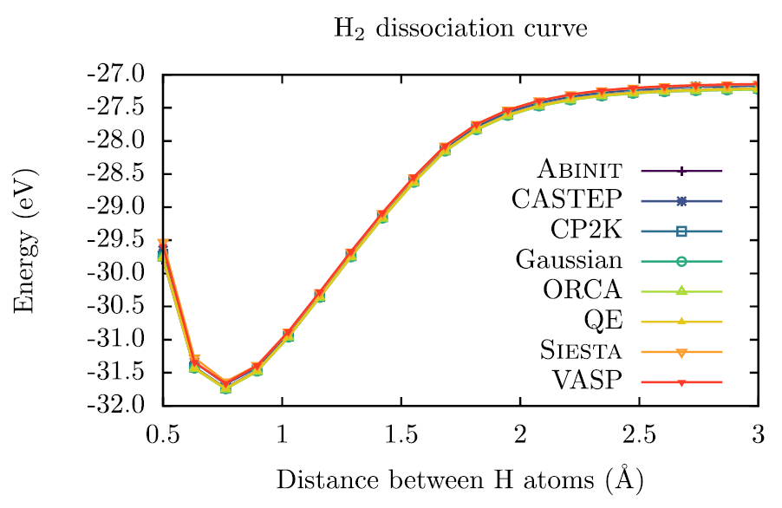
Results replicability over ab initio codes

Slide 5
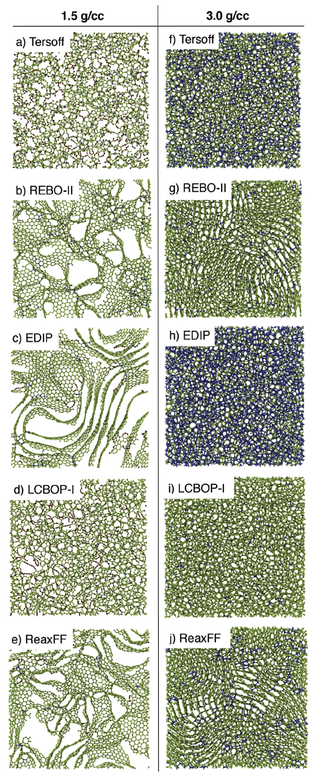
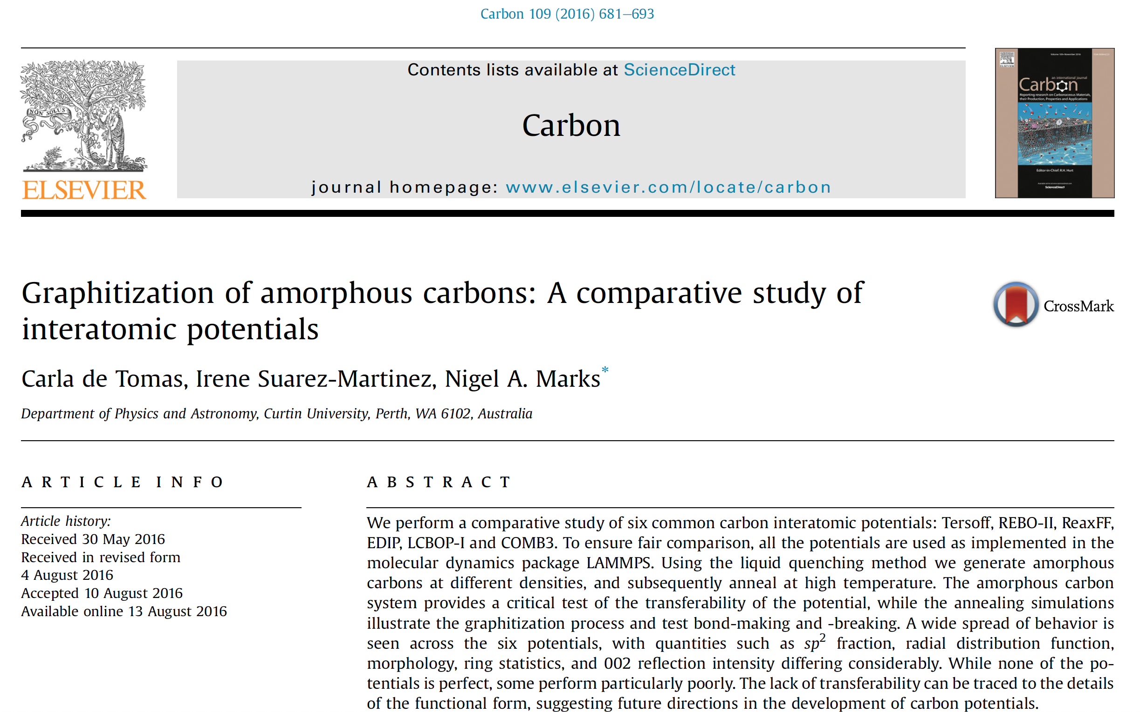
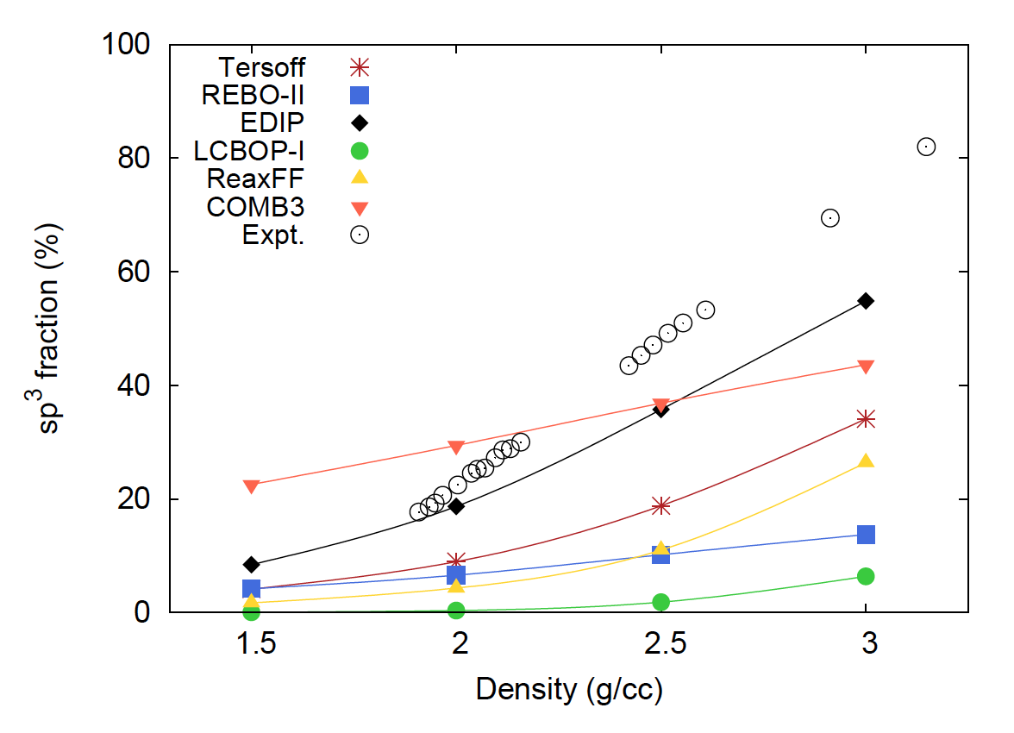
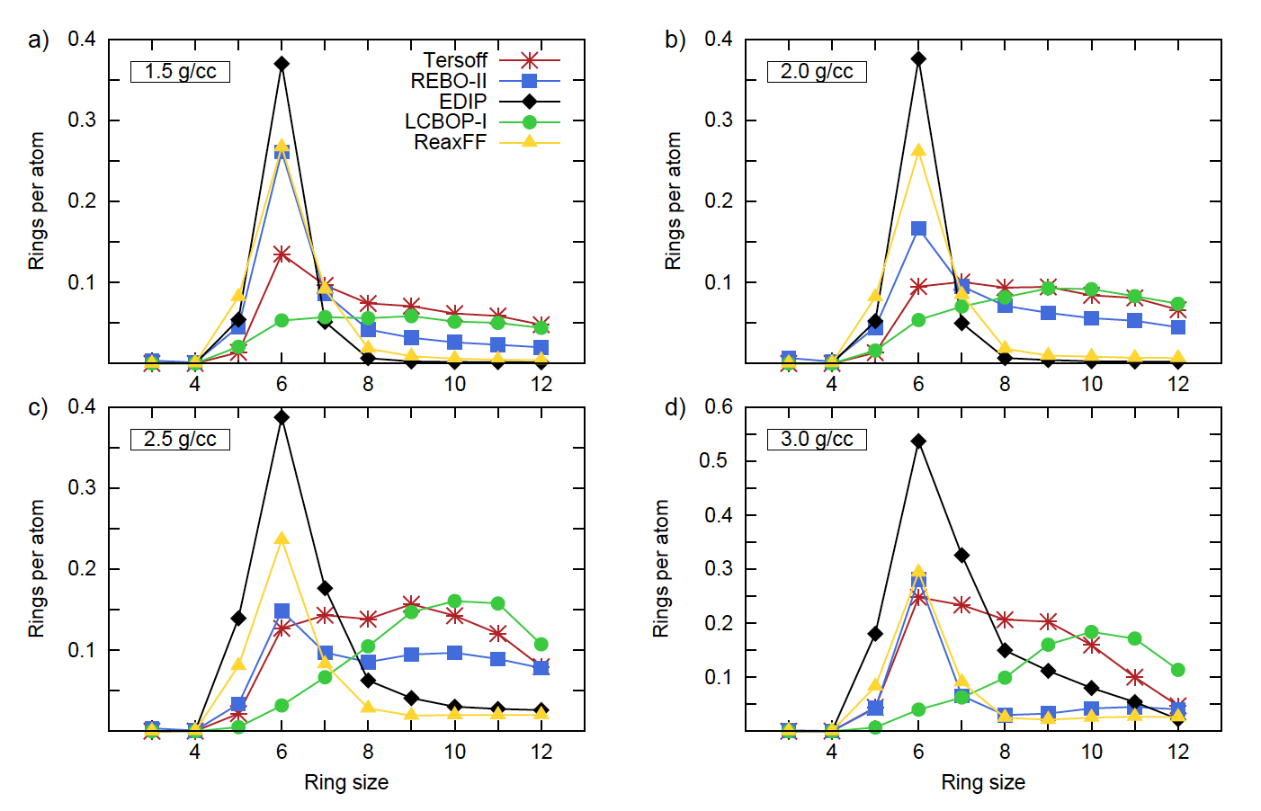
Carbon predictions over available MD potentials

Slide 6
Machine learning force fields - MLFF

Slide 7
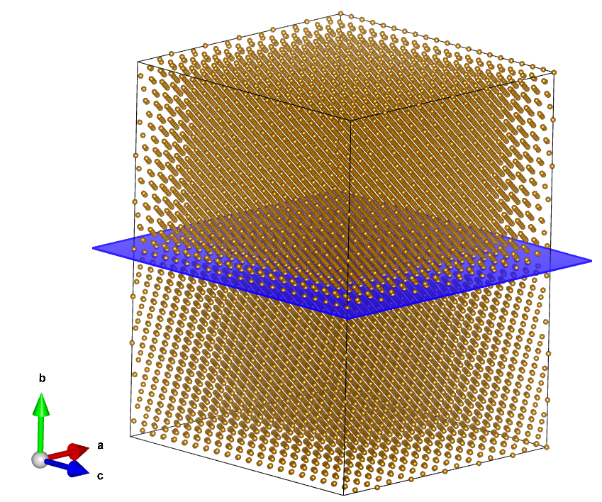
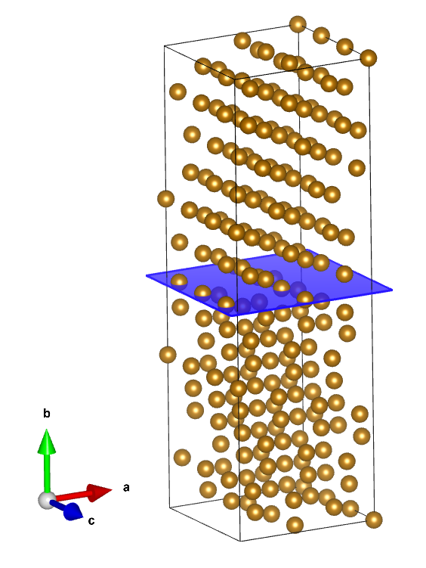
From 200 atm to large cells
with almost DFT accuracy
at finite temperatures

Slide 8
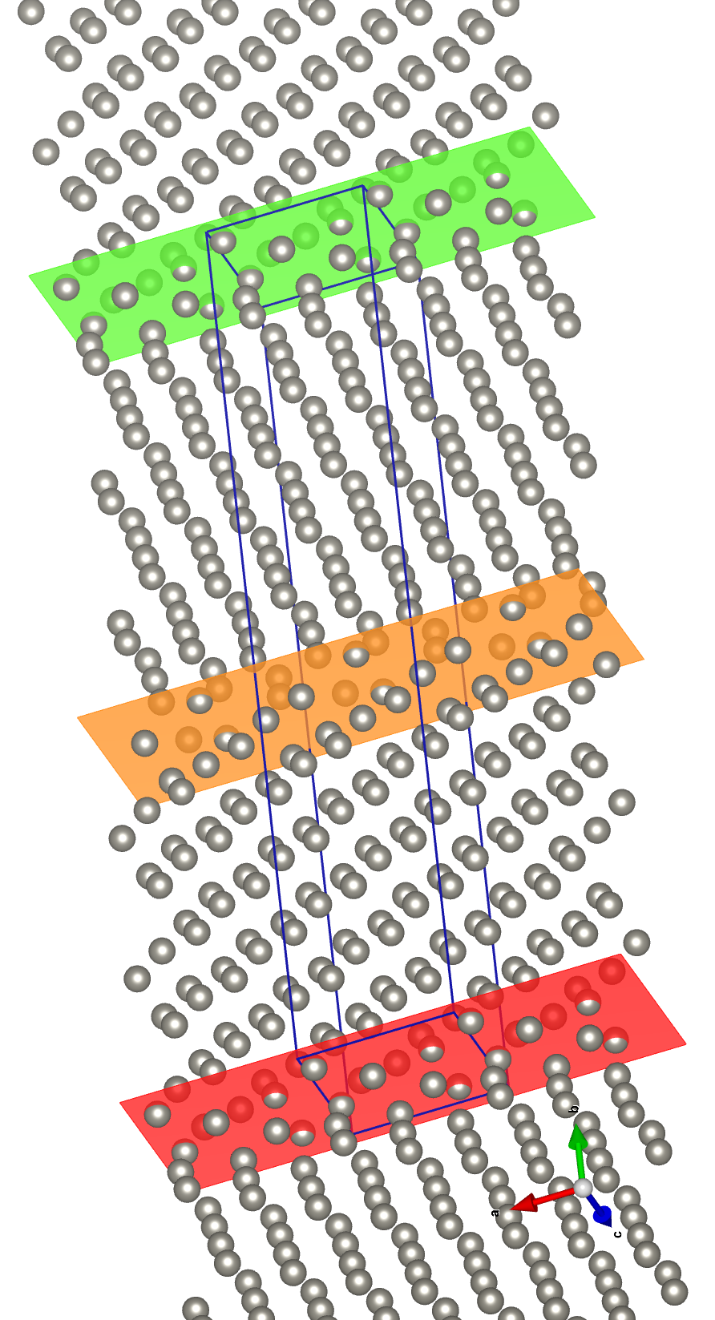
MLFF in VASP
create training system
minimize its energy
AIMD heat up the structure
On-the-fly learning
equilibrate for selected time period (NpT or NVT)
skip to classic MD with MLFF

Slide 9
MD fundamental scheme
structure – initial position and velocities
topology – molecular description
forces are determined from the DFT calculations
force fields – potential functions V of interactions
compute forces
update r and v in repeating in N steps
solve Newton equation
of motion
output – position, velocities energies

Slide 10
Learning on the fly – hydrate

Slide 11

Learning on the fly – hydrate

Slide 12
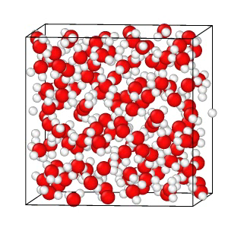
Learning on the fly – hydrate

Slide 13
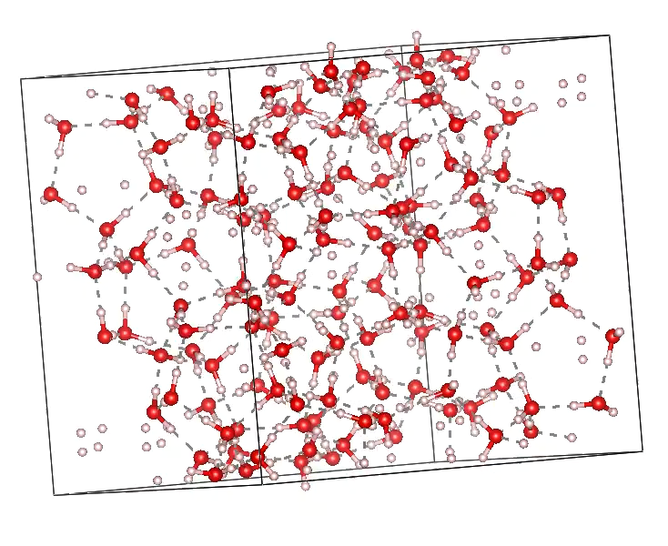
Learning on the fly – hydrate - optimized

Slide 14
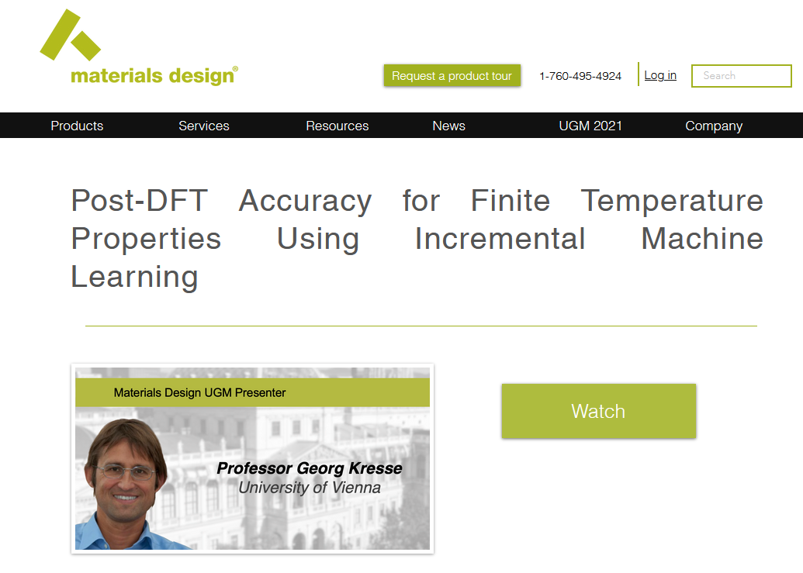
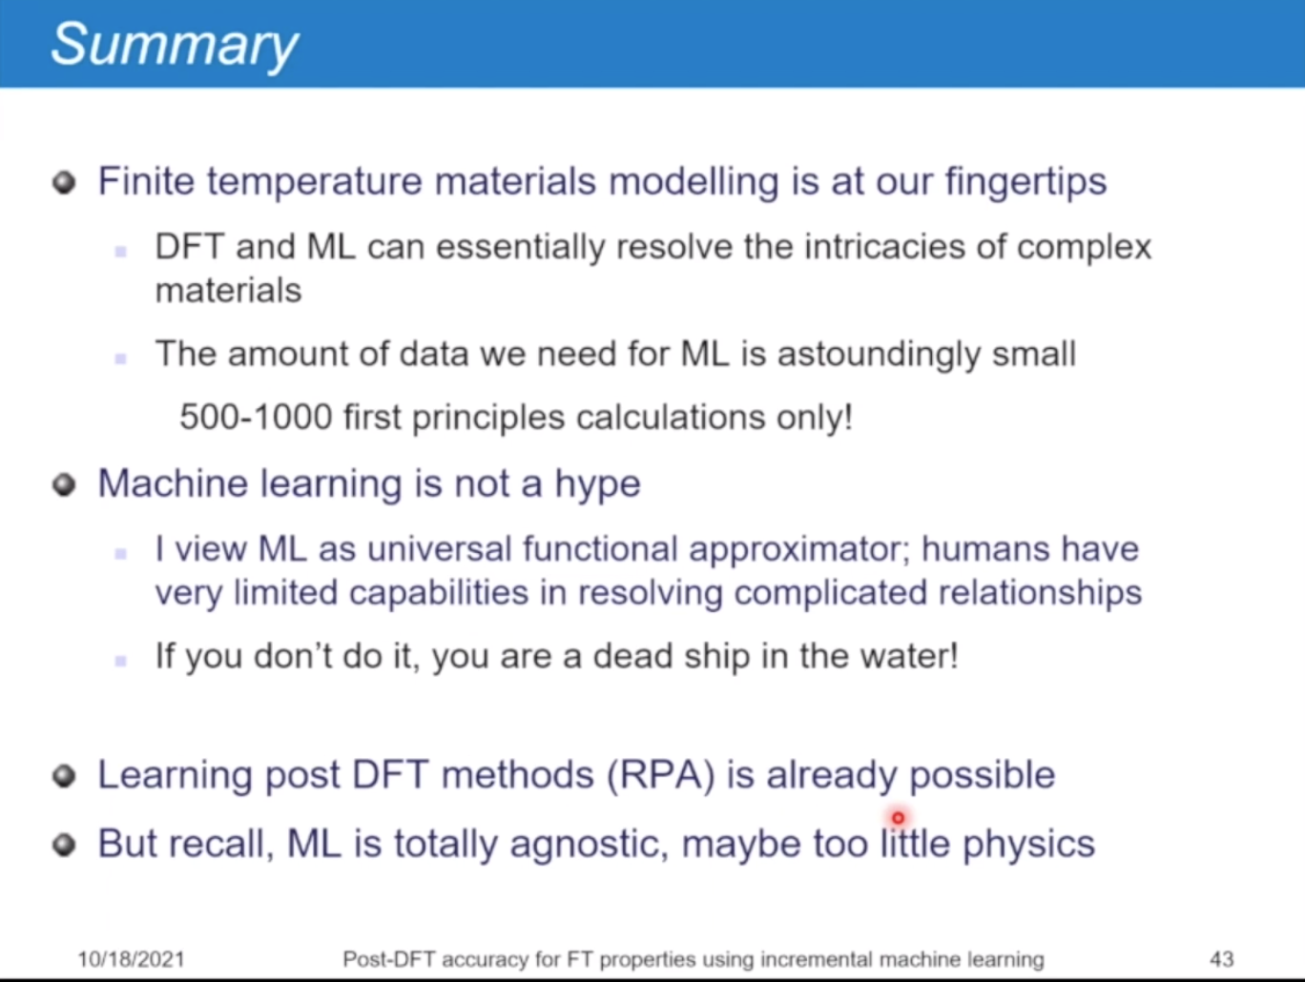
If you don’t do it, you are a dead ship in the water!
Webinar available at:
https://www.materialsdesign.com/
webinars/recorded/ugm-2021-kresse

Slide 15
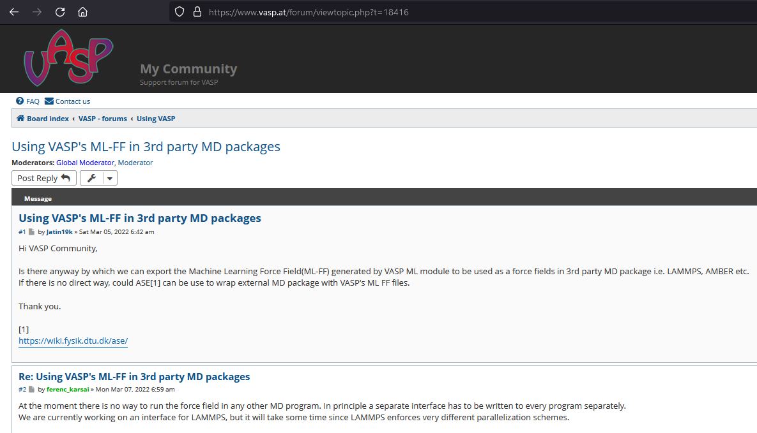
Why LAMMPS and MLFF?

Slide 16
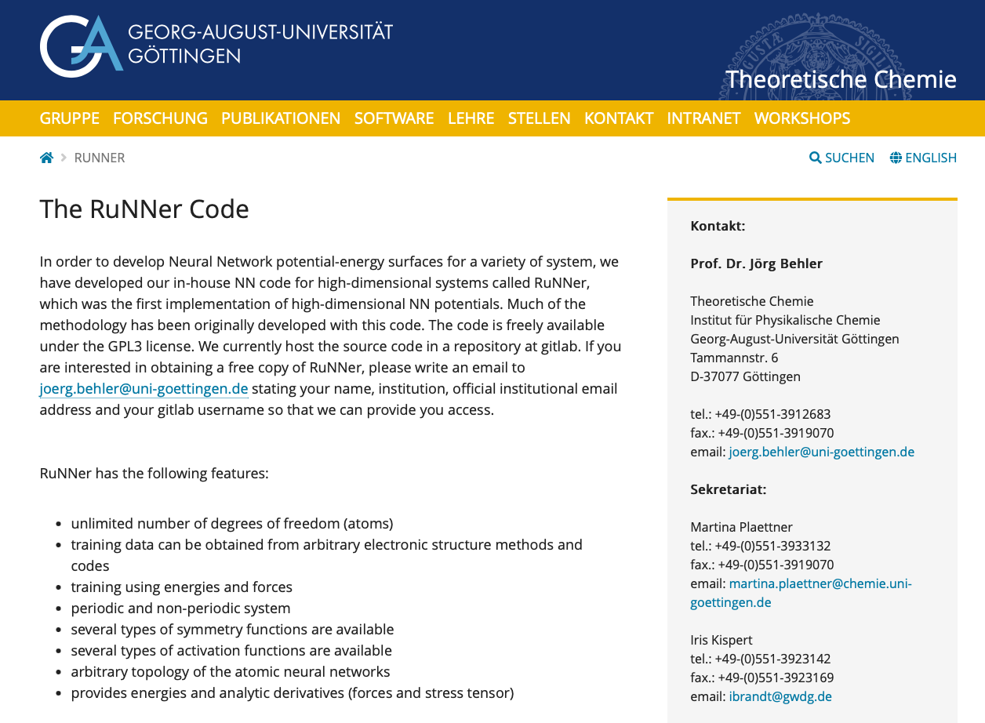
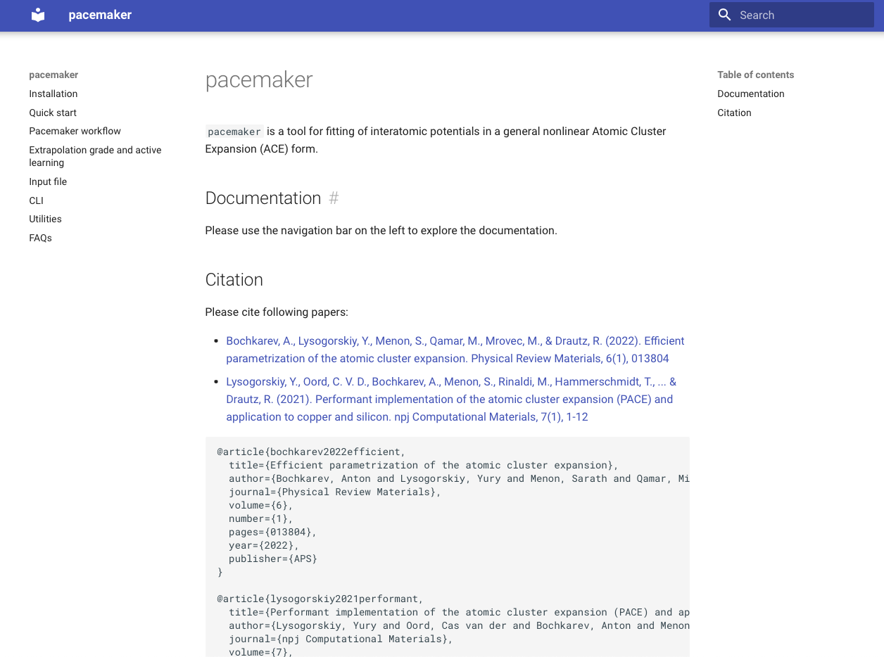
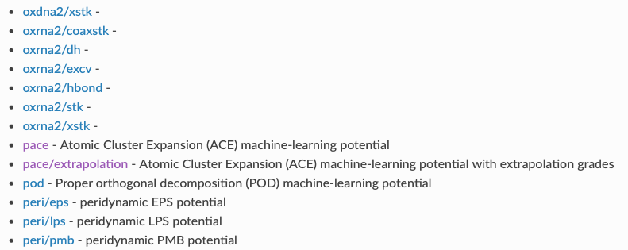
DFT into LAMMPS

Slide 17
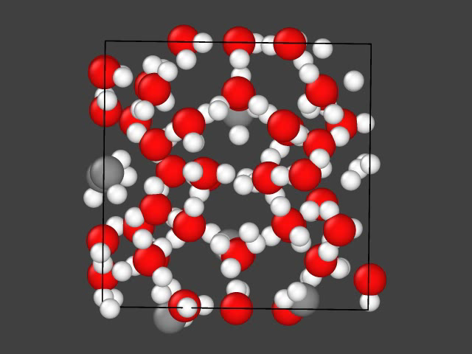
Learning on the fly – hydrate

Slide 18
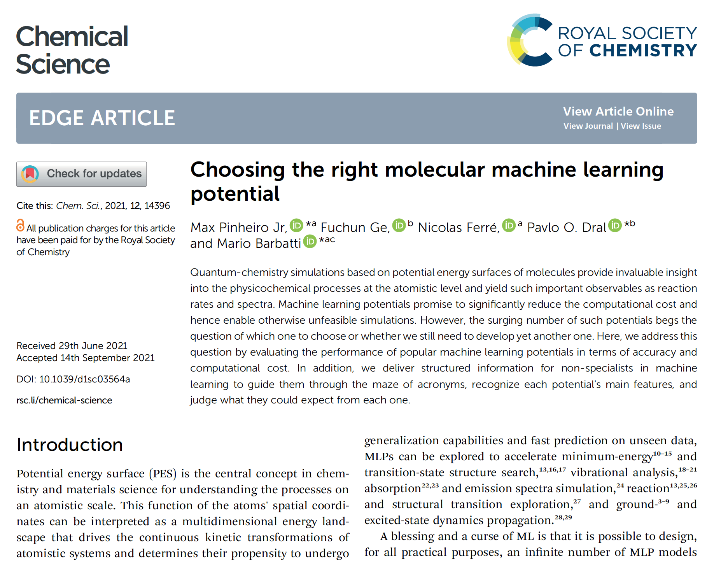
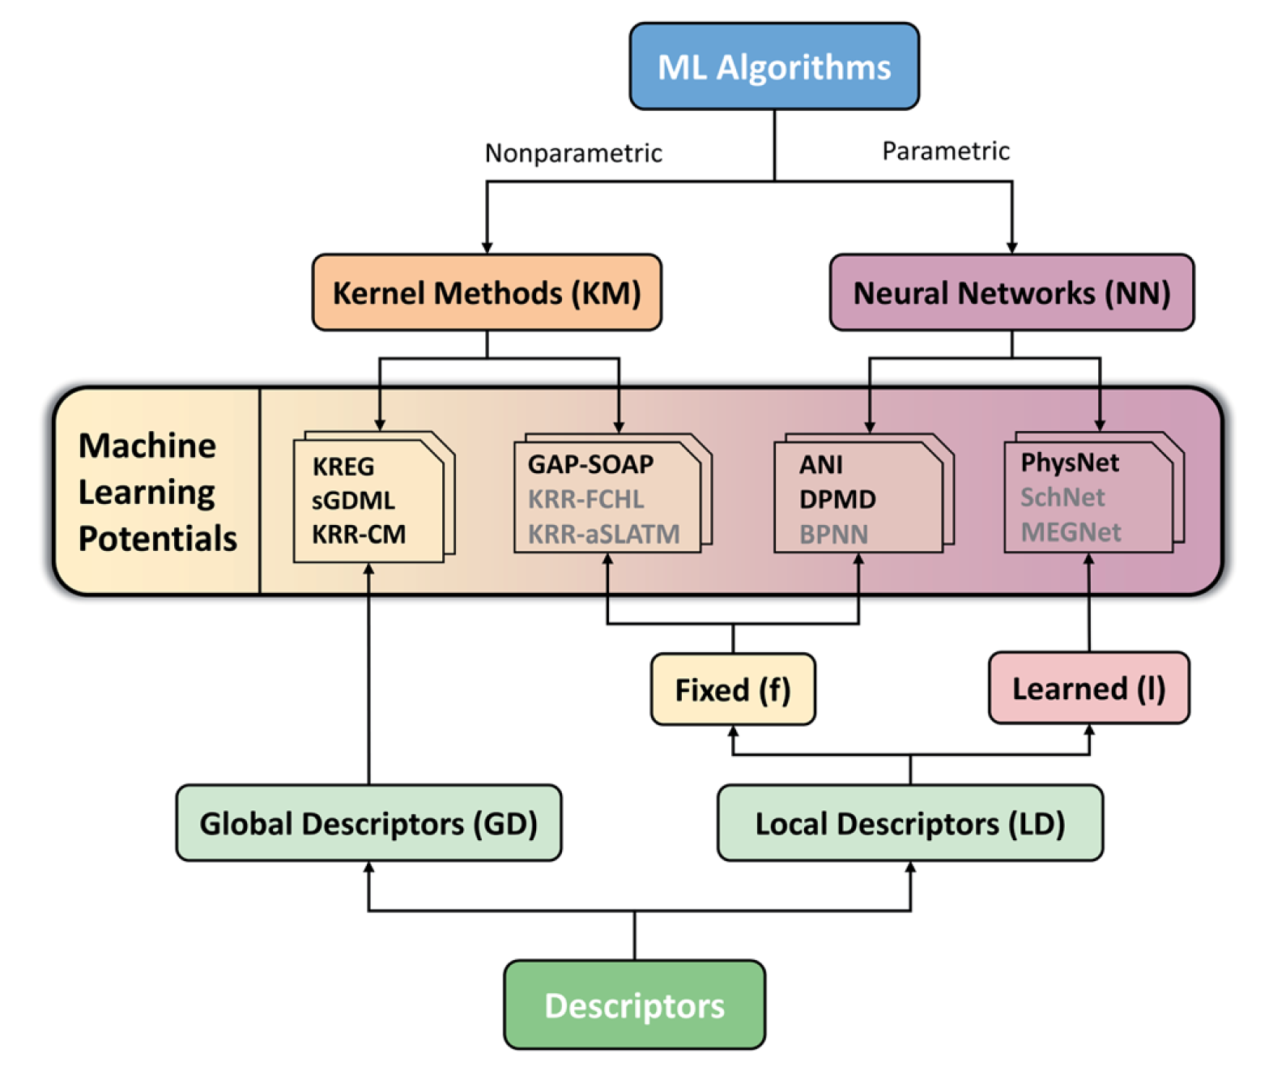
There are many MLPs, I got lost!

Slide 19
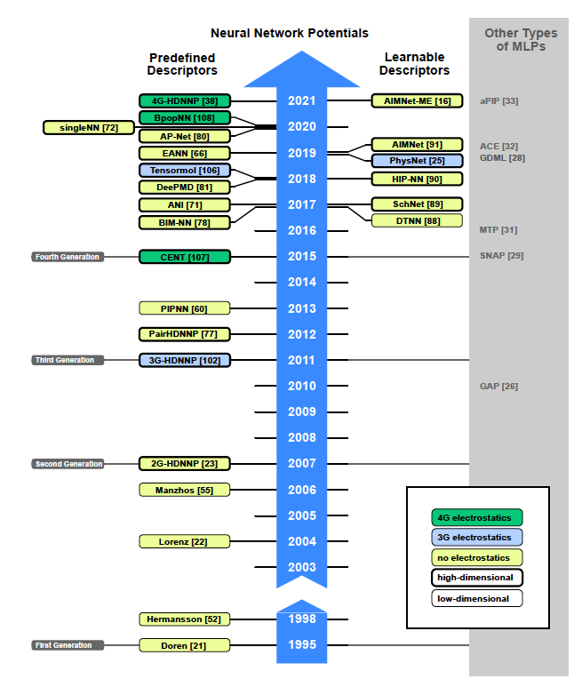
There are many MLPs, I got lost!

Slide 20
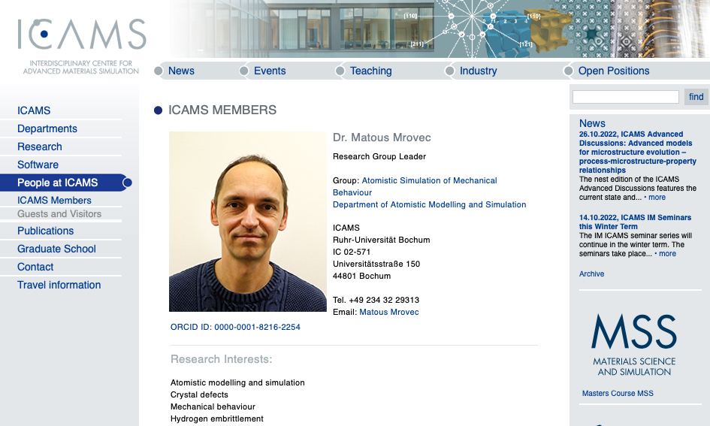
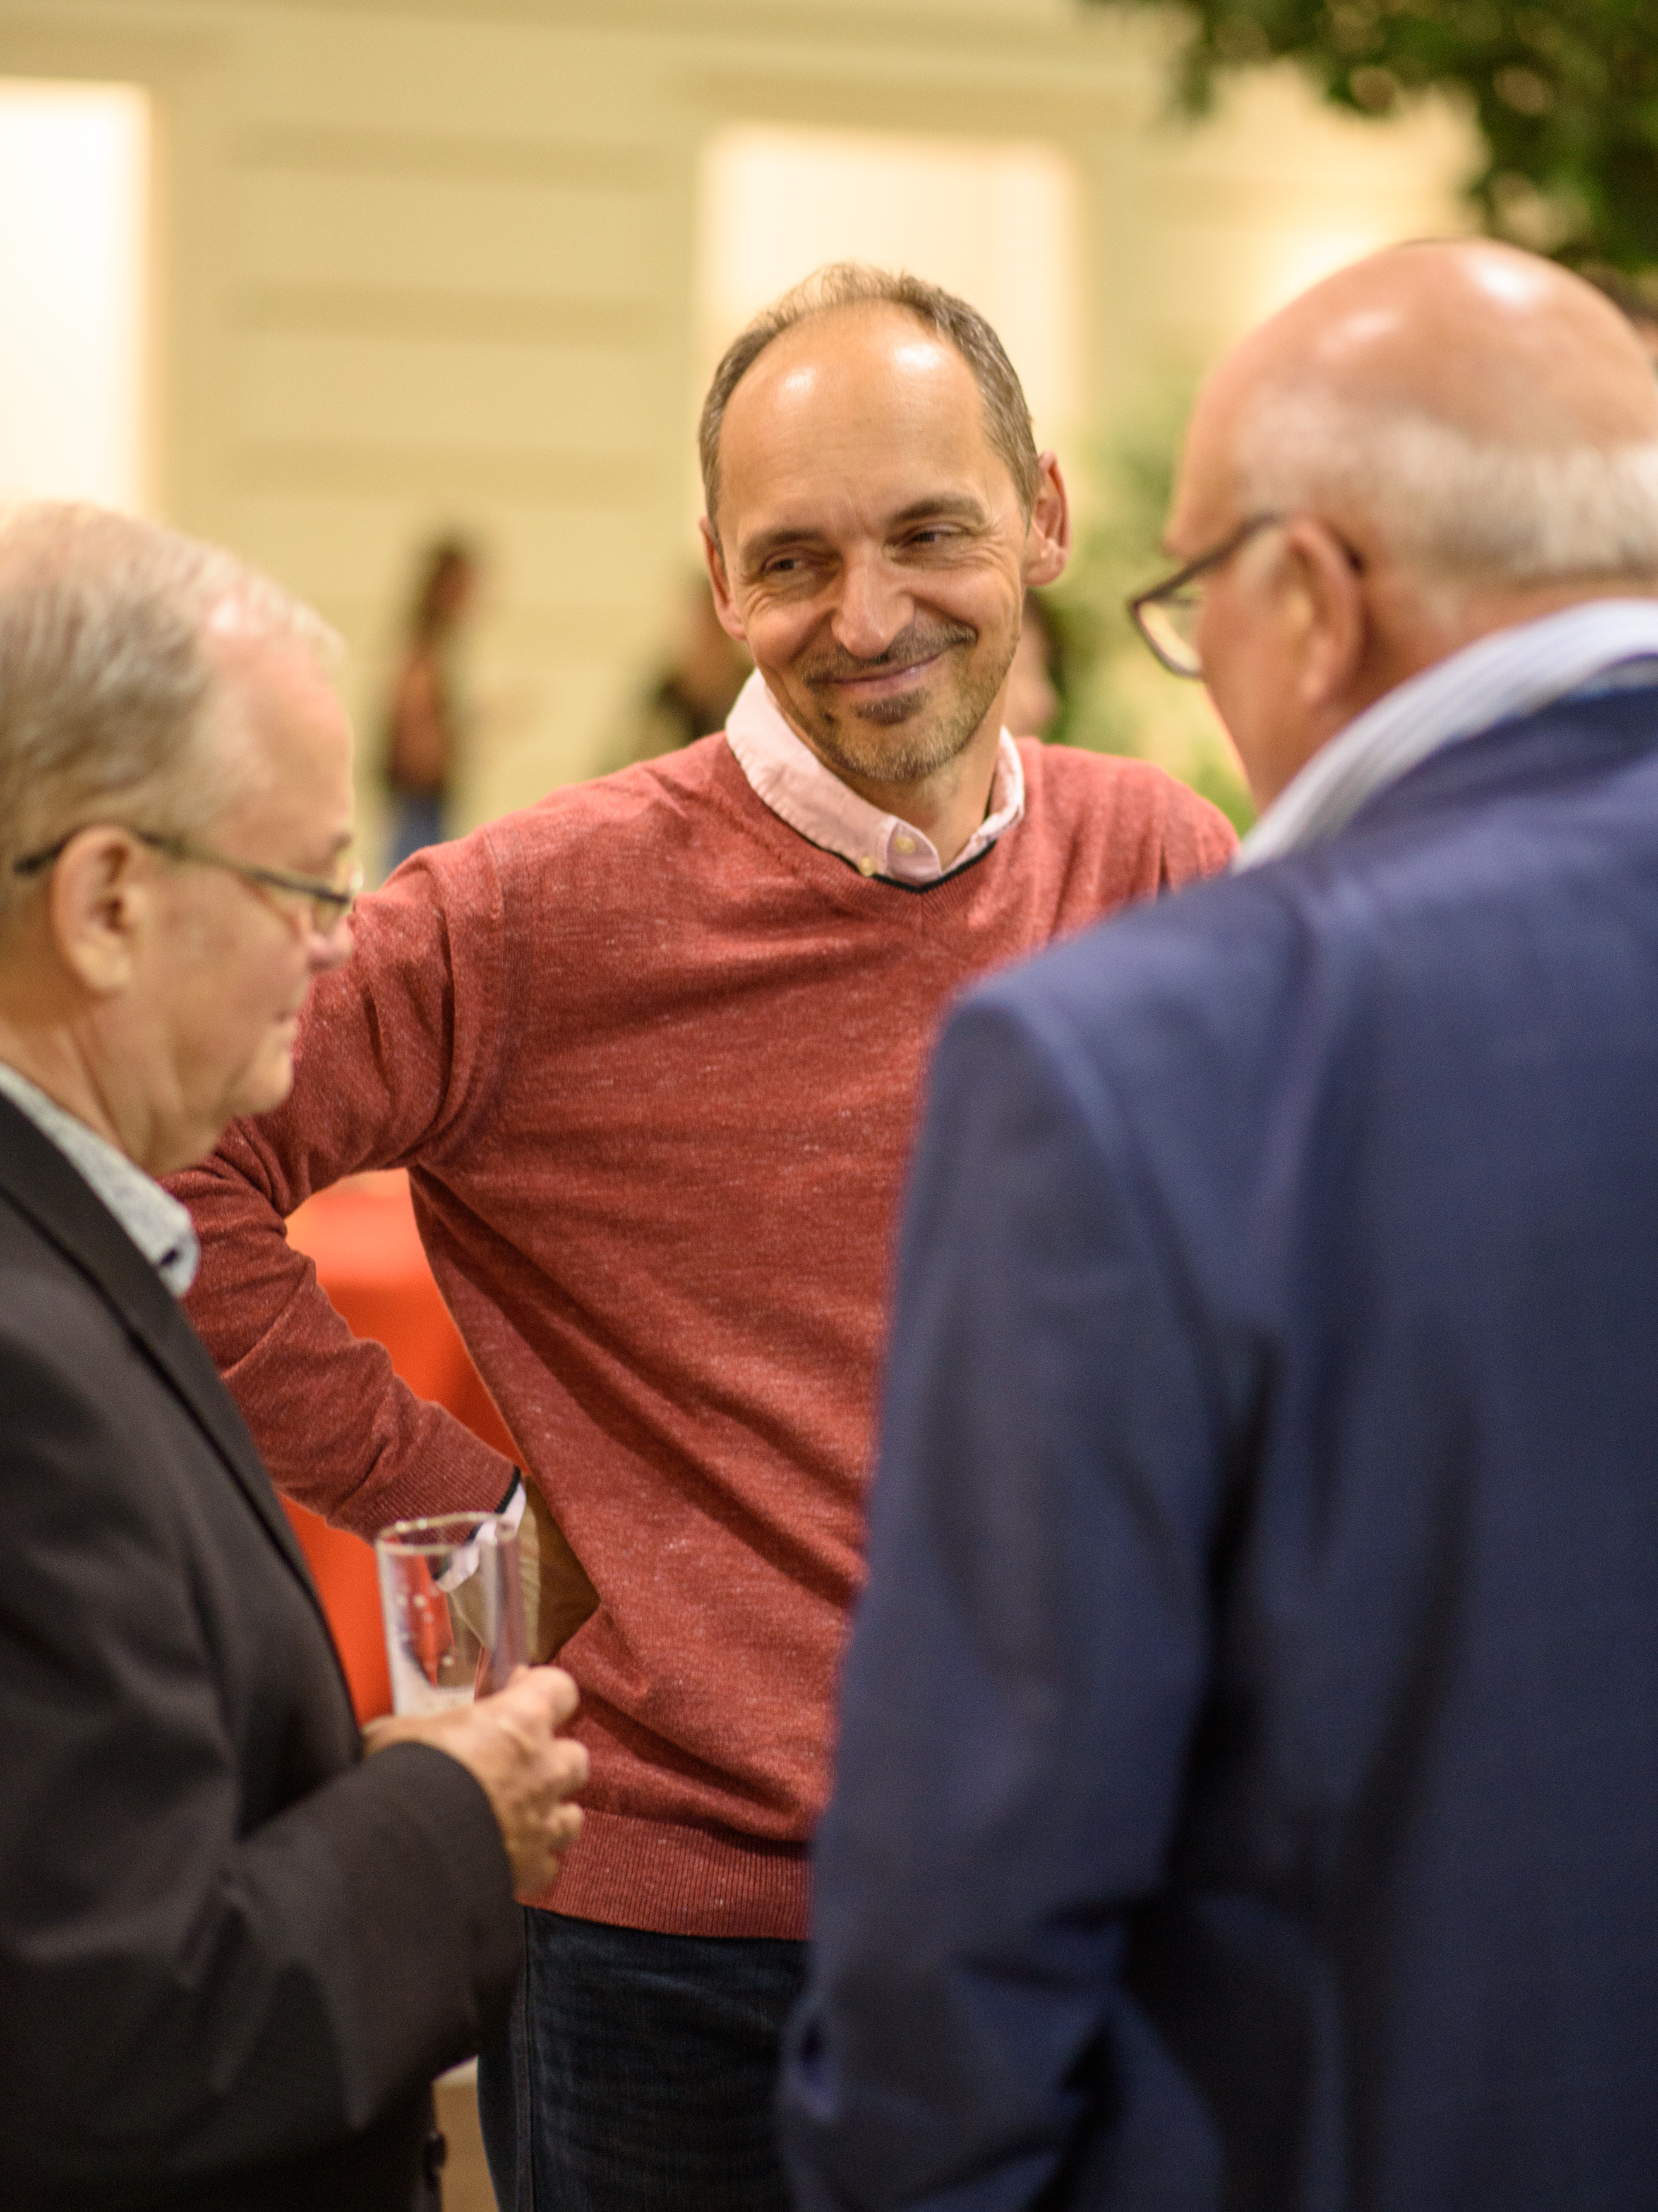
Pacemaker

Slide 21
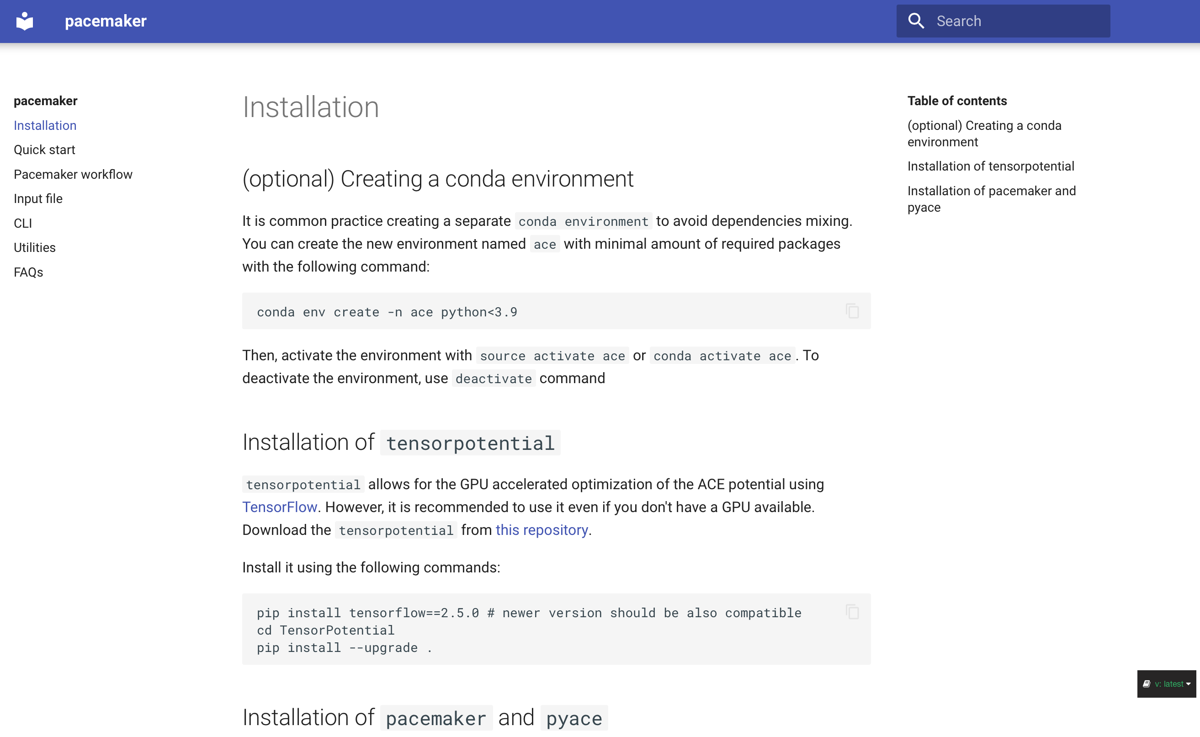
Pacemaker
https://pacemaker.readthedocs.io/en

Slide 22
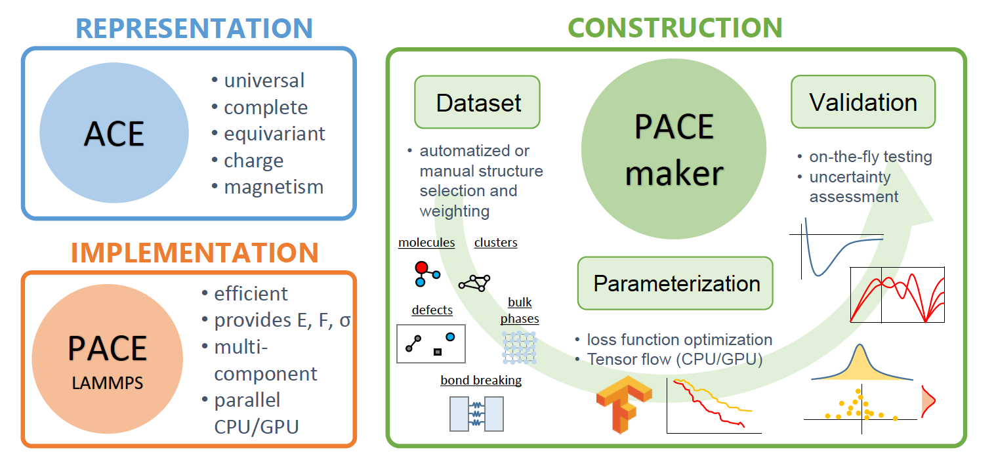
Pacemaker
A. Bochkarev et al. Phys. Rev Mat 6, 013804 (2022)

Slide 23
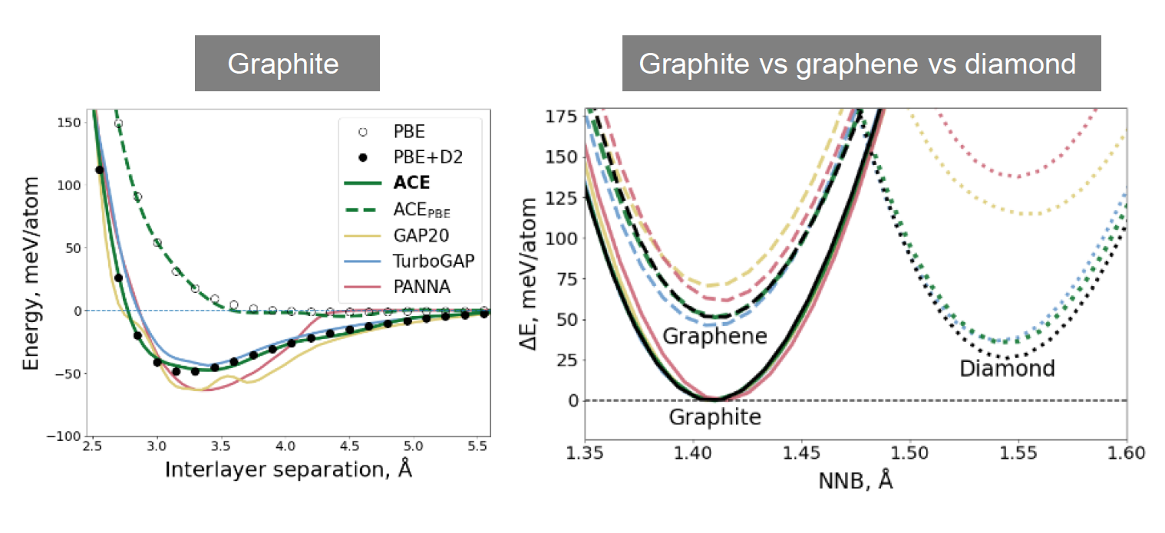
Subtleties of carbon

Slide 24
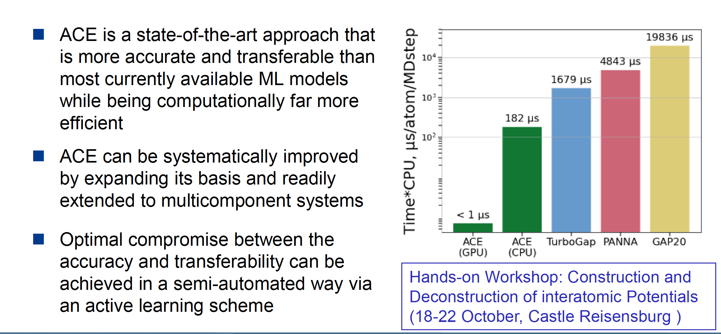

Slide 25
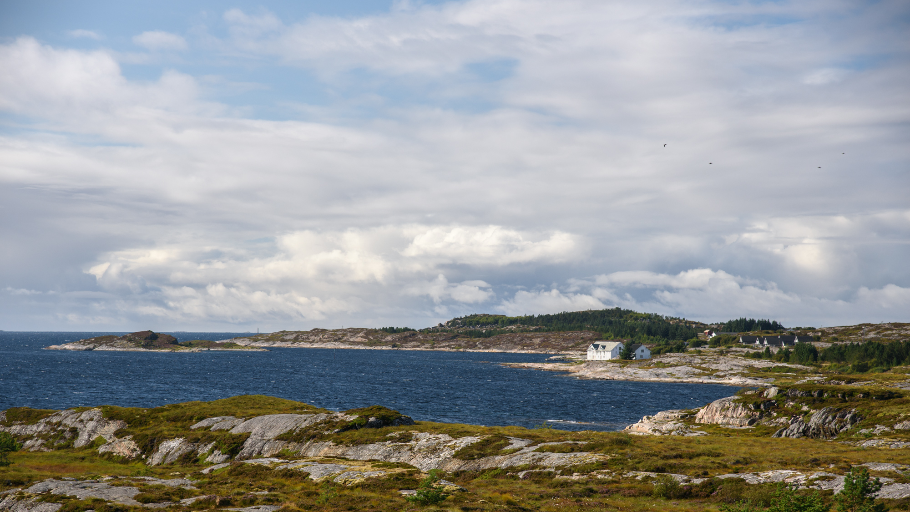
Thank you!
www.eeagrants.org
Facebook, Twitter, LinkedIn, Instagram
YouTube: EEANorwayGrants
Mail: info-fmo@efta.int

