Slide 1

AB INITIO (first principles) calculations short introduction
Petr Šesták
sestak@fme.vutbr.cz
Nanomechanics lecture
Brno University of Technology

Slide 2
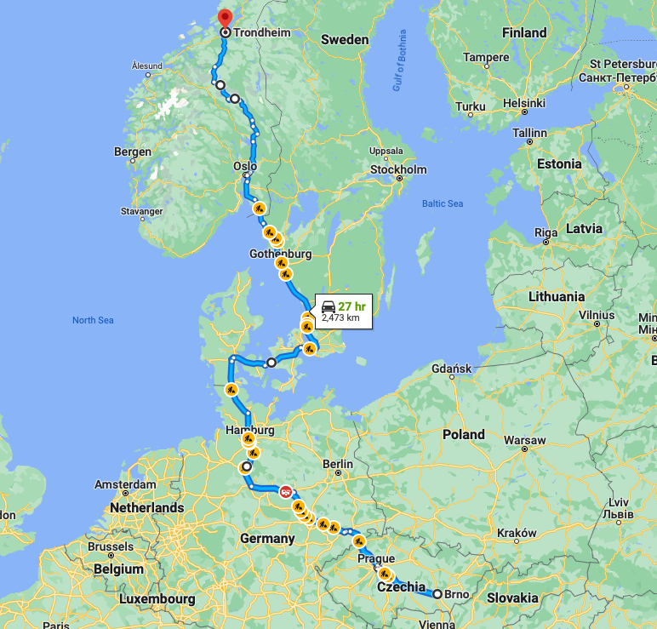

Brno - Trondheim

Slide 3

Computational material science

Slide 4
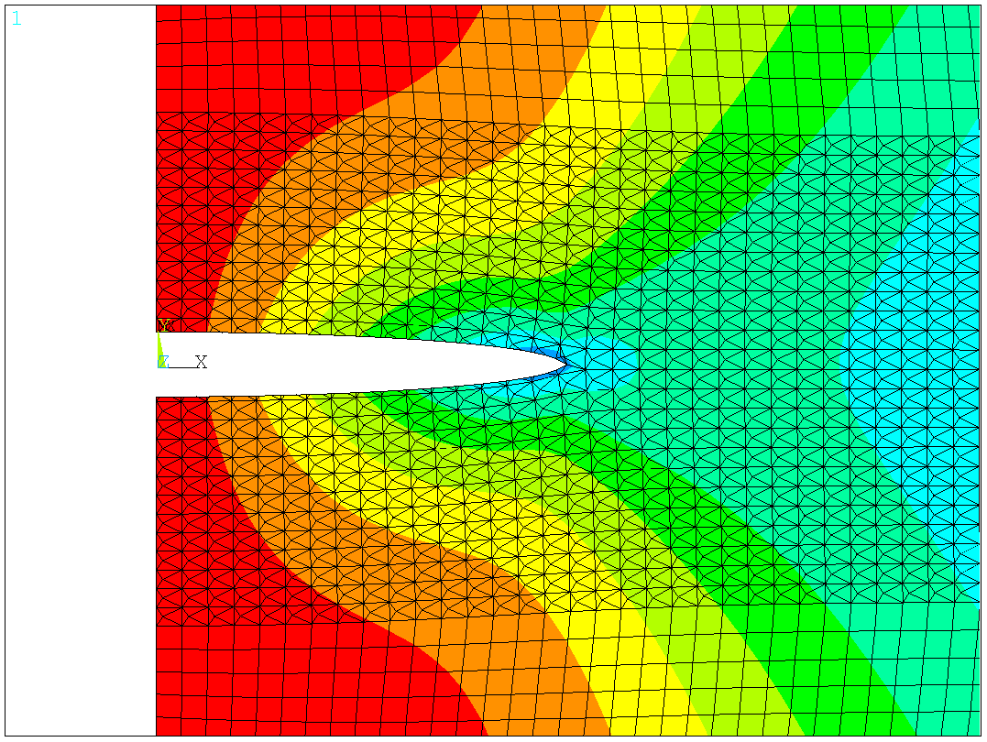
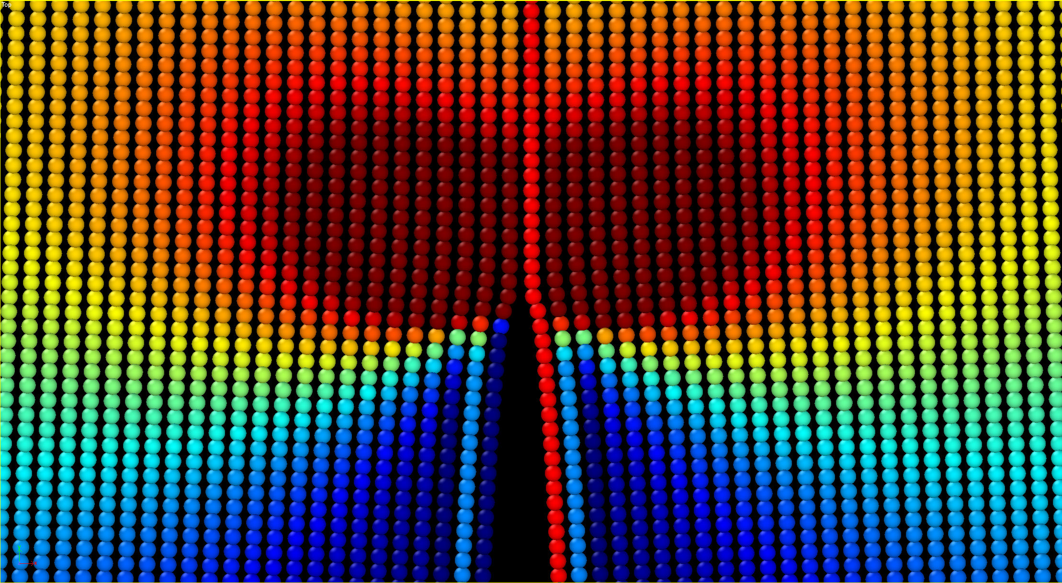
Multiscale modeling
continuum model
finite elements
microstructure
discipline
physics – chemistry – mat. science – engineering
atomistic model
molecular dynamics
quantum mechanics
ab initio
nm
μm
mm
m
length

Slide 5
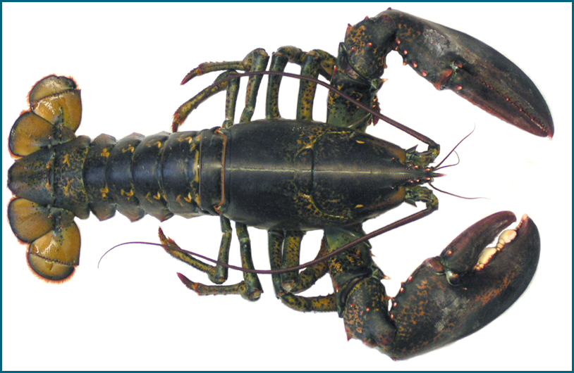
Sample of multiscale modeling
Cuticle of Homarus americanus

Slide 6
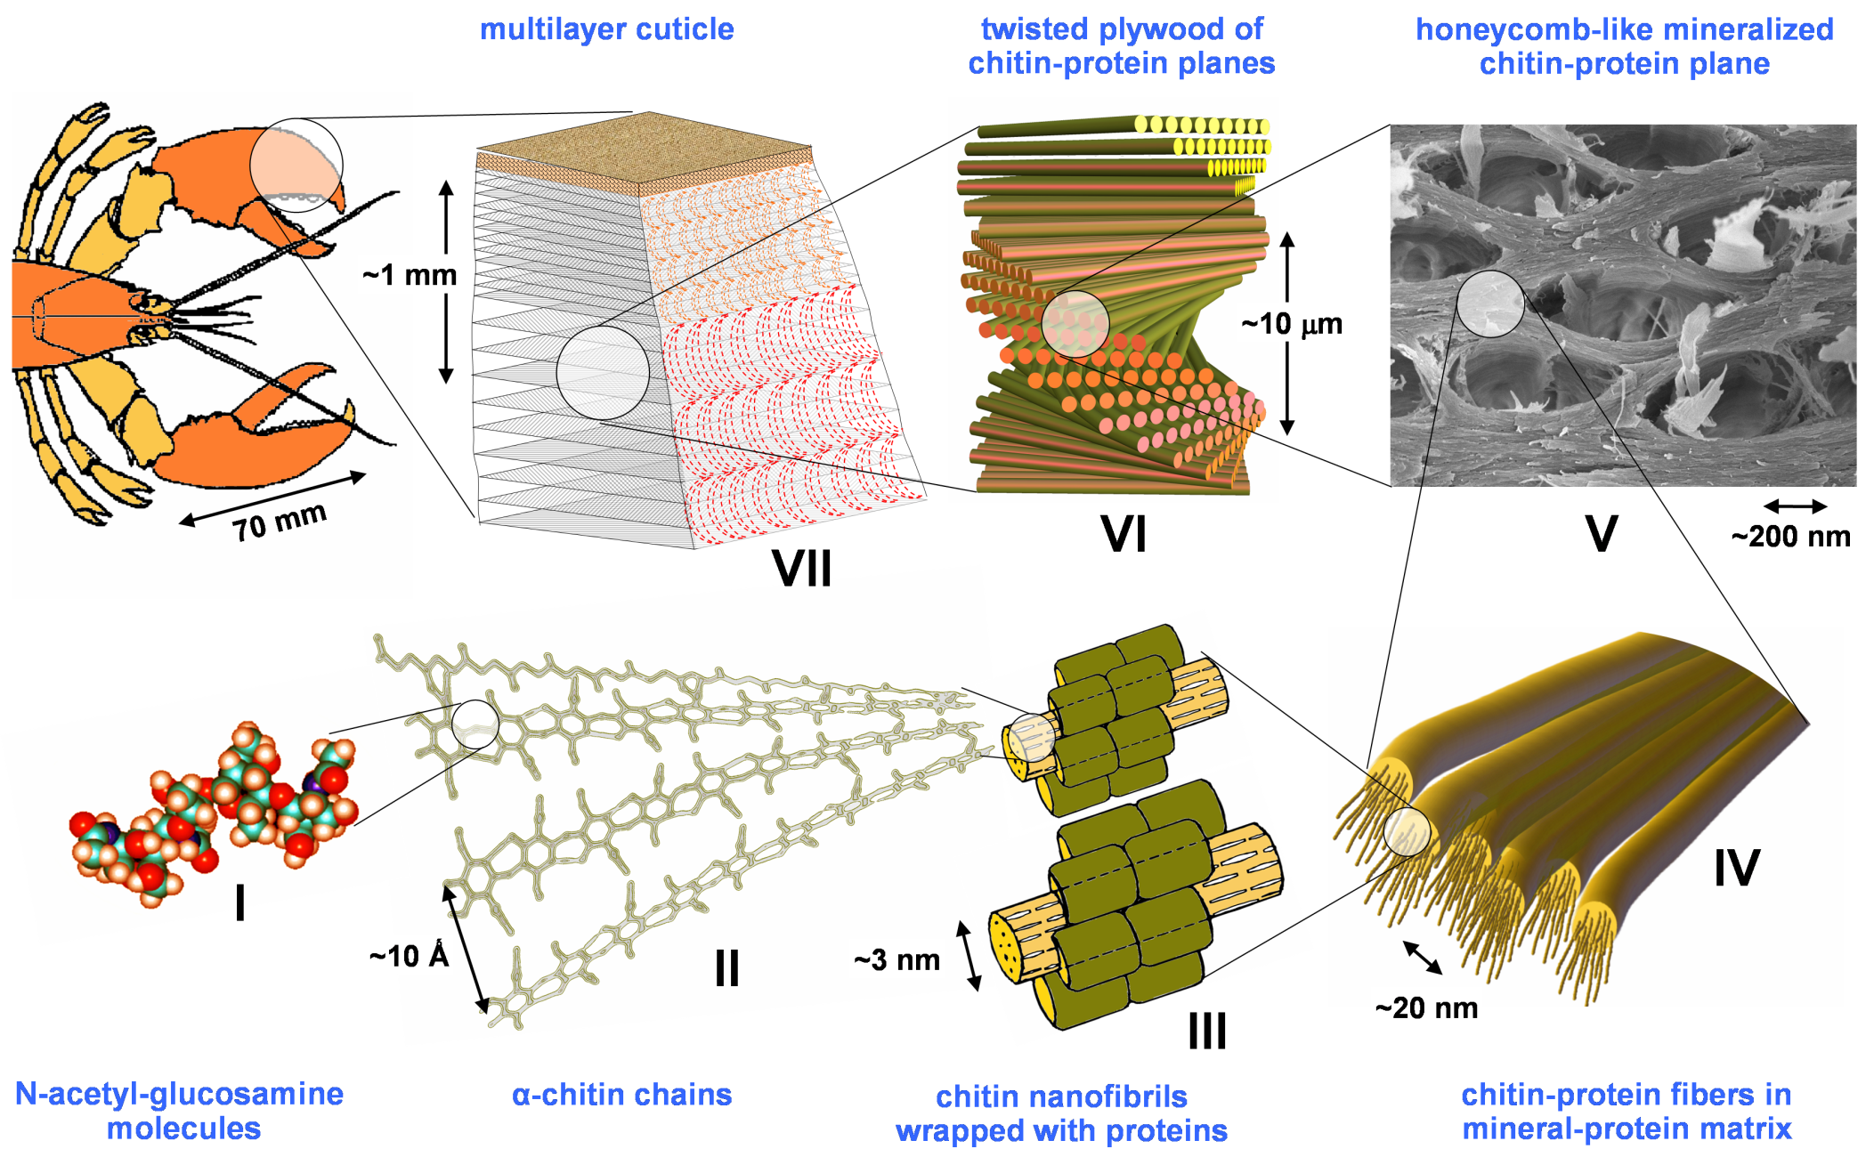
From milimeters to nanometers
D. Raabe et al. / Acta Materialia 53 (2005) 4281 - 4292

Slide 7
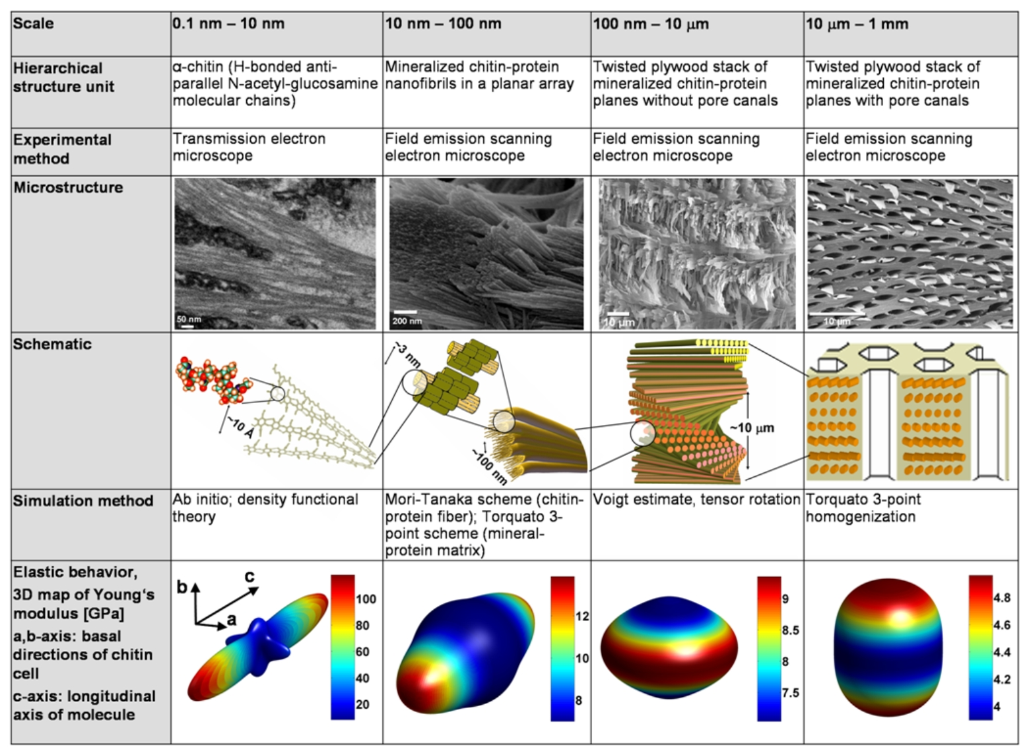
Multi-scale changes in the elastic anisotropy
Advanced Materials 22 (2010) 519.

Slide 8
Ab initio simulations and molecular dynamics
Molecular Dynamics | Ab initio
easy – based on Newton mechanics | results from Quantum Mechanics
simulations of large scale system with planar defects, temperature | magnetic, optical, electrical, etc. characteristics
potentials require calibration (Ni-Ni, Ni-Ti, etc.) | accuracy, no input data needed
finite temperatures | no temperature – simul. at absolute zero temp.
milions of atoms | limited to small systems (approx. 100-1000 atoms)
 | standard DFT no vdW but has been impl.
requires HPC (High Performance Computing) | requires HPC (High Performance Computing)
-
-
-
-
Ab initio is very often used for calibration of MD potentials.

Slide 9
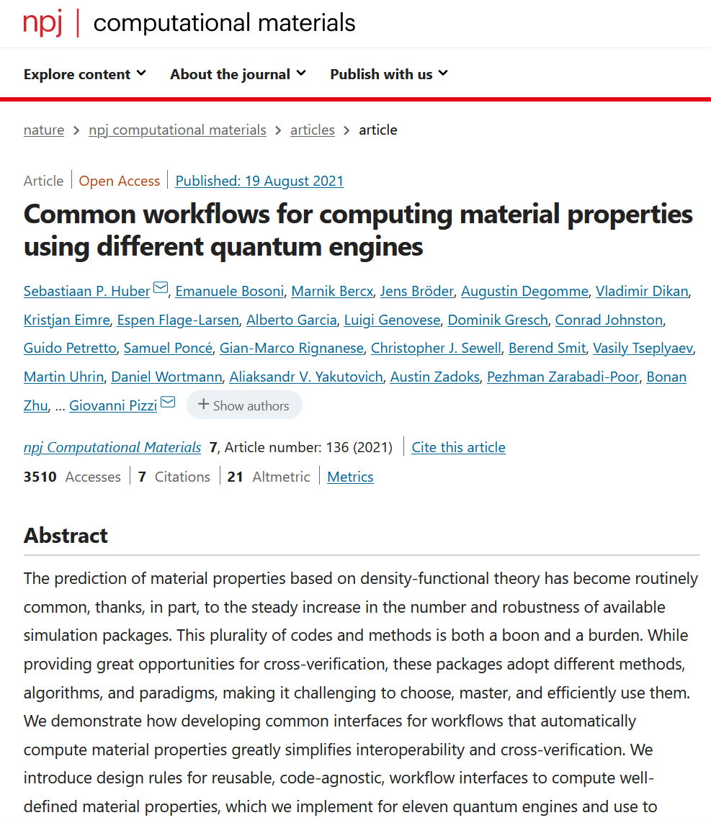
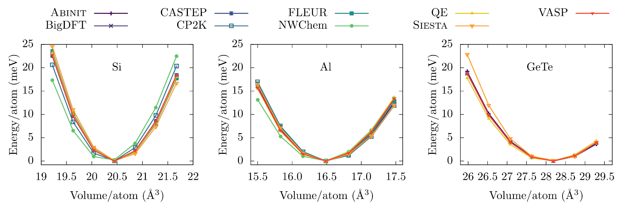
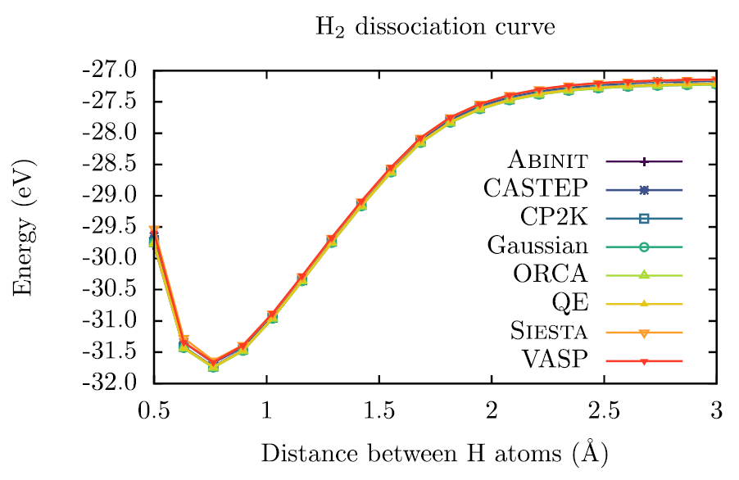
Results replicability over ab initio codes

Slide 10
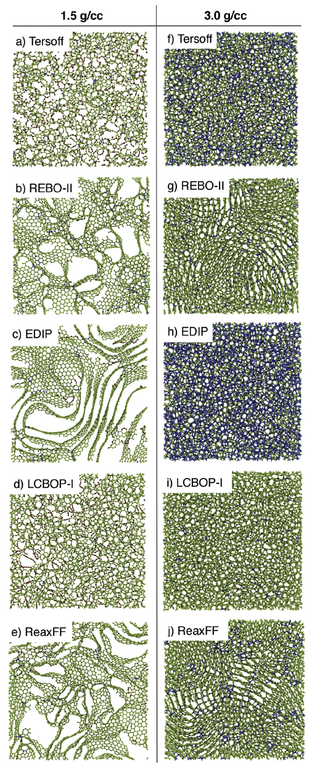
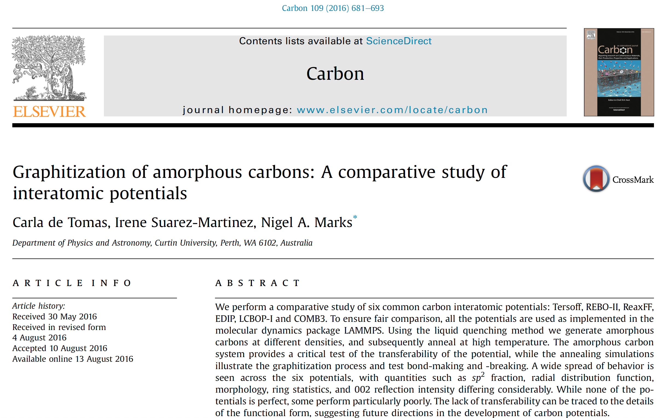
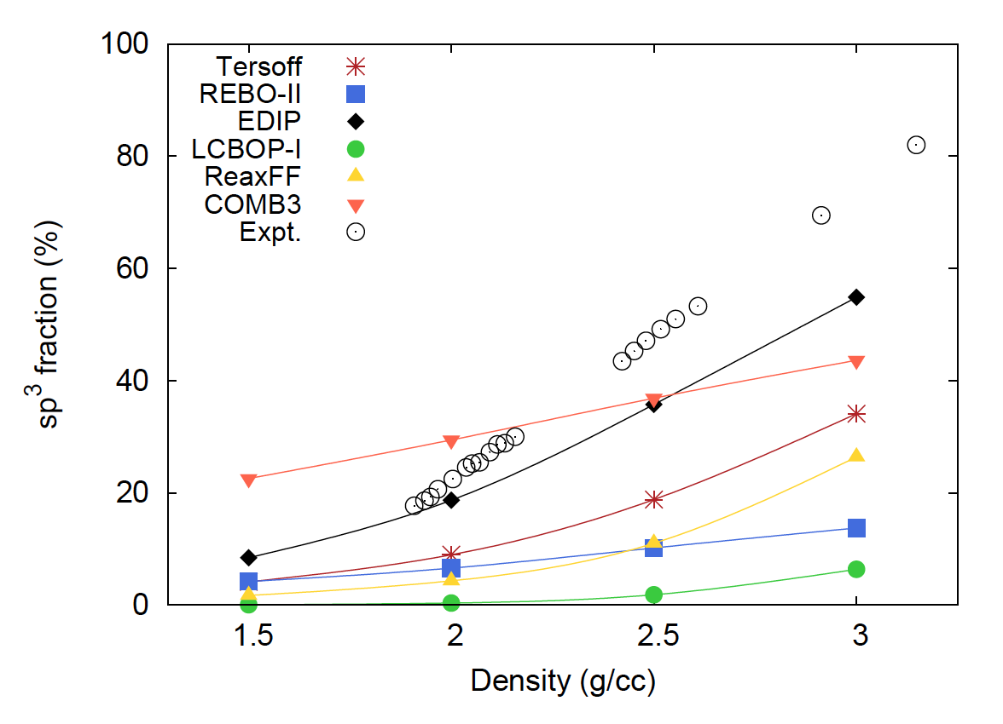
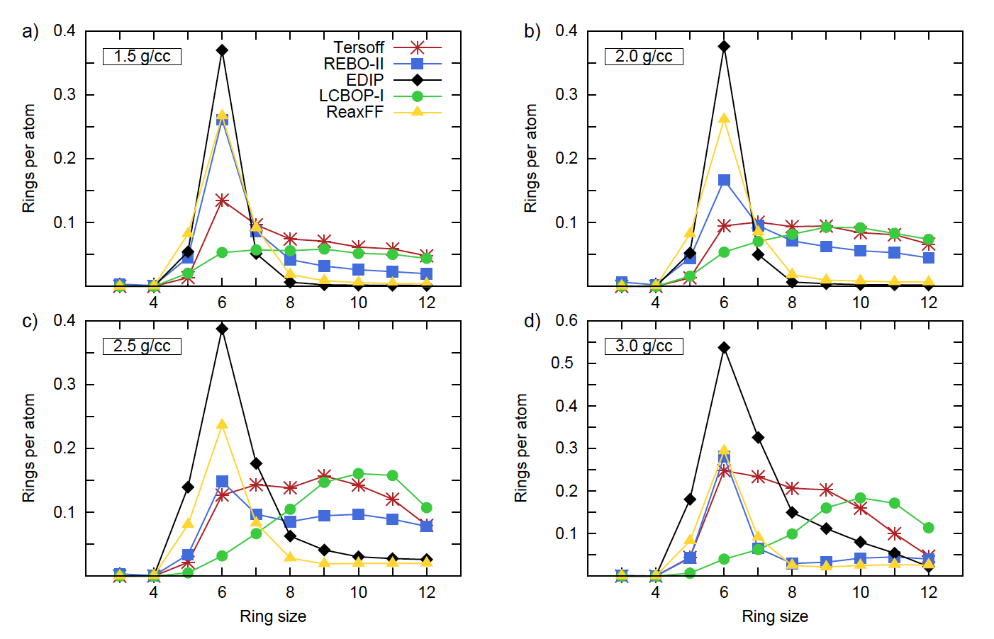
Carbon predictions over available MD potentials

Slide 11
Comments from scientific audience
I believe in DFT calculations but I do not believe in DFT models.
We need quantum computers!
MD potentials can reflects behavior they were tested for.
Precision must be improved!

Slide 12
How to get DFT precision into MD??

Slide 13

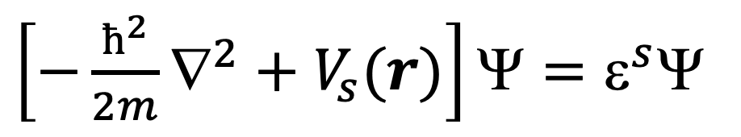
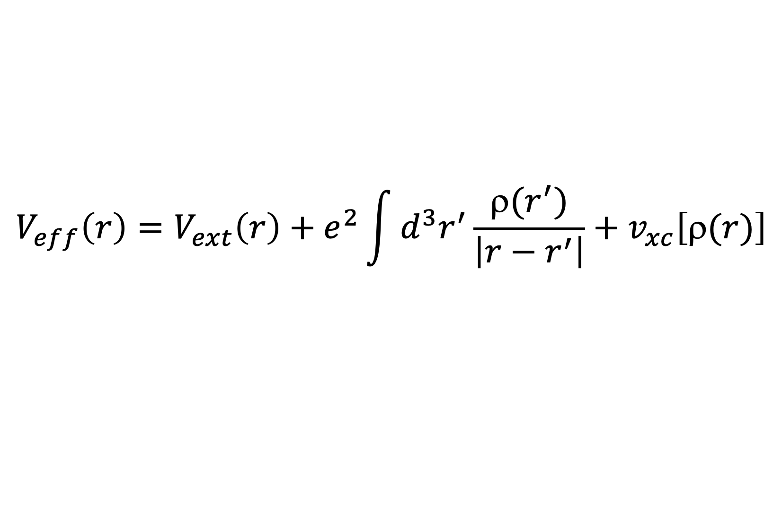
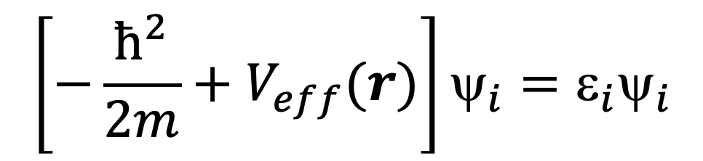
Ab initio methods (first principles)
The most used ab initio codes
based on:
DFT – Density Functional Theory*
Schrödinger | DFT – Kohn Sham equation
many body electron interaction | electron interacting with external potential created by ions and electrons
difficult to solve for more than 2 electrons | can be solved
interaction: electron-electron, ion-electron and ion-ion
$\left[−\frac{ħ^{2}}{2m}∇^{2}+V_{s}(r)\right]Ψ=ε^{s}$Ψ
$$\left[−\frac{ħ^{2}}{2m}+V_{eff}(r)\right]ψ_{i}=ε_{i}ψ_{i}$$
$$V_{eff}\left(r\right)=V_{ext}\left(r\right)+e^{2}\int{d^{3}r^{′}\frac{ρ(r^{′})}{\left|r−r^{′}\right|}+v_{xc}\left[ρ(r)\right]}$$
*W. Kohn and J. L. Sham; Phys. Rev. 140 (1965) A1133
*P. Hohenberg and W. Kohn; Phys. Rev. 136 (1964) B864-871

Slide 14
DFT self-consistent cycle

Slide 15



Ab initio methods (first principles)
computational codes
  VASP (Vienna Ab initio Simulation Package) – pseudopotentials (www.vasp.at)
    commercial license
    it is used very often
    available pseudopotentials are very well tested
    hybrid pseudopotentials
  Abinit – pseudopotentials (www.abinit.org)
    free under GNU license
    generation of pseudopotentials by users
    some extra features than other codes (Linear Response Functions - direct calculation of phonon spectra, elastic constants, etc.)
    very good parallelization (using multithread program run)
  Wien2k – all electron (no pseudopot.) (www.wien2k.at)
    commercial license
    computationally more demanding than VASP or Abinit
    good parallelization
    no pseudopotential – all electron code
pseudopotentials
  PAW (Projector Augmented Waves), ultra-soft, norm-conserving
  exchange – correlation energy:
    LDA – Local Density Approximation
    GGA BPE – Berdew Burke Ernzerhof
    GGA PW – Perdew Wang

Slide 16
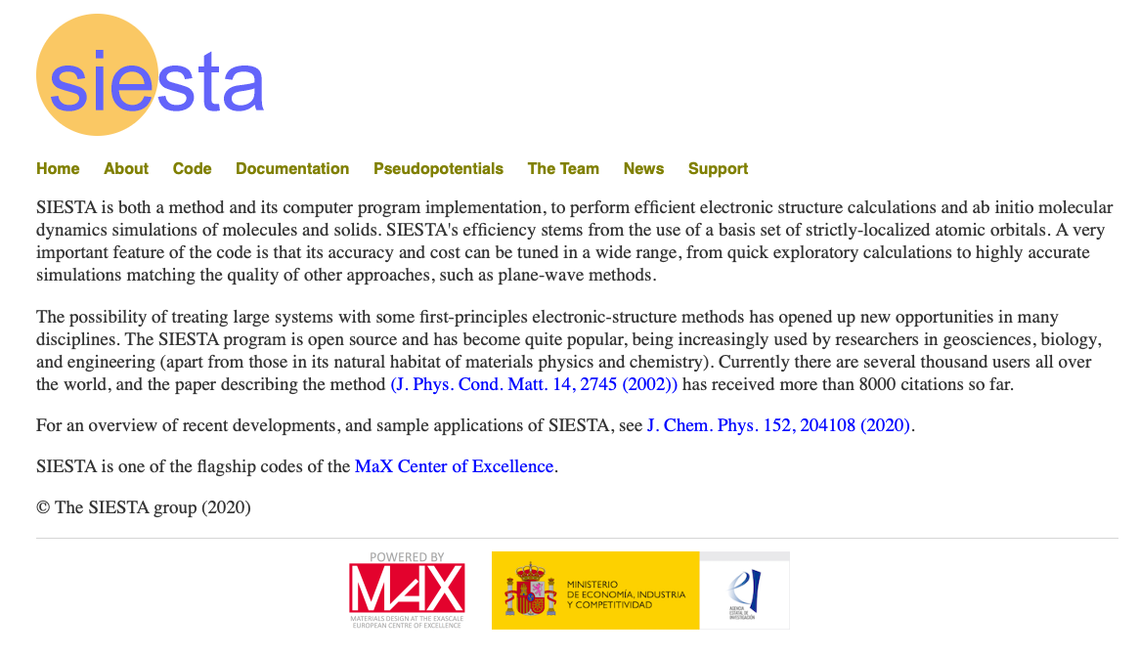

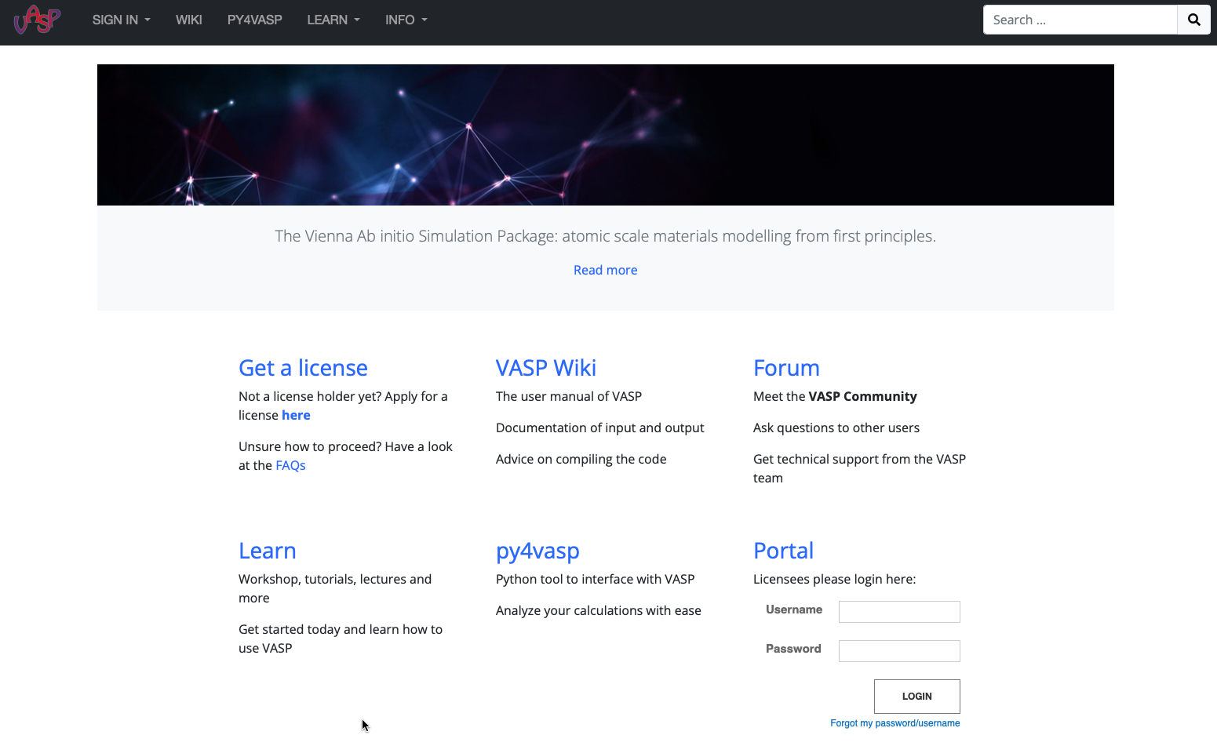
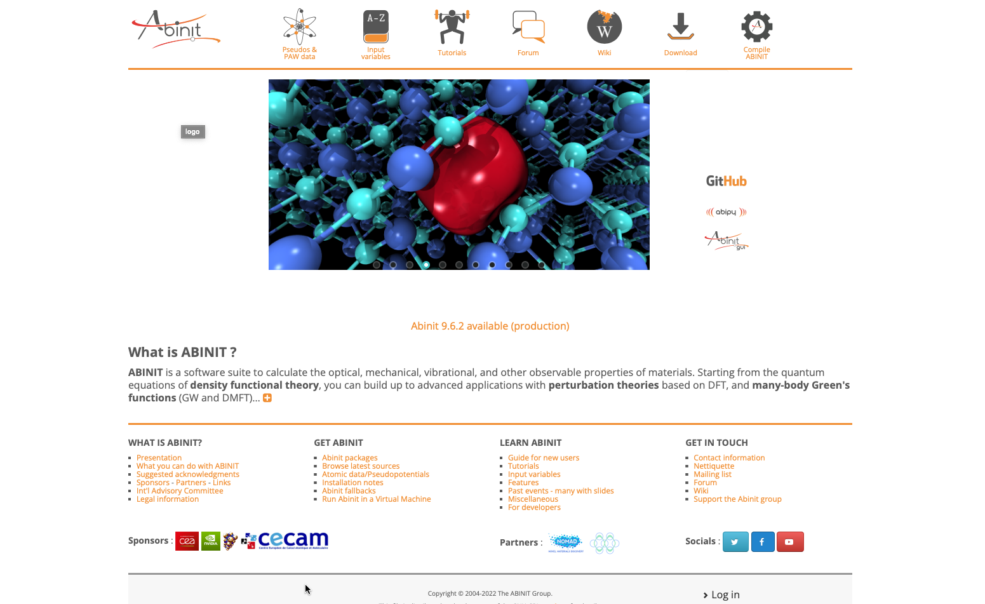
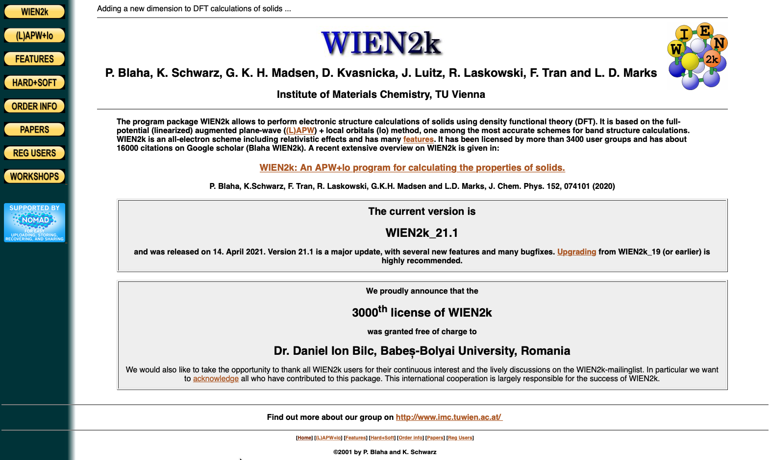
Available codes

Slide 17
Available codes
AND MANY MORE

Slide 18
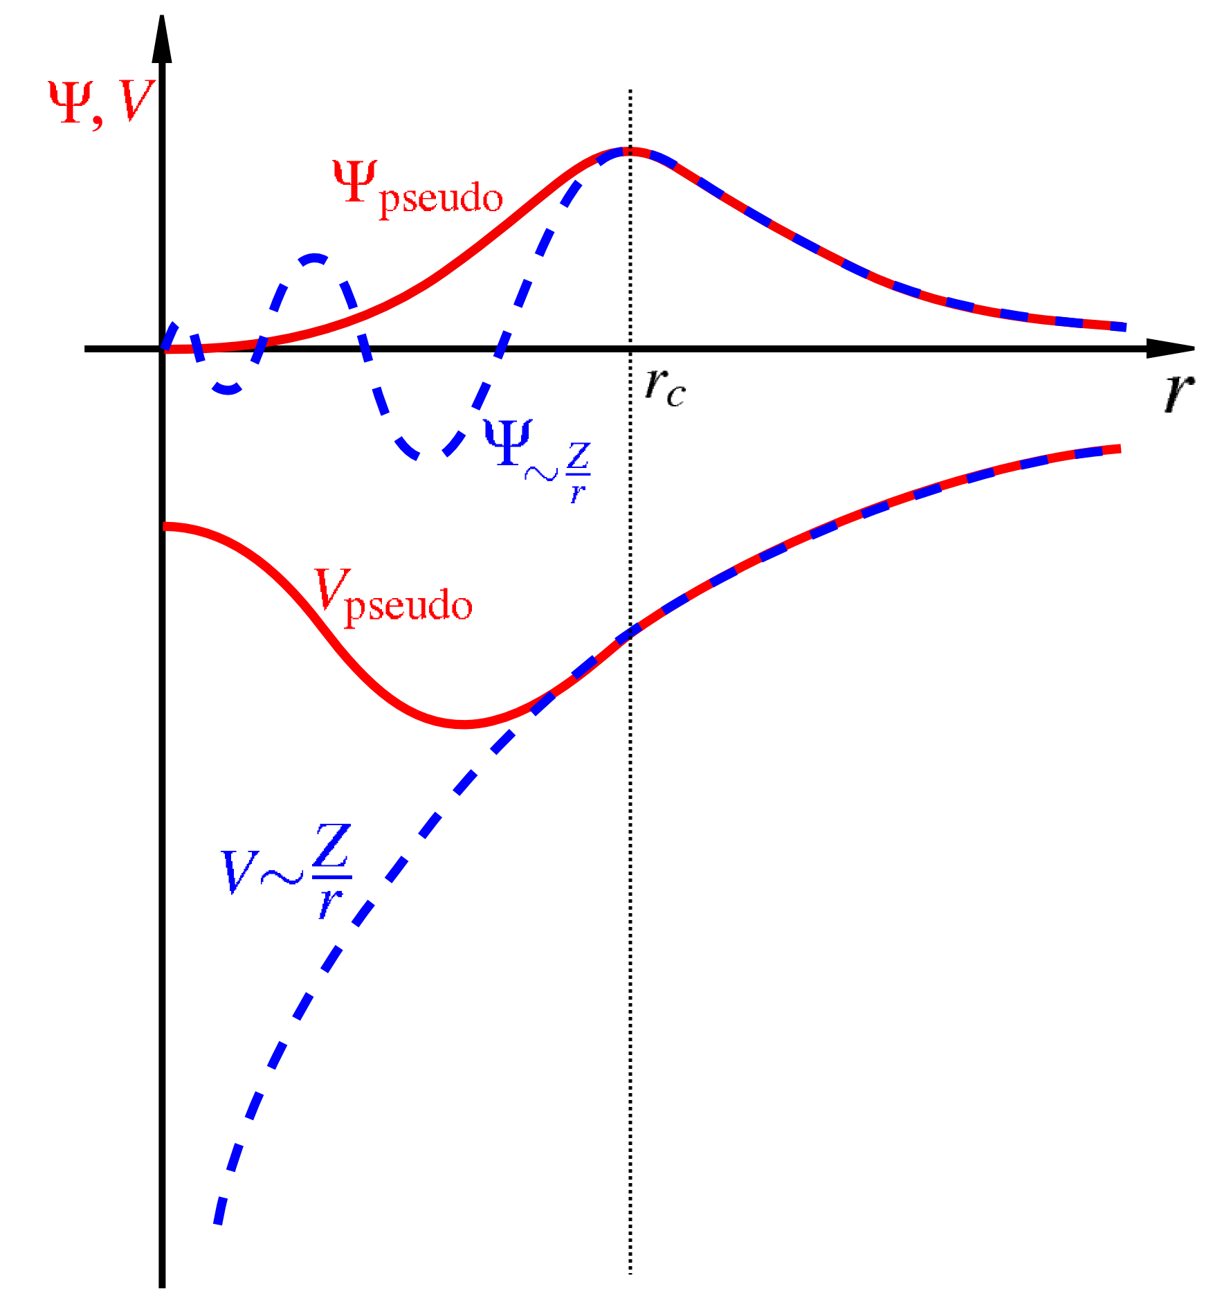
Pseudopotential approach
Pseudopotential is a very efficient way how to reliably describe valence electrons. Core electrons are kept frozen in their configurations – they are considered as a rigid non-polarizable ion cores while valence electrons are precisely described.
Types:
  norm-conserving – very old, inappropriate for magnetic mat.,
  ultrasoft,
  PAW – Projector Augmented Waves
  (the most used pseudopotential,
  recommended for VASP* or Abinit**).
*G. Kresse and D. Joubert; Phys. Rev. B 59 (1999) 1758-1775
**M. Torrent et al.; Comp. Mater. Sci. 42 (2008) 337-351

Slide 19
available outputs from Ab initio simulation
the total energy of studied system (important are changes of the energy for different structure configurations)
the stress tensor along with all forces acting on each atom
phonon spectra computed by direct method or Linear Response Function
optical properties of materials
electrical properties of materials (dielectric constants)
Density of States (DOS) - band gap energy of semiconductors
charge density
structure optimization – positions and cell shape (find the structure configuration with the lowest total energy)
structure optimization under specified conditions – cell shape optimizations with constant volume, etc.

Slide 20
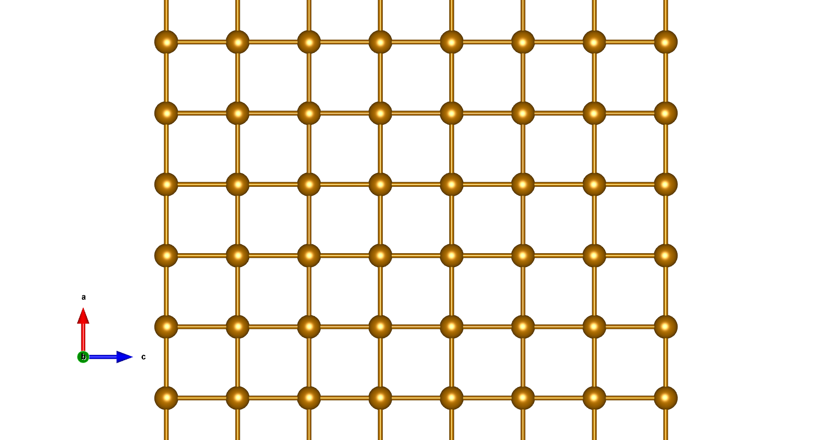
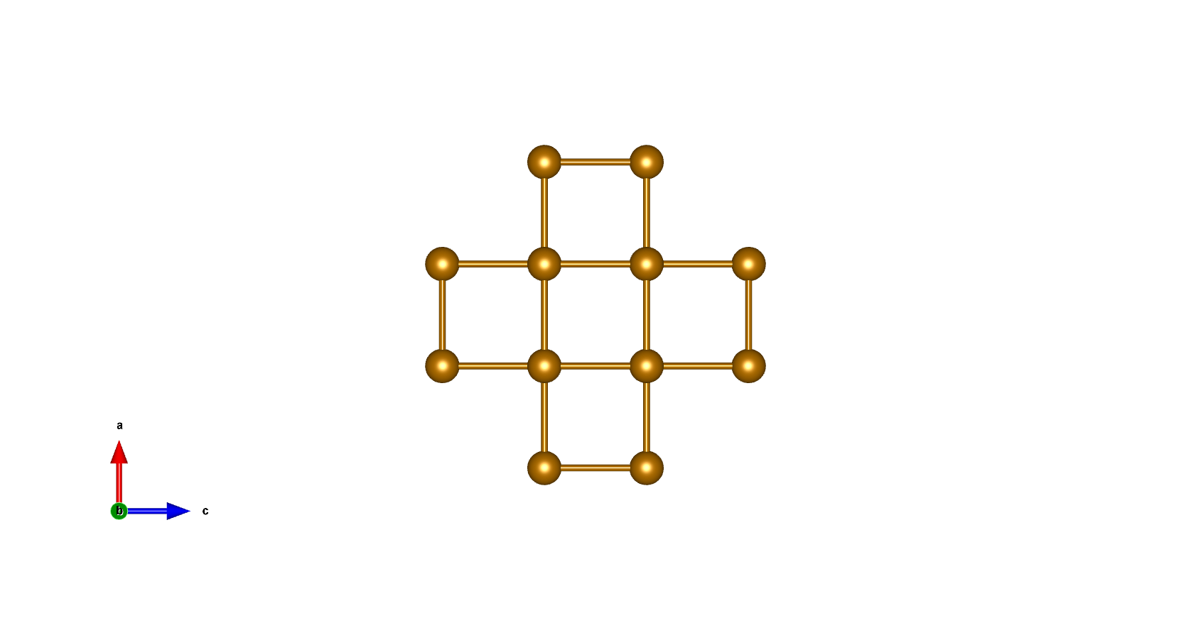
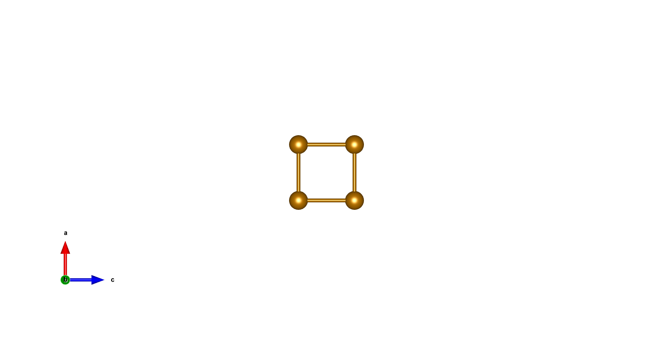
Periodic boundary conditions

Slide 21
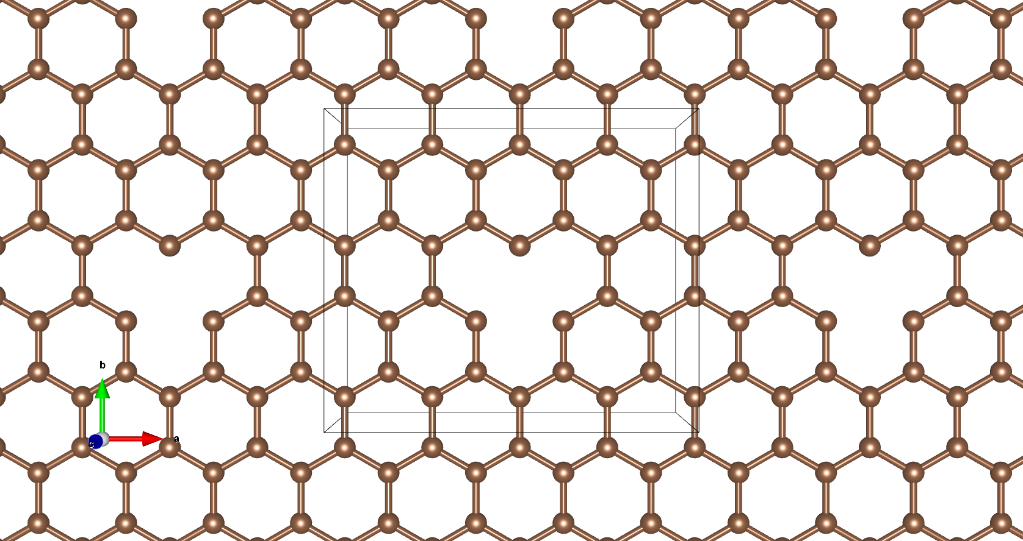
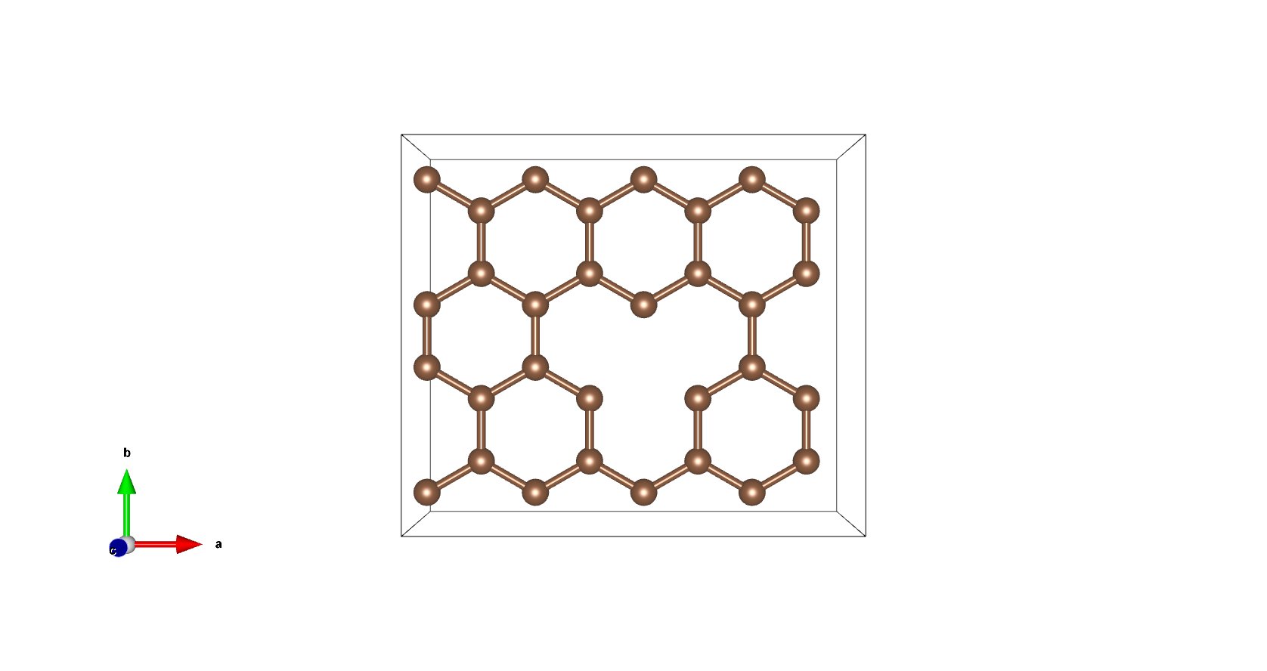
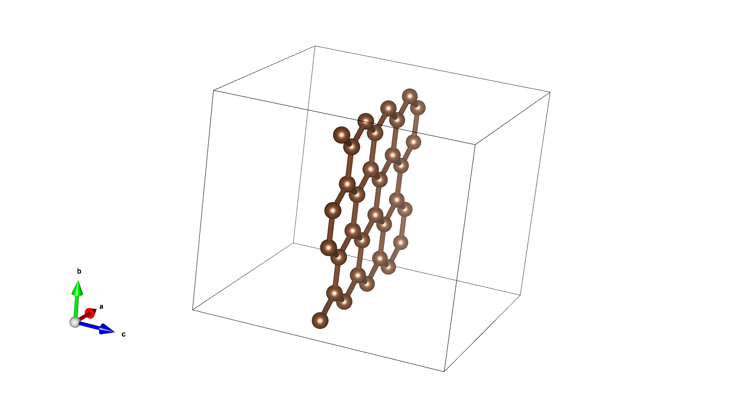
Periodic boundary conditions
Large structures

Slide 22
Periodic boundary conditions
Large structures
some youtube sample
https://www.youtube.com/watch?v=5qdNafdyaG0

Slide 23
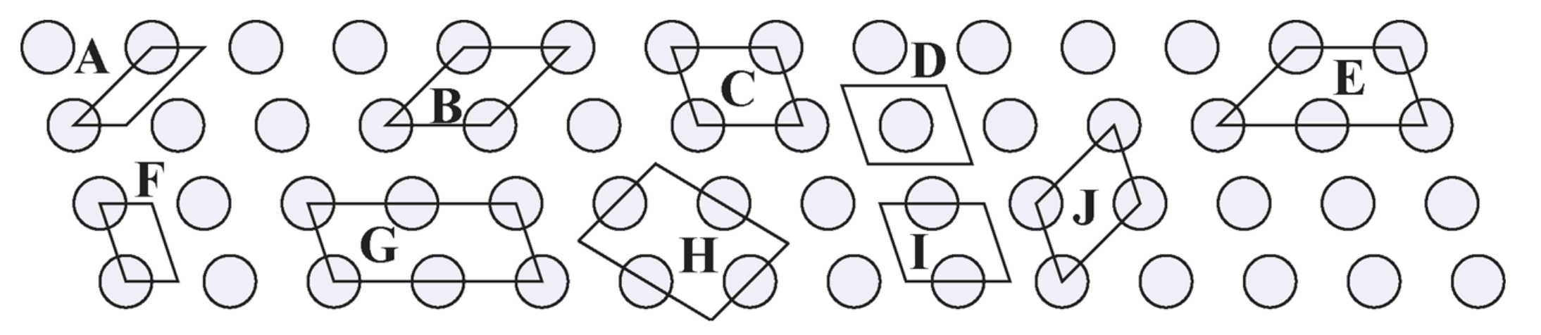
Periodic boundary conditions

Slide 24
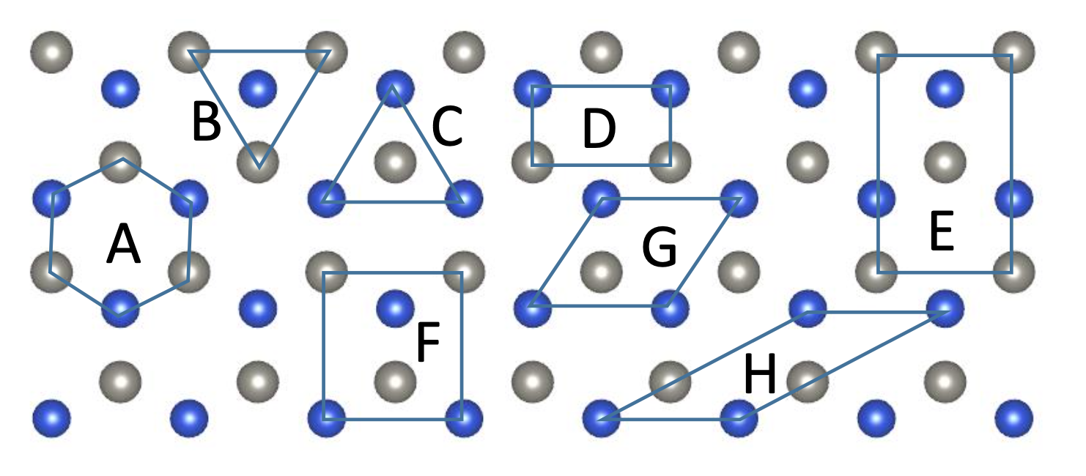
Periodic boundary conditions

Slide 25
VASP – output examples
tensile test of graphene sheets

Slide 26
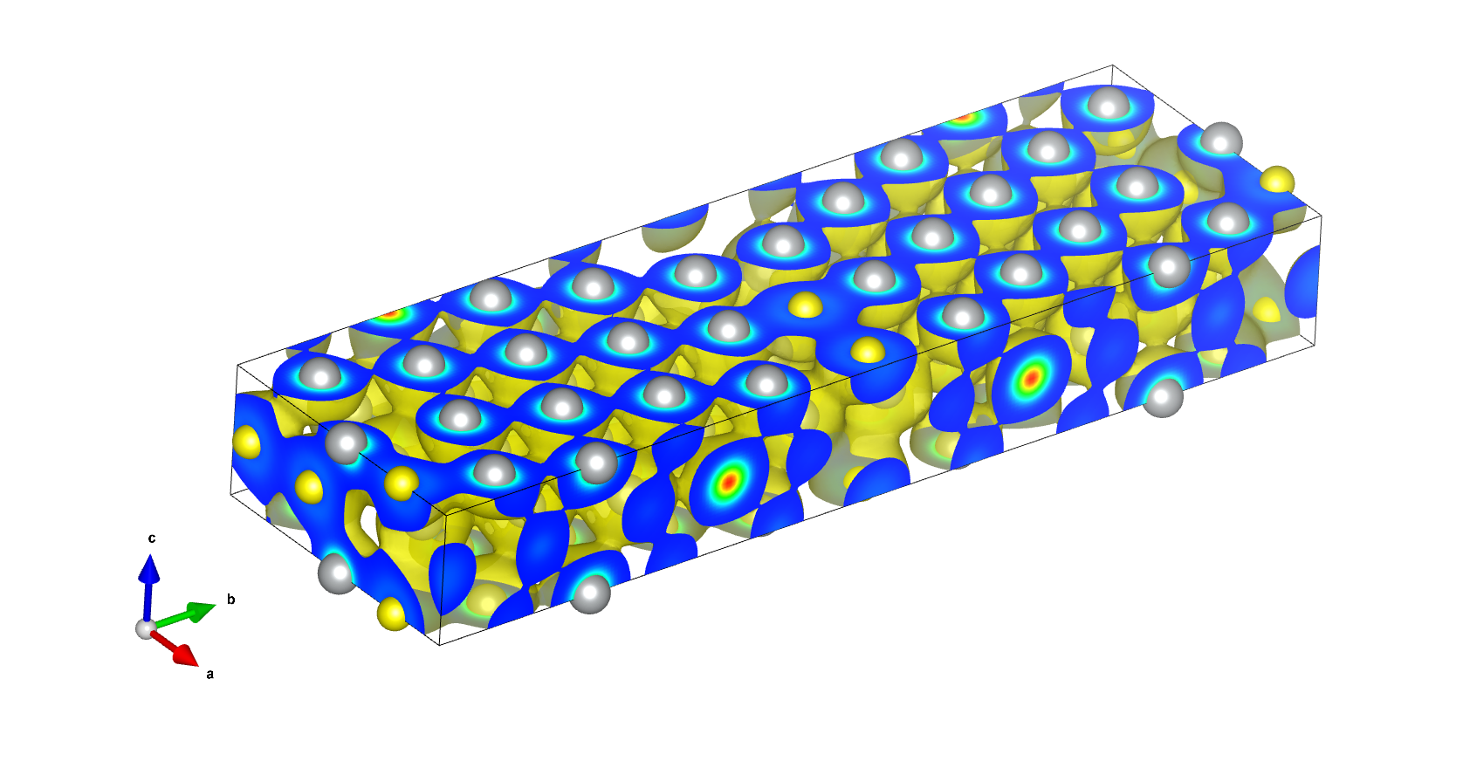
VASP – output examples charge density
Sample of 3D charge density of ∑5 (210) grain boundary.

Slide 27
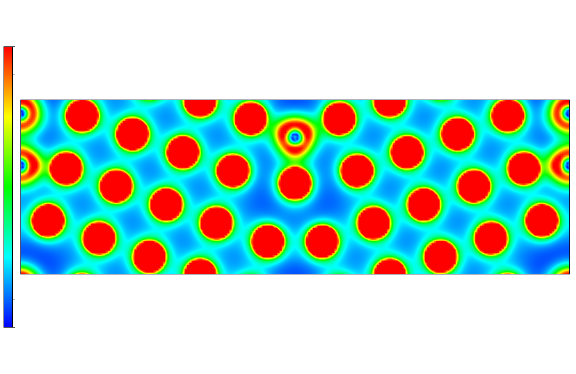
VASP – output examples charge density
Sample of 2D charge density of ∑5 (210) grain boundary.
an impurity atom

Slide 28
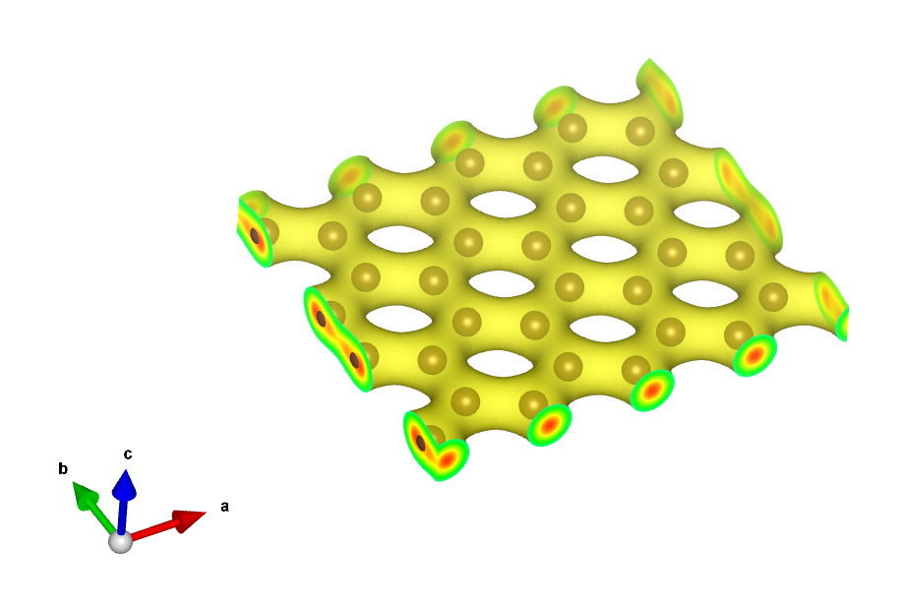
VASP – output examples: charge density
Sample of 3D charge density of graphene sheet.

Slide 29
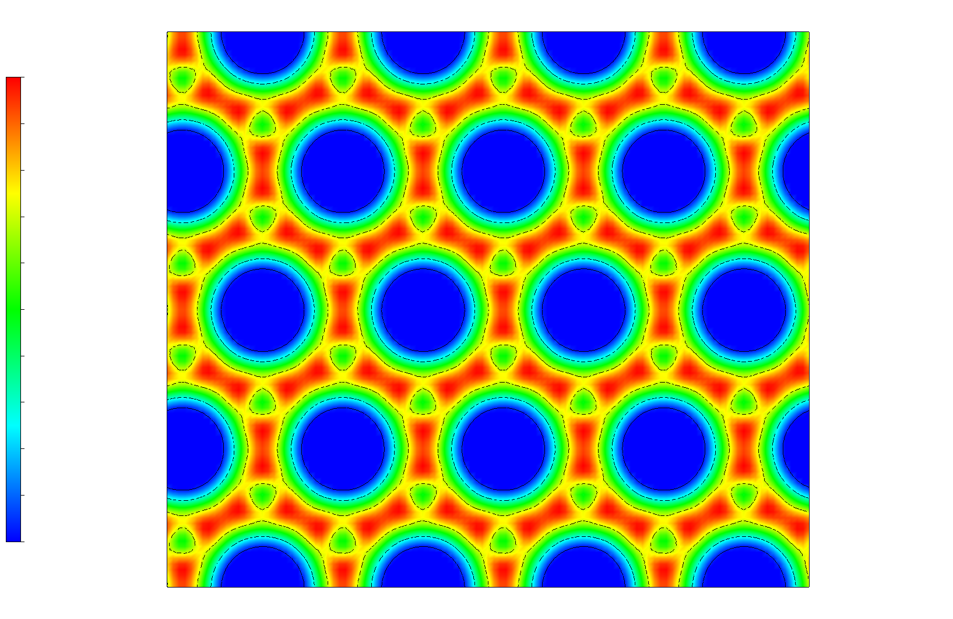
VASP – output examples: charge density
Sample of 2D charge density of graphene sheet.

Slide 30
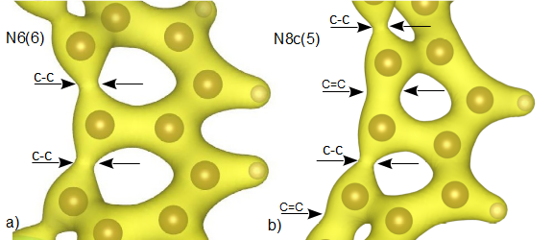
Charge density strong and weak bonds
*P. Sestak,J. Wu,J. He,J. Pokluda and Z. Zhang; Phys. Chem. Chem. Phys. 17 (2015) 18684 DOI: 10.1039/c5cp02043c59

Slide 31
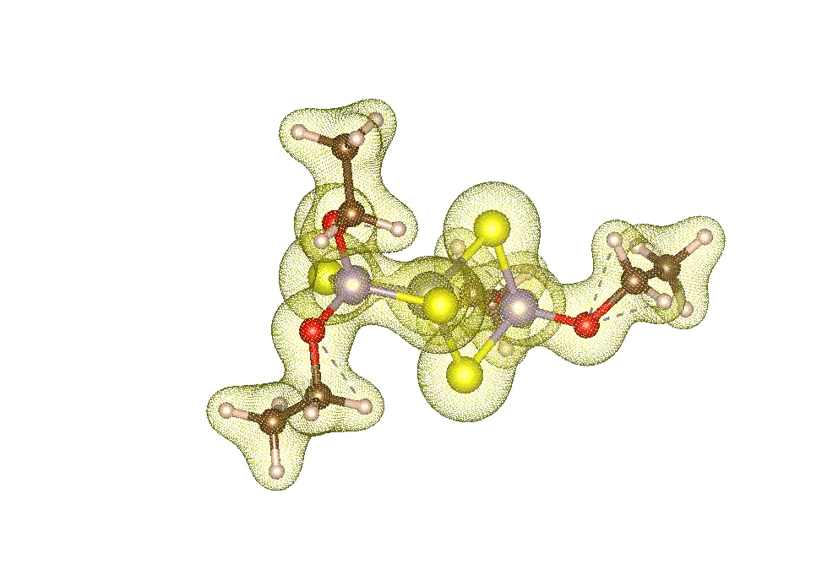
Charge density of molecules

Slide 32
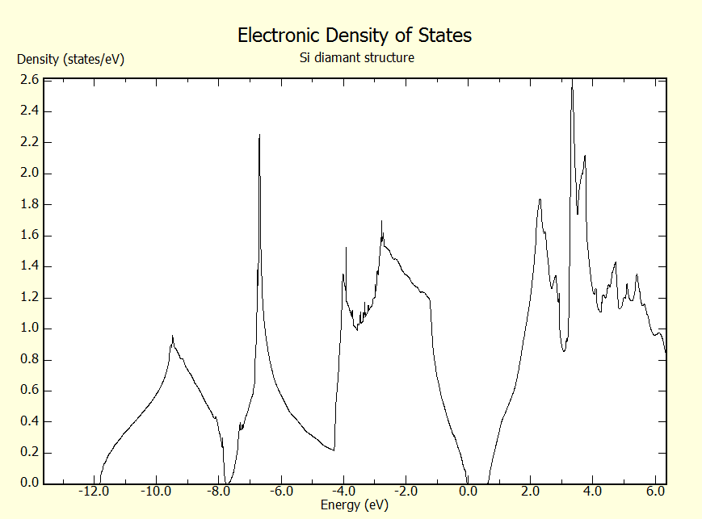
VASP – output examples: density of states
Sample of Si density of states - SEMICONDUCTOR.

Slide 33
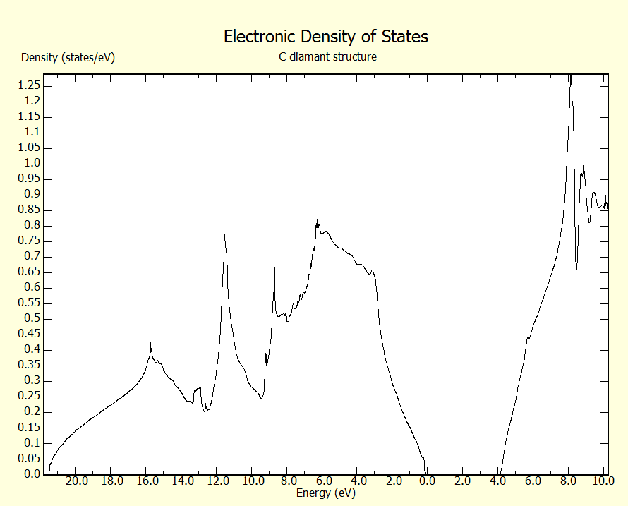
VASP – output examples: density of states
Sample of C density of states - INSULATOR.

Slide 34
AIMD - ab initio molecular dynamics

Slide 35
MD fundamental scheme
structure – initial position and velocities
topology – molecular description
forces are determined from the DFT calculations
force fields – potential functions V of interactions
compute forces
update r and v in repeating in N steps
solve Newton equation
of motion
output – position, velocities energies

Slide 36
Ai initio molecular dynamics calculations
Taking advantages and disadvantages of ab initio and MD simulations.
  disadvantages:
    the simulation space/cell is small (up to 1000 of atoms)
    only thousands of the time steps (for time step 1fs → entire time 1-10 ns)
    for the VASP the simulations are performed under constant volume
    minimal number of atoms should be at least 200 to achieve enough interaction for the MD
  advantages:
    NO potentials required
    temperature included
    precise simulations → computed from electronic density
    magnetism included

Slide 37
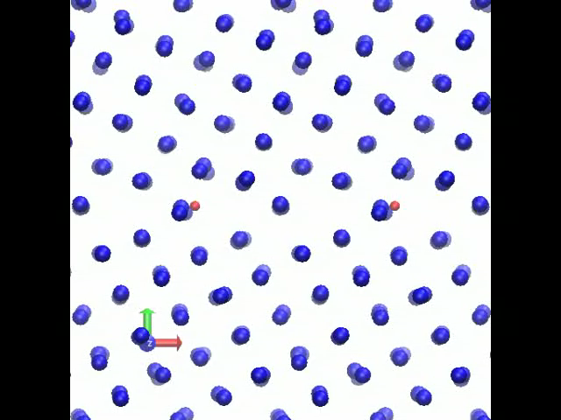
First principles molecular dynamics calculations GB+H

Slide 38
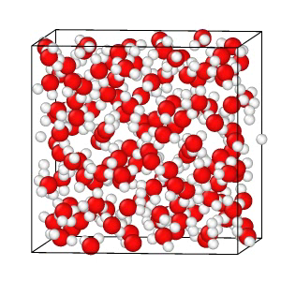
Hydrate – something went wrong

Slide 39
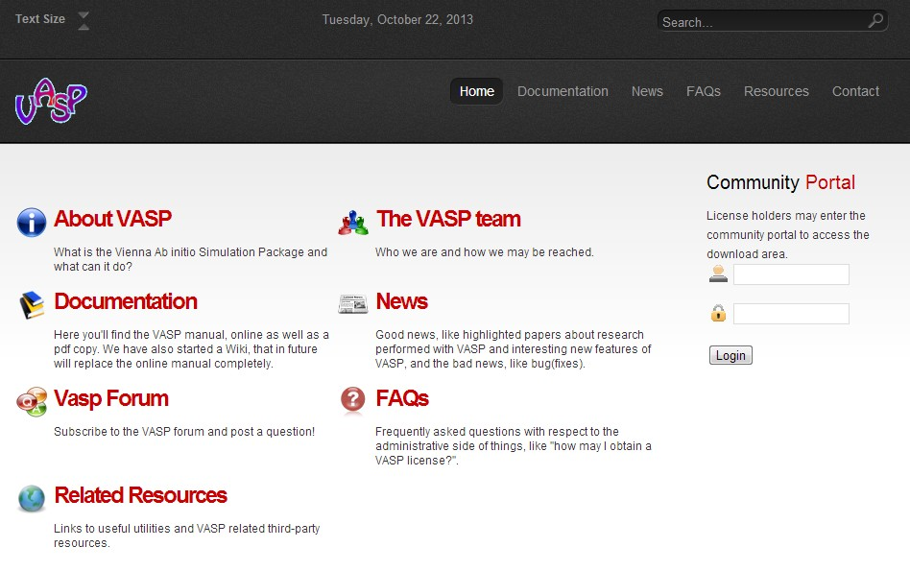
VASP
www.vasp.at
  documentation
  tutorials
  forum

Slide 40
When we should use the DFT?
Can be our problem described using a small unit cell (nanoscale, around 10nm)?
Does temperature play important role?
How many elements from the periodic table are introduced?
What quantity (physical, chemical, etc. ) am I looking for?
Validating of MD potentials.

Slide 41
Car-Parrinello Methods www.cpmd.org

Slide 42
Let’s go to some examples
Questions?
Acknowledgement
This lecture is supported by the project
of the EEA Grants with reg. num. EHP-CZ-ICP-3-012
of Brno University of Technology

Slide 43
HPC – High Performance Computing
HPC introduction

Slide 44
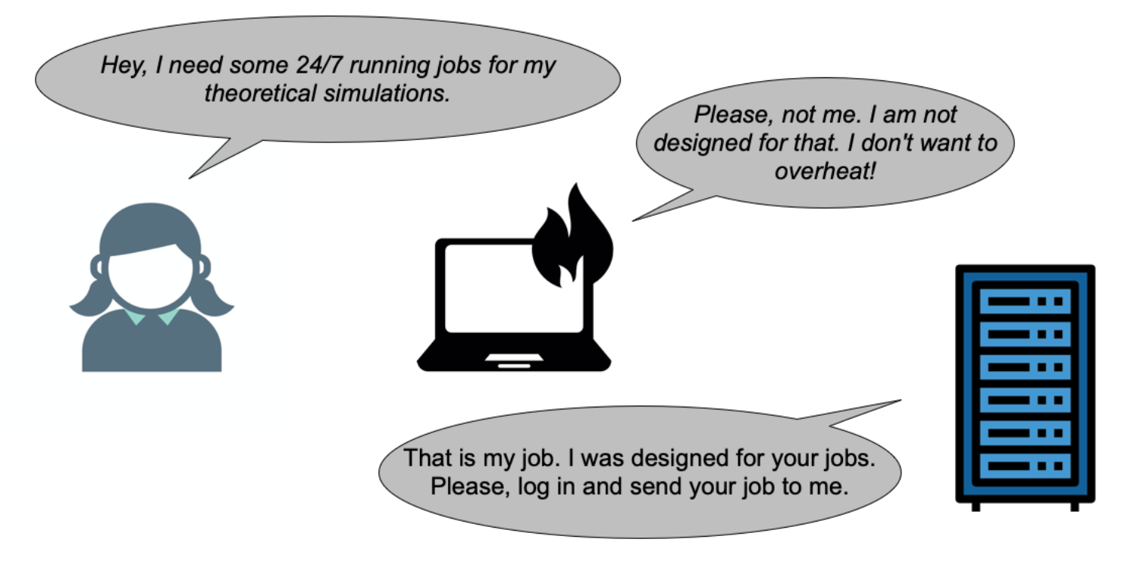
HPC – High Performance Computing

Slide 45

HPC – High Performance Computing

Slide 46
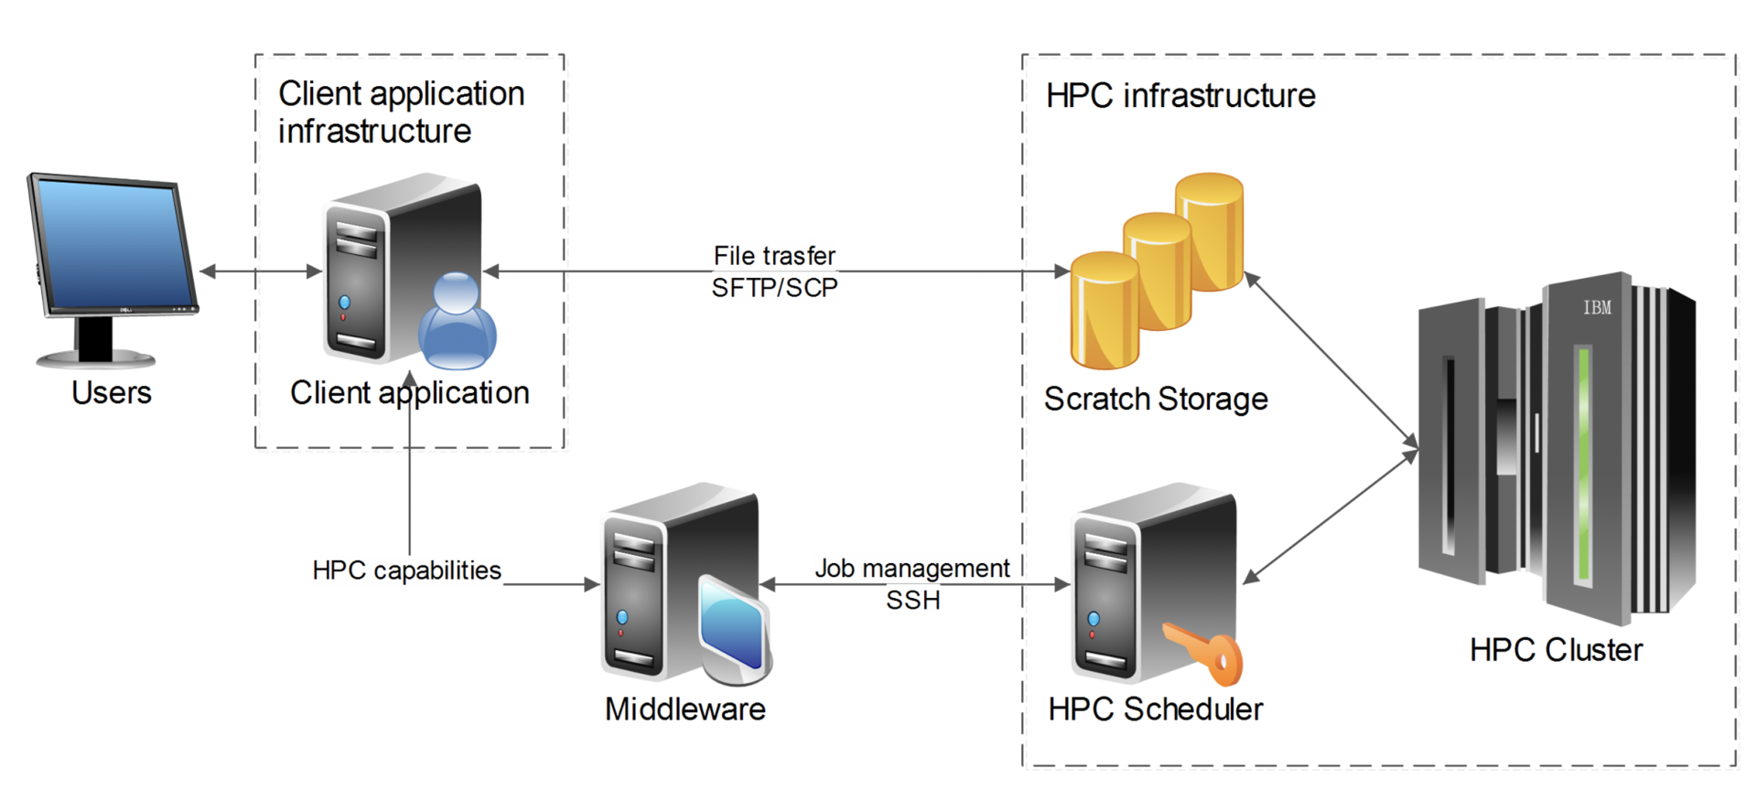
HPC – High Performance Computing
https://www.it4i.cz/en/research/research-flagships

Slide 47
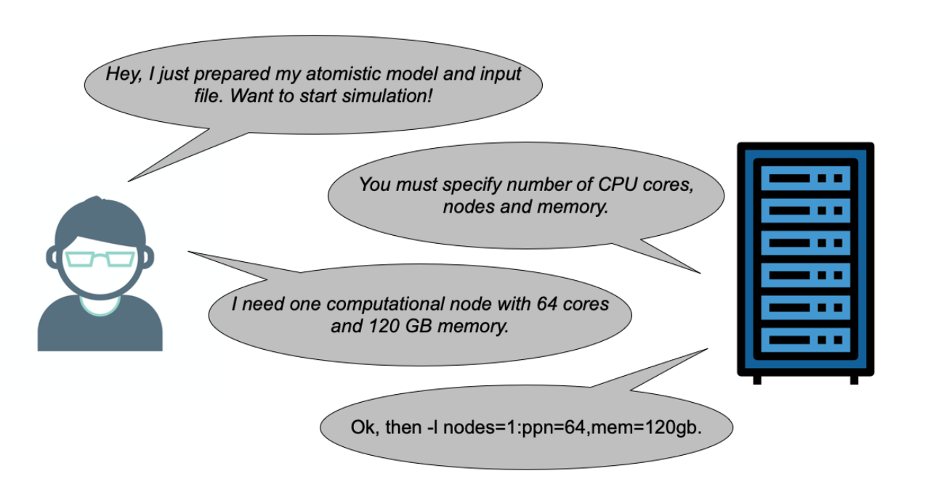
HPC – jobs submission

Slide 48
HPC – High Performance Computing
#!/bin/bash
#PBS -N NAMEJOB
#PBS -l nodes=1:ppn=64:epyc7551
#PBS -l mem=120gb
#PBS -q default
##PBS -l walltime=2:00:00
cd $PBS_O_WORKDIR
module add vasp-6.3.0-openmpi-4.1.0
mpirun vasp_std >log.txt

Slide 49
HPC – High Performance Computing
#!/usr/bin/bash
#SBATCH --job-name GPU
#SBATCH --account OPEN-29-39
#SBATCH --partition qgpu
#SBATCH --gpus 8
#SBATCH --nodes 1
#SBATCH --time 48:00:00
export OMP_NUM_THREADS=16
ml VASP/6.4.2-NVHPC-24.3-CUDA-12.3.0-CUDA-12.2.0
time mpirun -np 8 vasp_std >log.txt

Slide 50
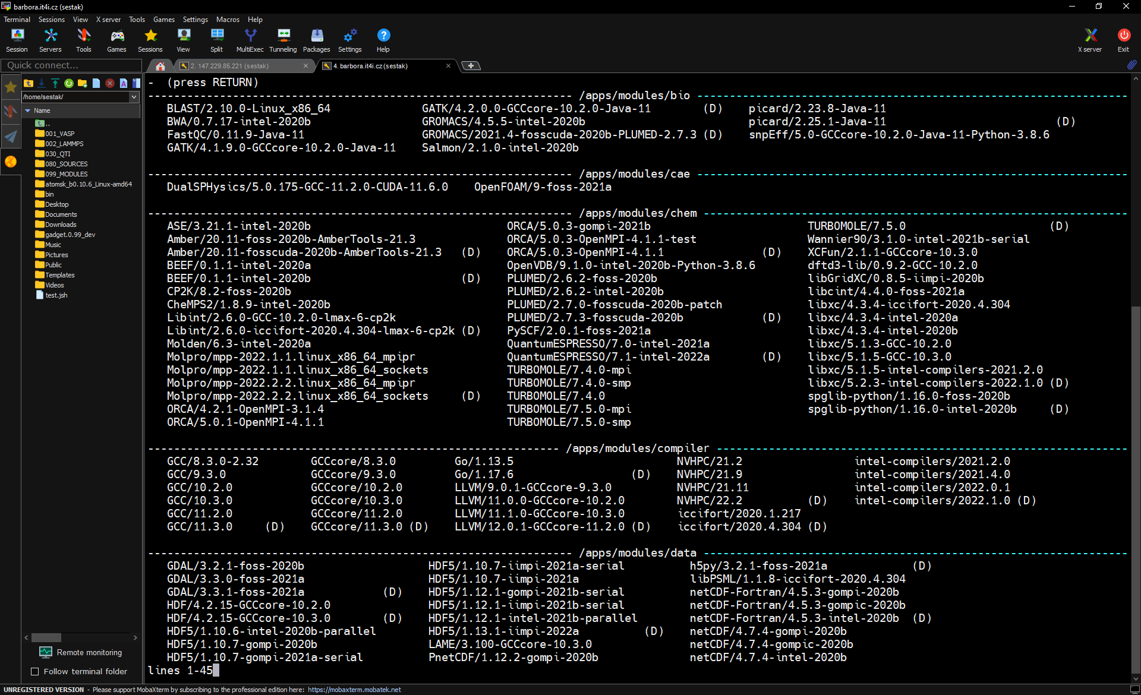
HPC – High Performance Computing

Slide 51
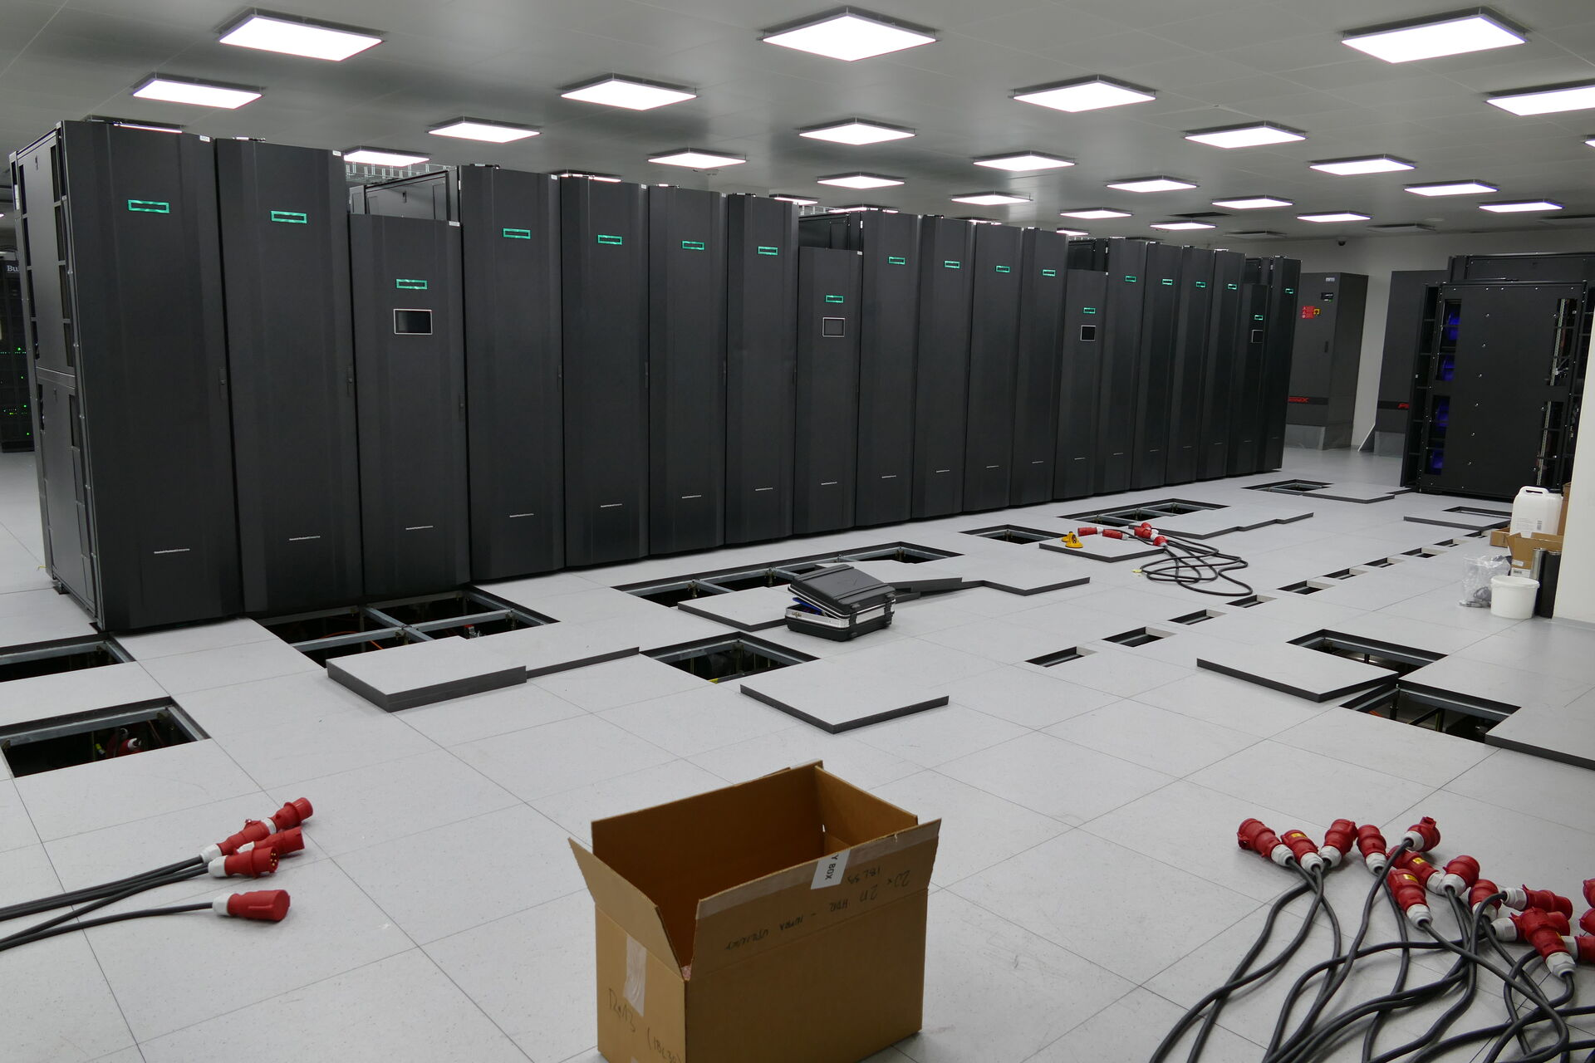
HPC – High Performance Computing
https://www.it4i.cz/en/infrastructure/karolina

Slide 52

eniac.fme.vutbr.cz
www.eeagrants.org
Facebook, Twitter, LinkedIn, Instagram
YouTube: EEANorwayGrants
Mail: info-fmo@efta.int

