Slide 1
Molecular Dynamic Simulation
theories and principles
Yifan Zhang
Notes:
Today I would like to share some theories and principles about Molecular Dynamic Simulation.

Slide 2
Outline
Brief on computer simulations
Introductory Molecular Dynamics (MD) simulations
Theories of MD simulations
Practice of MD simulations
Notes:
This presentation mainly divided into four parts. Brief on computer simulations. Introductory Molecular Dynamics (MD) simulations. Theories of MD simulations. Practice of MD simulations

Slide 3
Experiments
1. High cost 2. Difficult control 3. Technical barriers
Notes:
The most common method for scientific research is traditional experiments. It could be used in almost all research fields. From the large oil drilling platform to the small microscopes. But experiments also met a lot of problems. Such as high cost, difficulty to control (for example, 90% of hydrate mining tests are failed), and technical barriers (we can use experimental methods to observe the ice formation process, but we can not observe the exact formation mechanism at the atom level.) Therefore, there is an urgent need for some new methods to overcome these problems

Slide 4
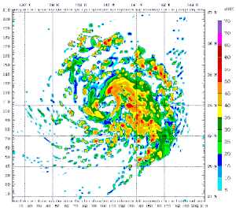
Computer simulations
Repeatable
Cheap
Intelligent
Notes:
Computer simulation is the method that can solve these problems easily. As a new research method, it only needs to use some supercomputer instead of buying some equipment or making some raw materials for the experiment. Of course, the supercomputer is also expensive but still cheaper than the equipment or the raw material. And also, you can run the same simulation many times to get more accurate results. Besides, the simulation can solve so many problems such as hydrate, hydrogen br, and oil recovery, the only thing you need just build a different model and try other potentials, you also can adjust the parameter you used to make your result more accurate. It’s very intelligent.

Slide 5
Computer simulations
Computer simulation in research
Verification of theories
Explaination and prediction the experimental results
Independent exploratory tools
Notes:
Computer simulations is an independent exploratory tool. We can also imagine that simulation is a kind of bridge to link the theory and experiment. Simulation can verification of the theories, and it can be used to explain and predict the experimental results.

Slide 6
Computer simulations
Applications of computer simulations
Notes:
Up to now, computer simulations have already been applied in some fields：formation of galaxy, weather forecast, flight simulation, massive explosion study oil development. It already become one of the most common tool.

Slide 7
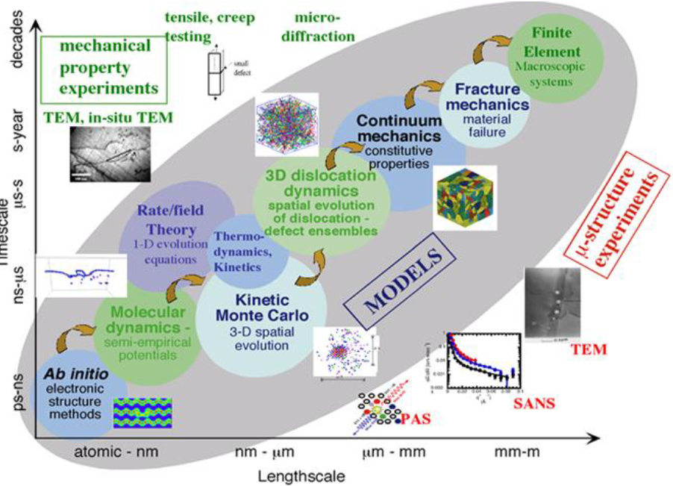
Molecular Dynamics (MD) Simulation
Notes:
Base on the different lengthscale and timescales, the computer simulation could be several different types:

Slide 8
Molecular Dynamics (MD) Simulation
Small system
Small time scale
Classic physics
(Newton’s laws of motion)
Notes:
Today, we focus on molecular dynamics. As the name showed, it is around the level of the molecule. The system for MD simulation is quite small, only around nm-μm level. And the timescale is also around ns-μs level. And MD also follows the law of classic physics (Newton’s laws of motion).

Slide 9
Molecular Dynamics (MD) Simulation
Simulate interactions of particles (atoms, molecules, granules, …)
Predict time evolution of N-body systems
Require parameters of initial atom coordinates, velocities, interaction potentials, ...
Notes:
The purpose of MD is to simulate the interaction of particles (ATOMs, molecules) and also predict time evolution of N-body systems. There are some important parameter we need to input before we run some MD simulations, that includes initial atom coordinates, velocities, and interaction potentials.

Slide 10
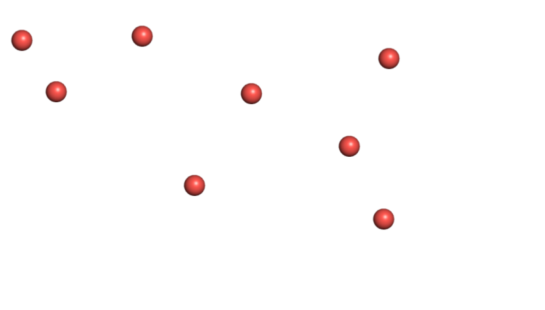
Theories of MD simulations
Goal
V
V

Slide 11
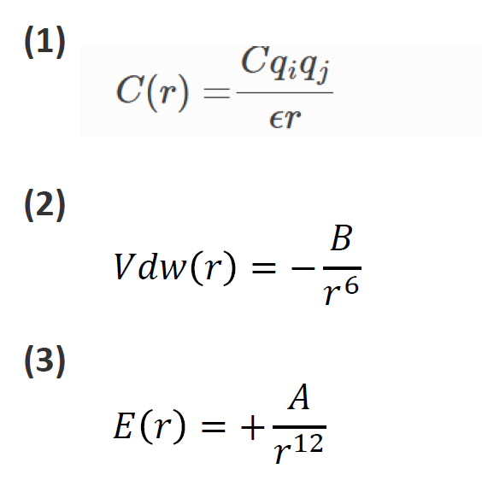
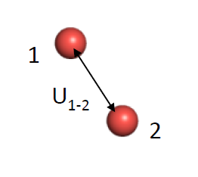
Theories of MD simulations
Inter atomic energy
Notes:
There is another important parameter we should know — inter-atomic energy. The interaction energy is mainly divided into two parts: the first part is coulomb force. In this equation, C is the Coulomb constant, C ≈ 8.988×10⁹ N⋅m²⋅C^{−2.} And qi and qj are the charge of these two atoms. ε₀ is the electric constant. And another part is van der Waals force, which also has two parts, the attractive part, and the repulsive part. A and B are a kind of constant depending on the type of the atoms.

Slide 12
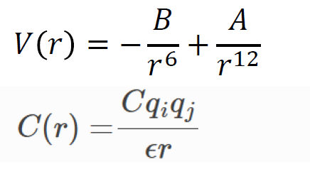
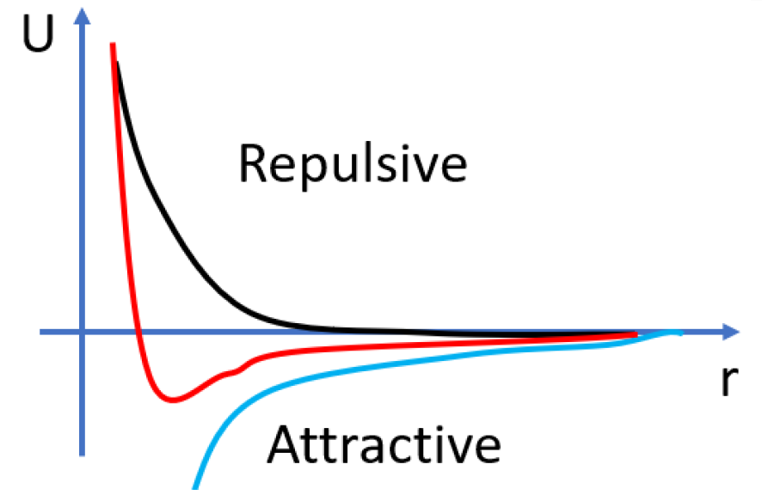
Theories of MD simulations
Inter atomic energy
Notes:
Here is the figure to show the van der Waals force. As the figure shows, the black curve is the repulsive part and the blue curve is the attractive part, and red curve is the finally curve after combine these two parts.

Slide 13
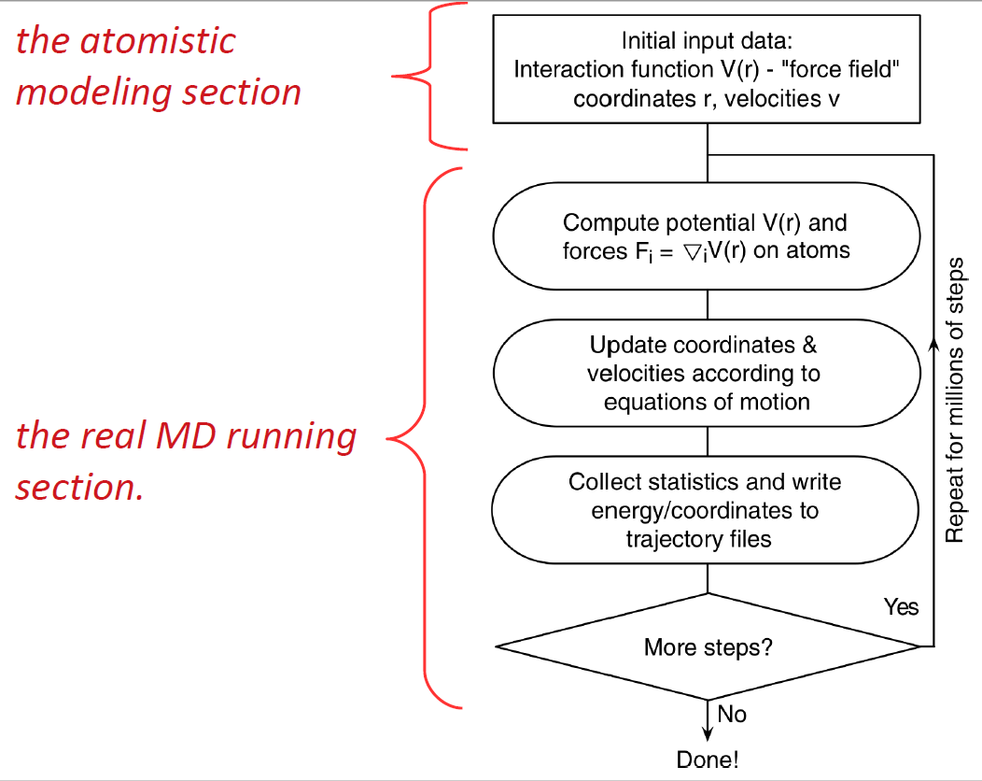
The common procedure of MD simulations
Notes:
Here is the common procedure of MD simulations. As I mention above, MD simulation needs some initial input data: force field, coordinates r, and the velocities. After getting these data, it will move to the running section. Compute the potential and force on atoms and you will get a new C and V and update C and V ac

Slide 14
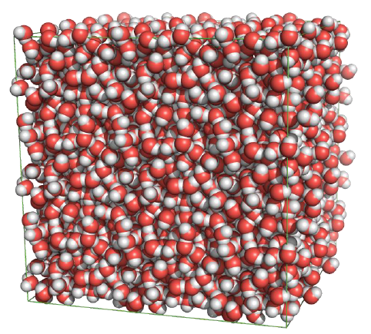
Molecular Dynamics (MD) Simulation
Example
Equilibrating water molecules: MD
Water molecules diffuse at a temperature
of 300K
Notes:
Here I have a simple example to help you understand the simulation process. The purpose of this example is to observe water molecules diffuse at a temperature of 300K. How to build this model?

Slide 15
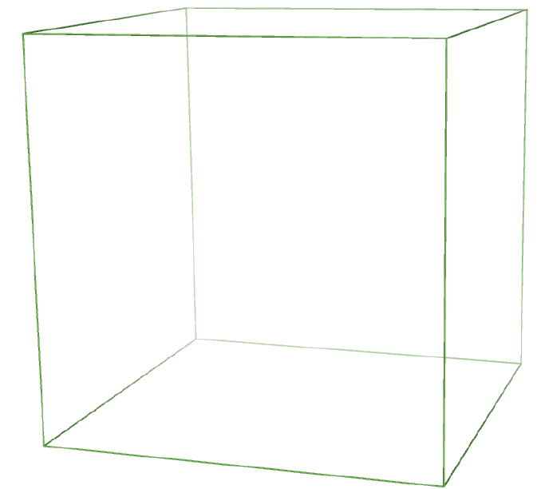
Practice of MD simulations
Building a MD simulation system from scratch
Setting simulation box
Setting up boundary
Notes:
1st, we setting the simulation box and also the boundary.

Slide 16
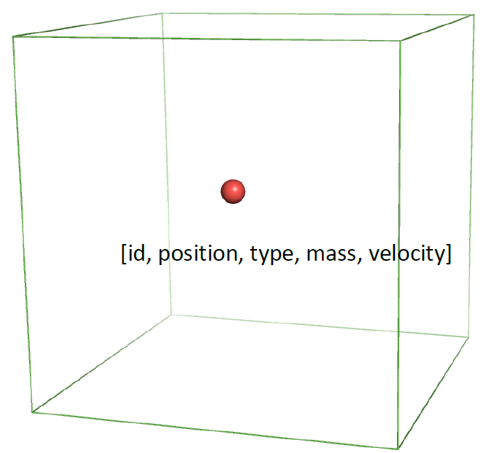
Practice of MD simulations
Building a MD simulation system from scratch
Putting point in the box
Defining properties
Notes:
And then we put the point in the box and we also need to define the properties of this point. (ID, position, type, mass, velocity). These parameters are provided in the input files, rui will more detail about this later

Slide 17
Notes:
And then we just put more points inside the box, and defining more properties.

Slide 18
Notes:
If we just add

